Slide 1
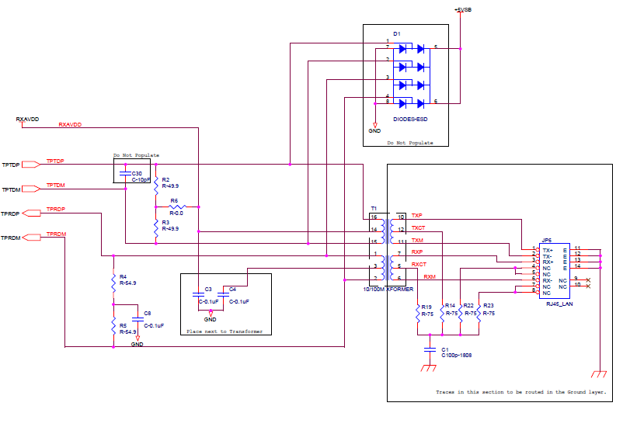
DEMO-board schematic: http://www.ti.com/lit/df/snlr010/snlr010.pdf
Please take a look that receiver side is pull down
(through cap) in DEMO-board.
Do you still need customer’s own schematic? ( Customer do not want to open in e2e if available )
Please mind that the drawing (Before/After) page 2 of this ppt
file is which customer had sent to me.
Transmitter side:
Pull Up
TPTDP/TPTDM:
Transmitter
TPRDP/TPRDM:
Receiver
Receiver side:
Pull down( through cap)

Slide 2
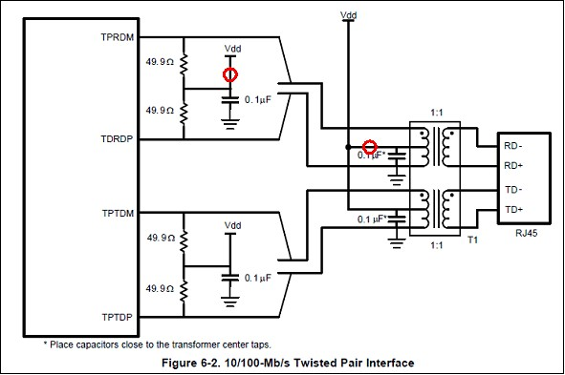
CAT5 cable
Before: following Data sheet Fig2 : Bit Error rate 10^-6 for 100m cable (1)
After : remove red circle as DEMO-board(2) case : No error
(1)In case ~10m , no problem even ‘ Before’ case
(2)http://www.ti.com/lit/df/snlr010/snlr010.pdf

Slide 3
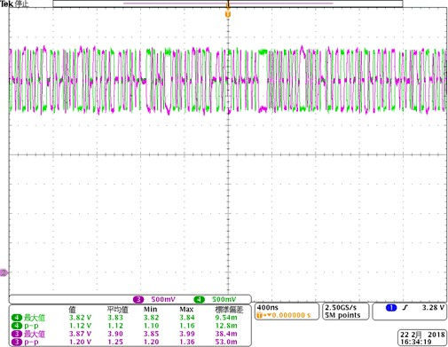
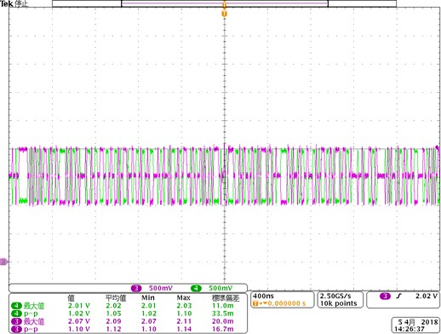
Before
Vcm=3.3V
After
Vcm is ~ 1.5V
As per customer, even tough ‘Before’ case, Peak to peak differential voltage , and its slew rate should
be same , no deformation even though ‘ Before ‘ case.
Question : Data sheet Fig6-2 is correct? Or DEMO-board(snlr010.odf is correct?)
Customer think DP83816 has equalizer inside, so customer think it should be work with no-error
even though ‘ Before’ case, but please advise customer’s corrective action is correctly or no.
( Customer don’t know internal bias of receiver circuit at TPRDP/DM, but he should follow data sheet
as ‘Before’ case??)

