Slide 1
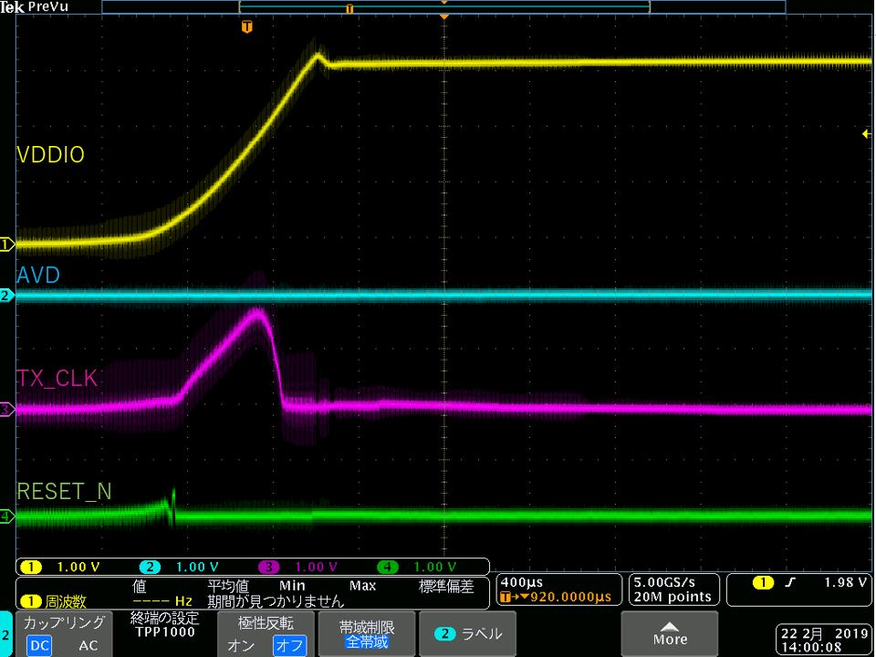
Pin voltage at power on
What is this behavior?
Is this operation normal?
The terminal as CRS, RX_ER, COL, RX_DV, RX_CLK and RX_D[0:3] is also rise up with VDDIO.

