Slide 1
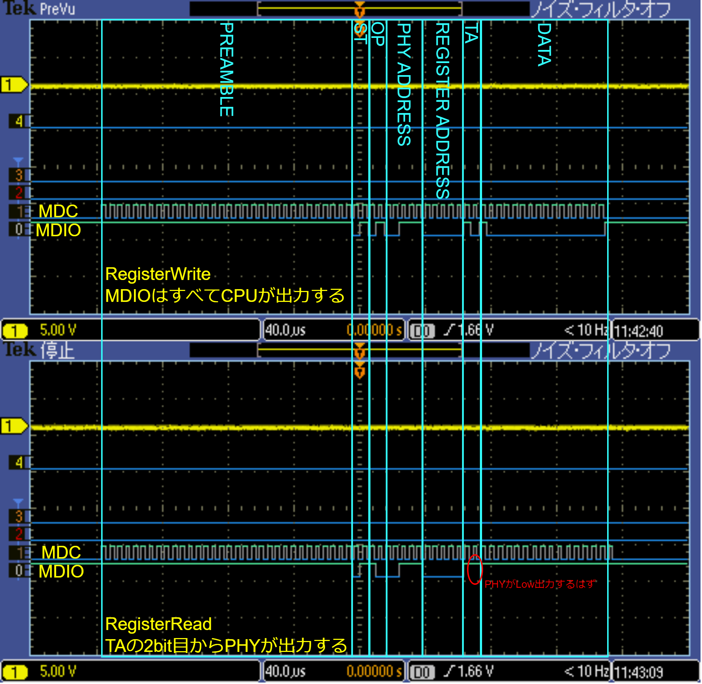
Register Write outputs all MDOIs.
The PHY should output Low on Register Read, but it remains High.

Slide 2
