Slide 1
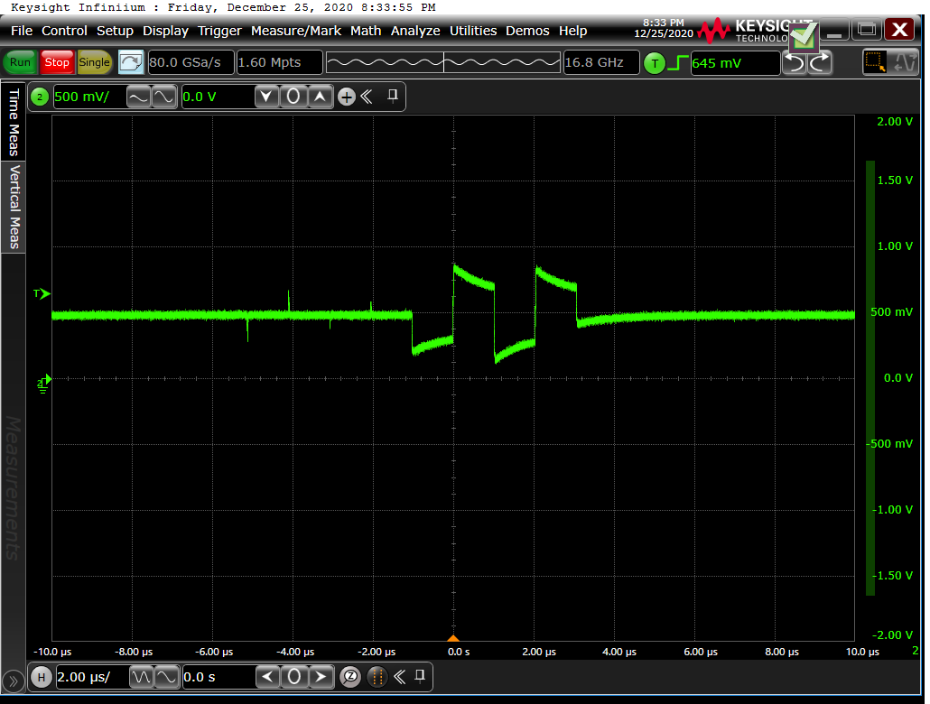
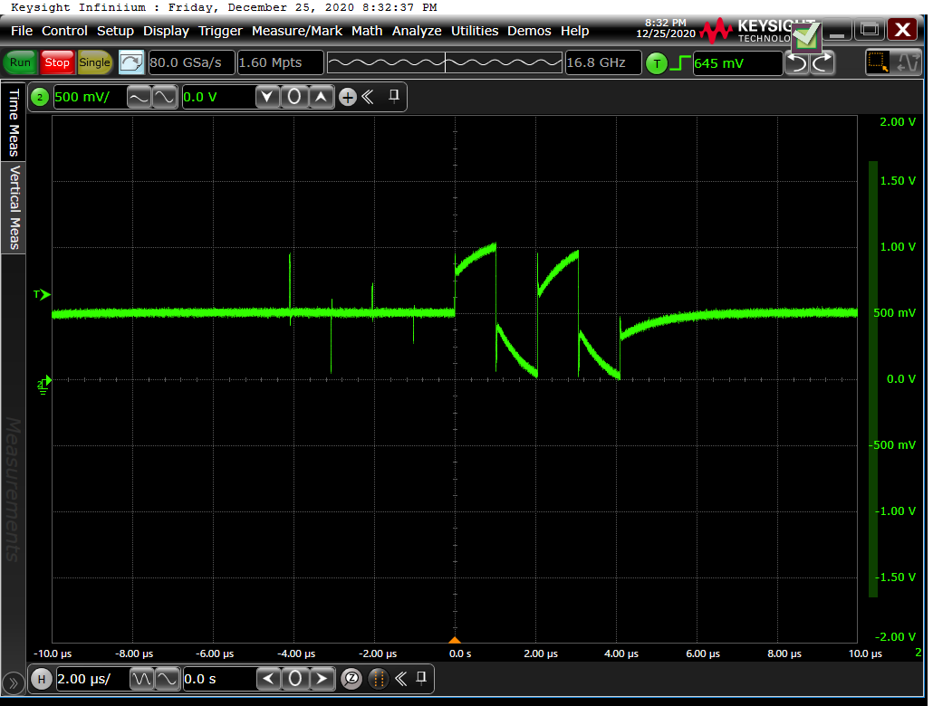
TD_X_B waveform
TD_M_B
TD_P_B

Slide 2
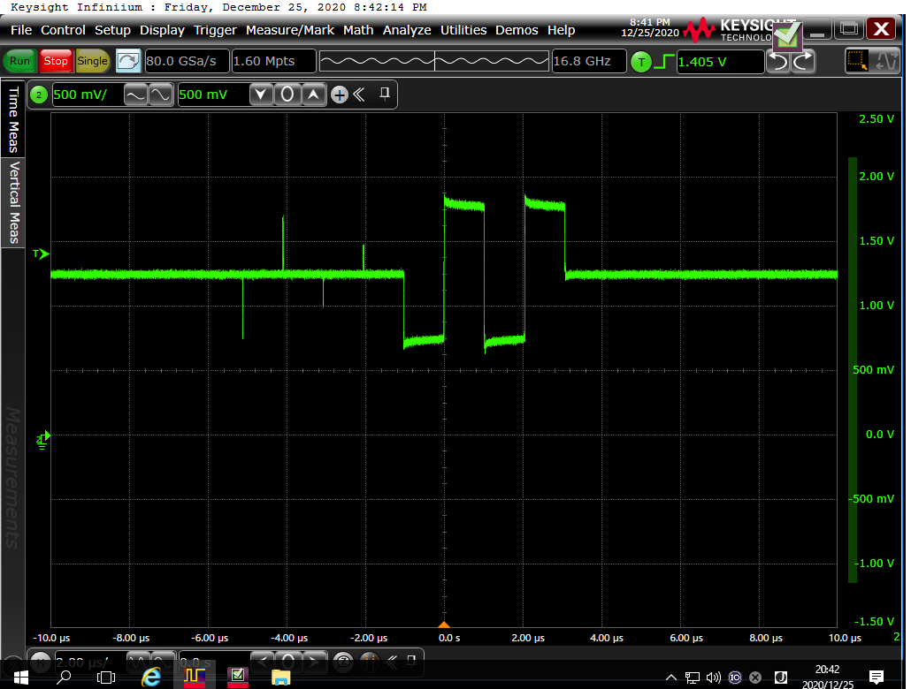
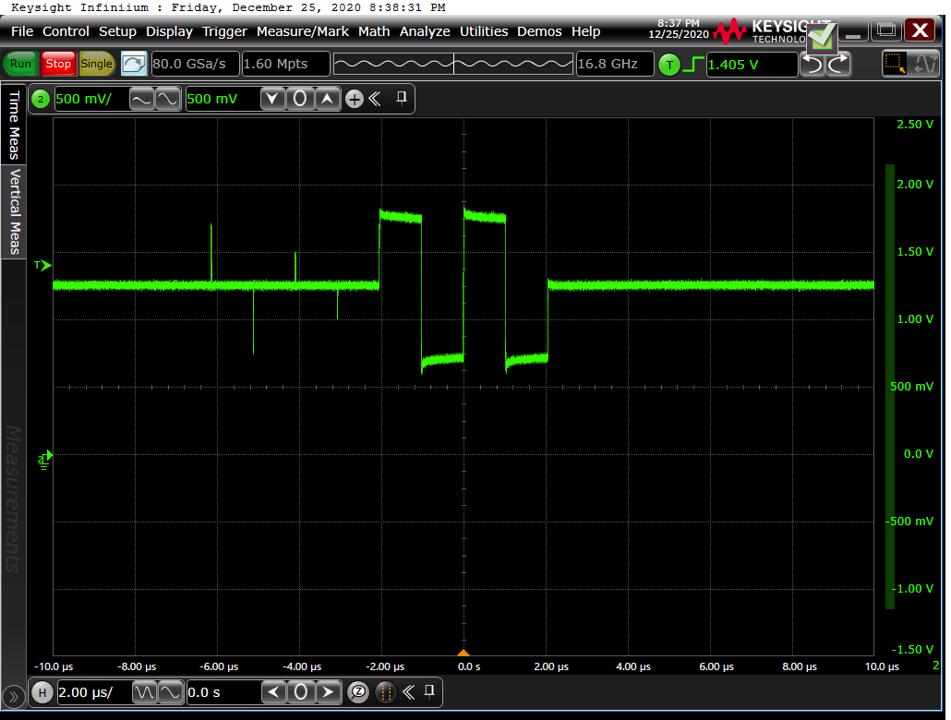
TD_X_D waveform
TD_M_D
TD_P_D

Slide 3
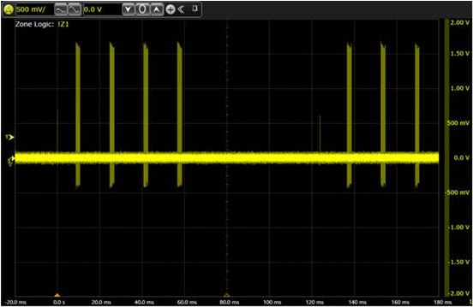
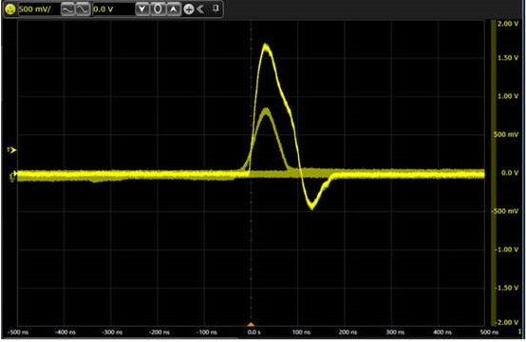
Link pulse: no link partner
Zoom
Normal link pulse
lower link pulse
Overlapped

