Slide 1
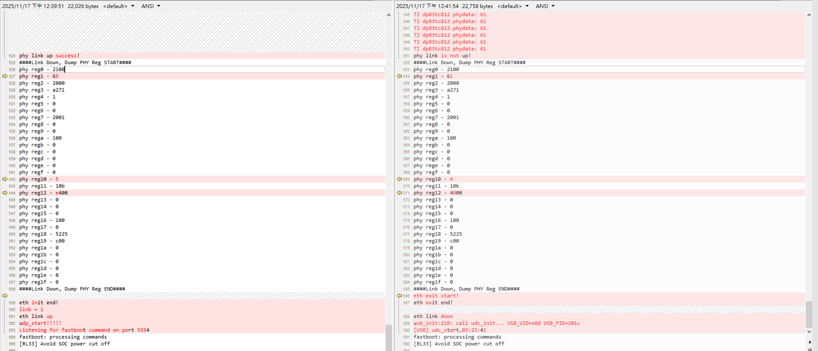
Dump DP83TC812R register
Link Successfully
Link Failed

