Slide 1
Schematic & Layout review DS90UB935
FPD-Link Applications Team

Slide 2
Schematic comments
Don’t have component values from schematic so it’s not possible to complete a full schematic review.
Some pins such as pin 25 can be seen with missing decoupling capacitors (VDDD) and VDDPLL_CAP
IDX pin & mode pin VDD reference:
  Reference to the post-ferrite bead VDD18 (device side)

Slide 3
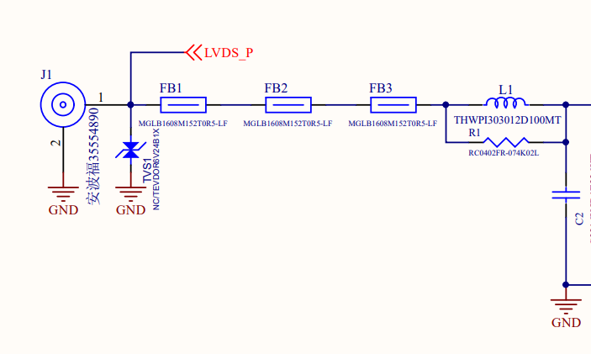
PoC network development
PoC network doesn’t appear to follow parts selected in the datasheet, please make sure to stay in compliance with channel specification

Slide 4
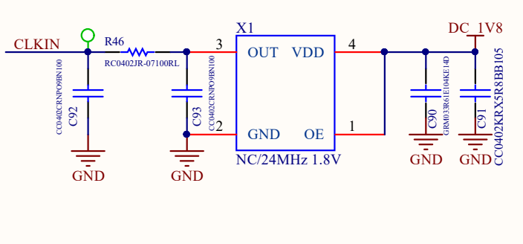
CLKIN oscillator selection
Although sync mode is listed a 24MHz oscillator is included which isn’t supported here.

Slide 5
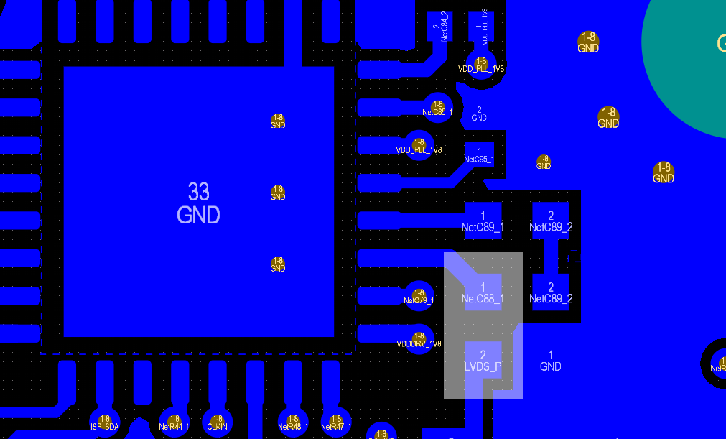
DOUT+ Trace
Recommended to make curves in the DOUT+ trace rather than 45 degree bends such as are seen here
Only if space

Slide 6
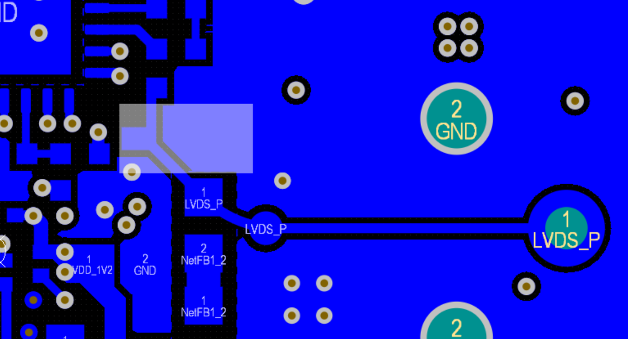
ESD diode placement
Placing the ESD diode closer to connector allows for PoC circuit to be protected as well as creating more room for curved DOUT+ trace

Slide 7
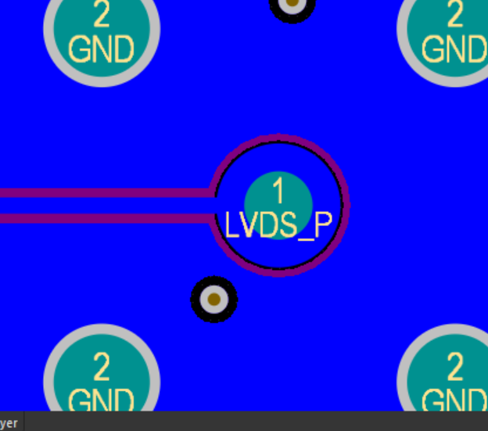
Connector spacing
Add more space between DOUT and GND (2-3x trace width)
  On all layers not just layer 8 where FPD is routed
Add shielding VIAs surrounding DOUT+ trace
  GND VIAs will help protect the DOUT+ trace from noise

Slide 8
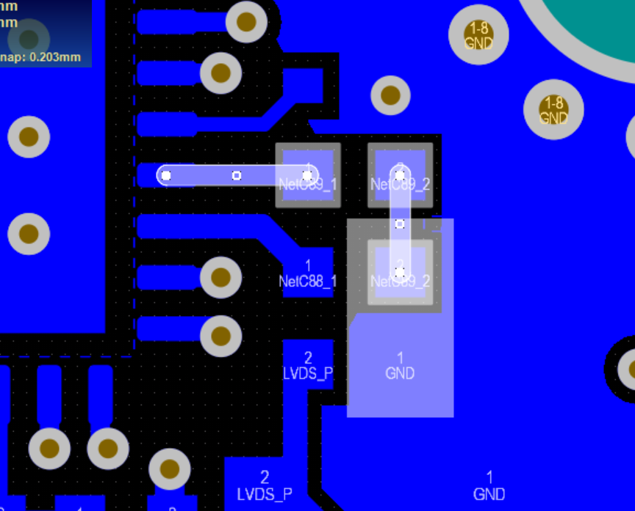
DOUT- impedance
Update DOUT- trace to be 50 ohm single ended

Slide 9
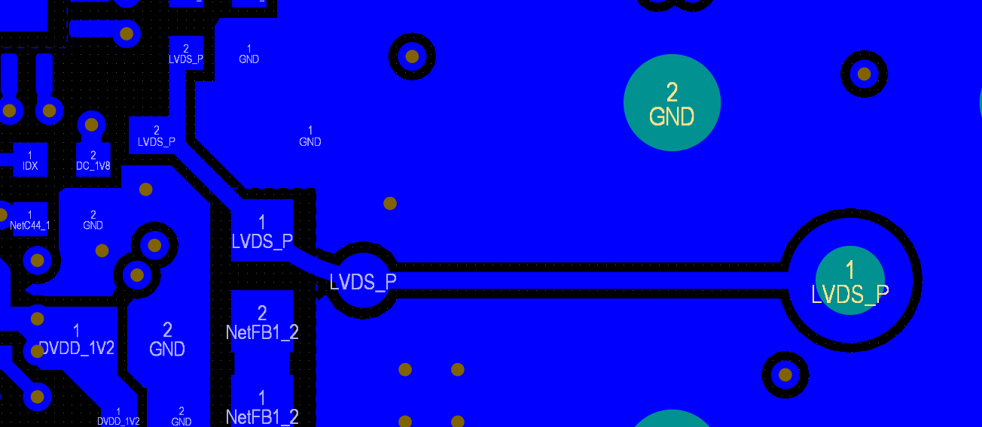
DOUT+ impedance
Test point directly on DOUT+ trace is discouraged as this results in an impedance discontinuity. Trace should be 50 ohm single ended
First ferrite bead should be close in size to the trace, layout like this will result in another impedance discontinuity.

Slide 10
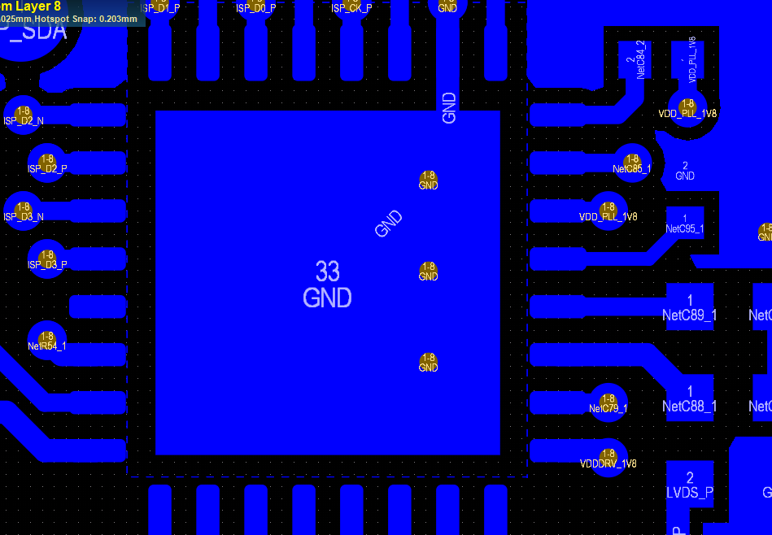
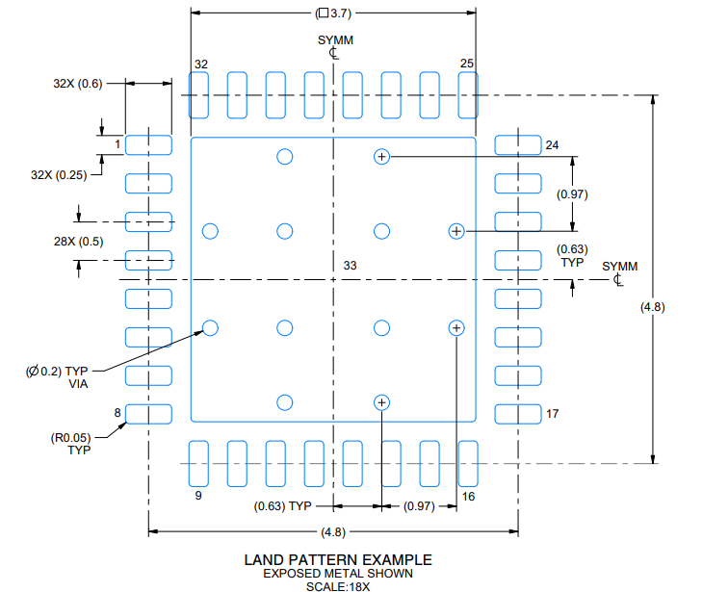
DAP GND VIAs
We only have 3 GND VIAs on the DAP which can be seen to the right, please see mechanical guidelines in the datasheet where we have 10 GND VIAs

Slide 11
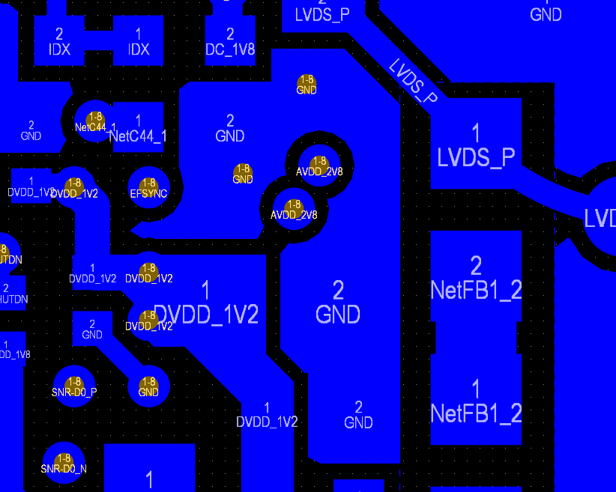
Add more GND VIAs to large isolated areas
GND islands which are not connected to other GND layers with VIAs are not recommended

Slide 12
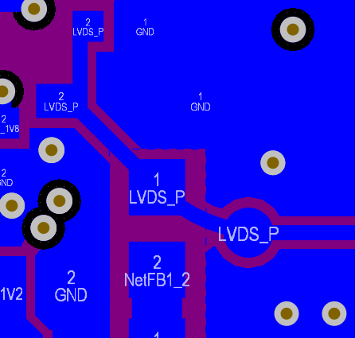
Anti-Pads below high speed traces
Add anti-pads in the GND planes below the component pads of high speed traces to minimize impedance discontinuity (update L7 in purple below)

Slide 13
Add “tear drop” to connector
Addition of a tear drop connecting the DOUT+ signal to the connector can be helpful to reduce impedance discontinuity

Slide 14
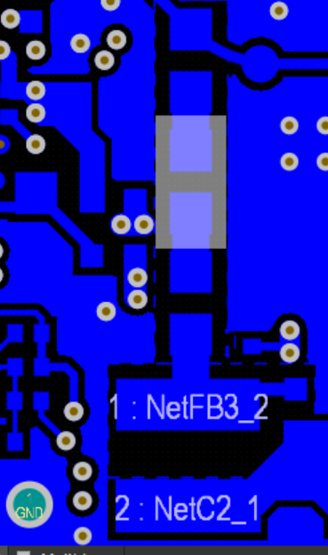
PoC network impedance
Confirm that impedance of PoC network is 50 ohm as to not create any impedance discontinuity on the high speed trace carrying DOUT+

Slide 15
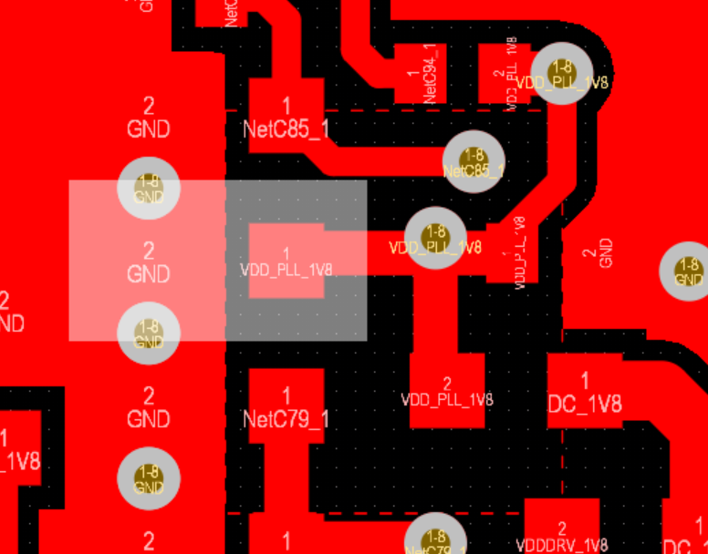
Decoupling Capacitors
Current should flow over the pads of capacitors on the way from power plane to power pin on the serializer

Slide 16
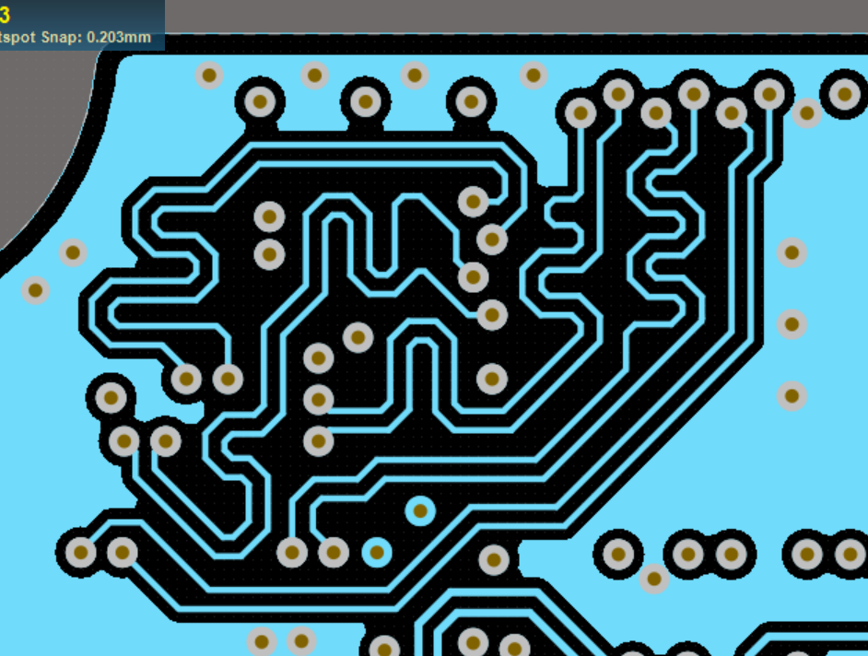
CSI-2 DPHY trace length matching
Length of all differential pairs should be within 5 mil of each other, please confirm if this was correctly done (cannot check on provided layout)
Confirm that routing is 100 ohm differential impedance, some spots where traces come apart likely are not 100 ohm
Add space between CSI signals & GND

