Slide 1
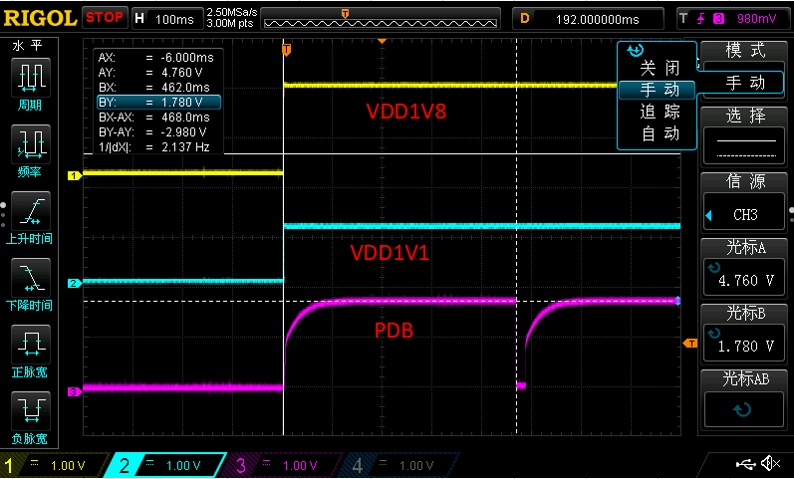
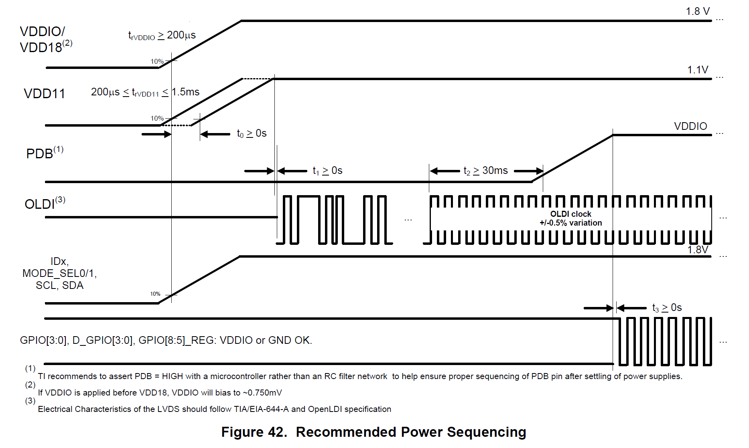
Why is your PDB getting pulled low after it’s enabled?
Can you zoom into the VDD18, VDD11 and PDB so we can see the timing and sequence?
Need to ensure PDB goes high after all the supply pins have settled to the recommended operating voltage
Zoomed in
1- Can you zoom in here?
2- What is happening here?
PDB negative pulse width required for the device reset should be minimum 2 ms

Slide 2
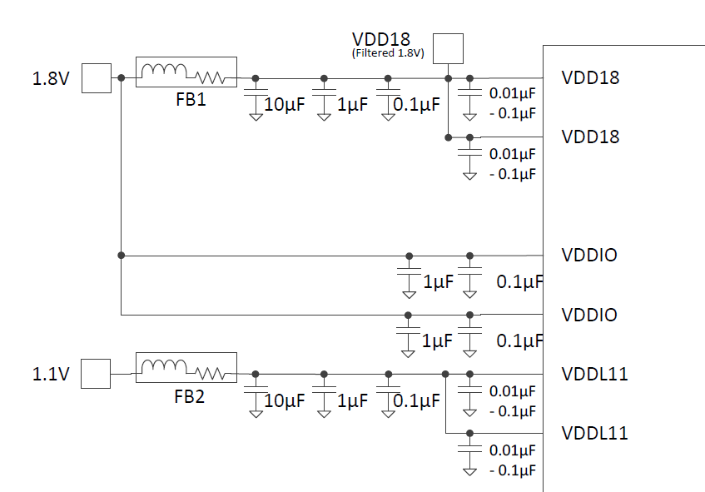
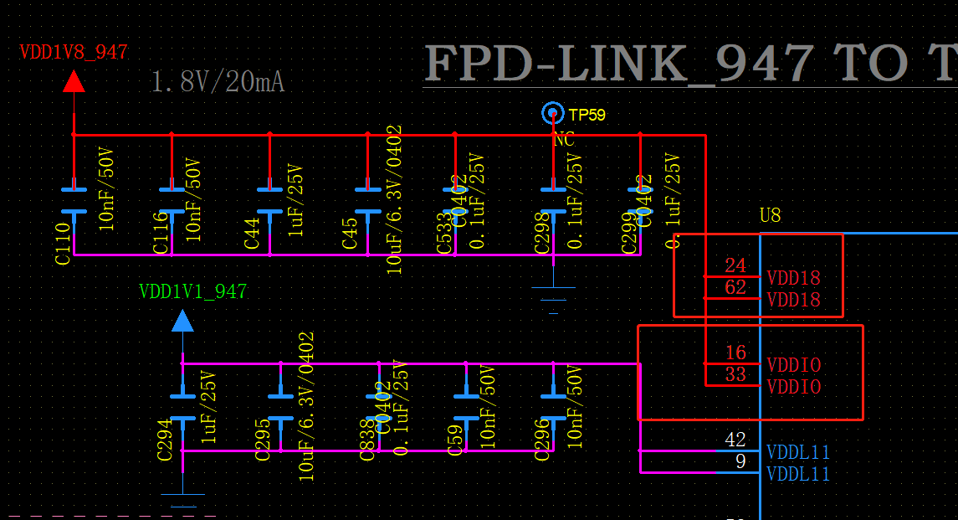








Each VDD pin needs its own separate Capacitor see yellow highlight below
Once you add a separate capacitor to each pin you can add a grouped capacitor – see blue highlight below
Where is your FB (Ferrite Bead) ? See Orange below
  FB needs to be connected to VDD18 and VDDL11
Each VDDIO pin connects to a 0.1 uf CAP and 1 uF CAP and then connects directly to 1.8V supply without FB

Slide 3
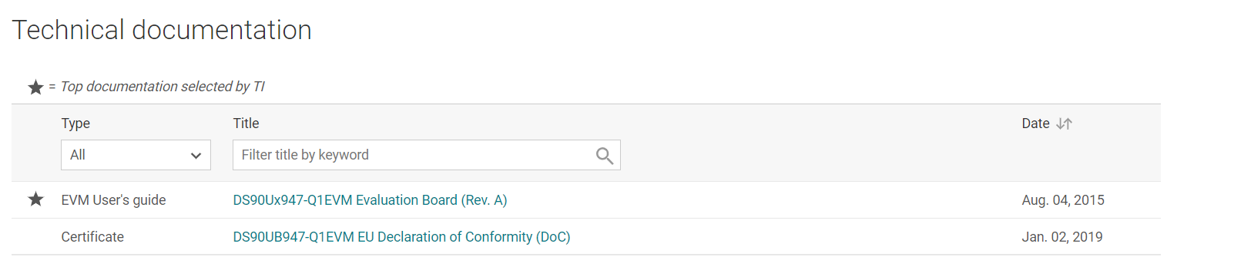
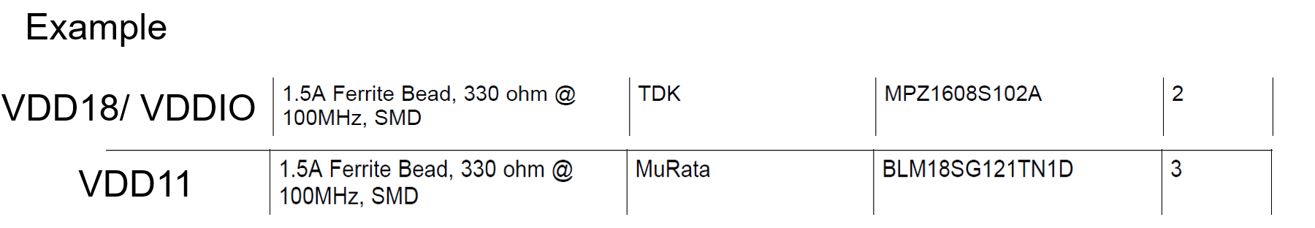
Ferrite Bead:
Please refer to EVM for FB and CAP recommendations:
https://www.ti.com/tool/DS90UB947-Q1EVM?keyMatch=&tisearch=search-everything&usecase=partmatches
https://www.ti.com/tool/DS90UB948-Q1EVM?keyMatch=&tisearch=search-everything&usecase=partmatches
Download user guide to see schematic

Slide 4
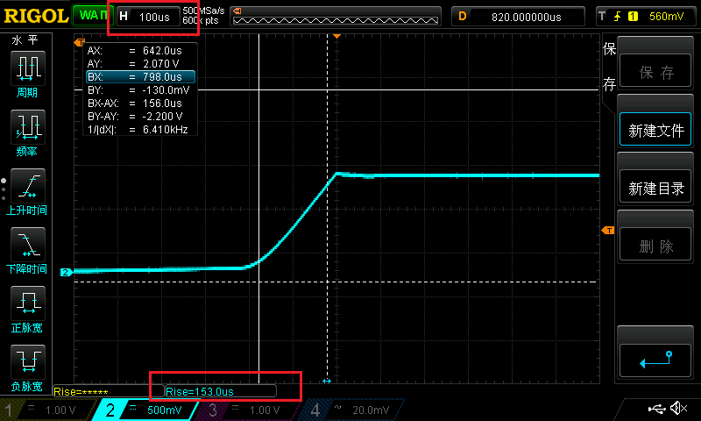
VDD11 rise time is almost 153us (this isn’t meeting datasheet spec)
Datasheet spec is minimum 200 us and max 1.5 ms

Slide 5
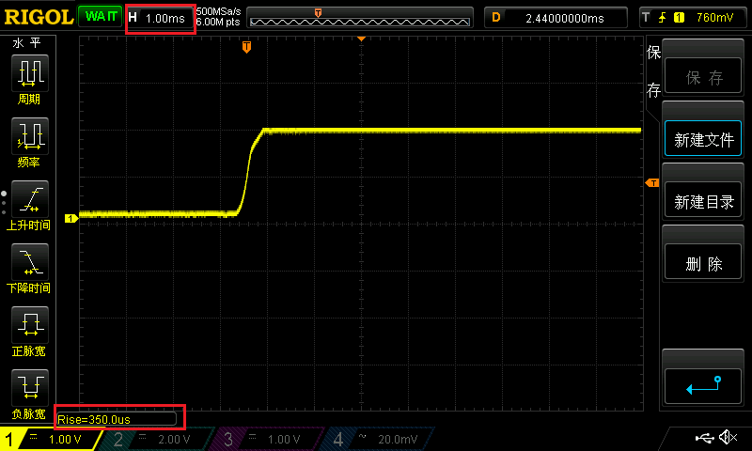
This is the VDD18(VDDIO), the rise time is almost 350us (this is ok)
Datasheet spec is greater or equal to 200 us

Slide 6
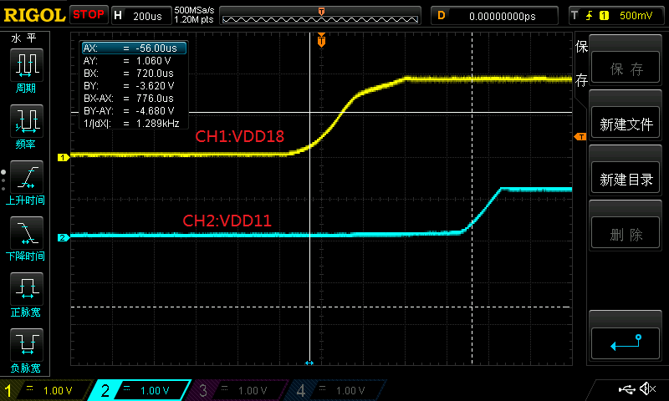
Datasheet spec is t0 > 0s so this should be ok

Slide 7
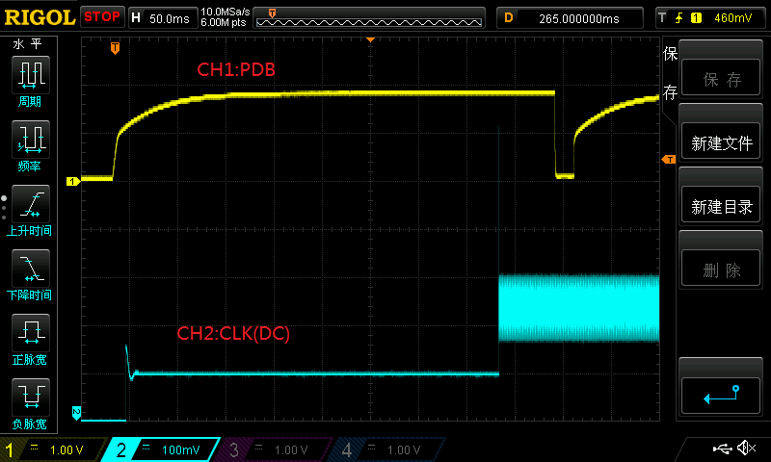
What is CLK DC ?
OLDI CLK needs to be active after all VDDs are stable and 30 ms before PDB is pulled high
Do you have a scope capture that shows t1, t2 and t3?

Slide 8
Back Channel CRC Errors
This can be caused by: Signal integrity issue with new layout, connector, power-supply noise, poor capacitor filter network, cable length, cable type, quality of cable, etc.
Recommendations for troubleshooting:
  On the 947 did you measure the VDD11, VDD18, and VDDIO are within min/max specs? Are there any overshoot/undershoot?
  On the 948 did you measure the VDD12, VDD33, and VDDIO are within min/max specs? Are there any overshoot/undershoot?
  Did you verify LOCK on the 948 is HIGH with an oscilloscope?
  What 947 OLDI PCLK frequency are you using?
  Is the 948 using the default back channel rate (5 Mbps) or is it at maximum (20 Mbps)?
  Is the 947 in single OLDI input or dual? Are you forcing this mode or auto detecting?
  Is the 947 in single FPD3 ouput or dual? Are you forcing this mode or auto detecting?
  Is the 948 in single OLDI ouput or dual? Are you forcing this mode or auto detecting?
  Do you have a PoC network on the channels ?
  Have you tried different cable length and different cable types?
  Confirm correct coax/STP mode strapped on both sides Ser/Des
  Confirm AC coupling caps for the cable mode selected in this application?

Slide 9
Recommendations:
Please make sure these CRC errors are not happening during power-up.
To do this you need to clear CRC register counters by writing 1 to 0x04[5] and then write 0.
After clearing the counters, you need to wait for some time and read reg 0x0C, 0x0A and 0x0B again and see if you still see new CRC errors.
In general, having CRC errors is not recommended since it can cause failing I2C communication or and BCC communications.
Debug Recommendations:
You can Run Map tool to check link integrity on ALP software
Can Also run BIST testing:
Before normal operation you can run the BIST test for few minutes/hours. At the end you can see if the link quality is good enough showing no errors (for more details see the datasheet)
During normal operation you can monitor the error registers mentioned above. For more details check the UH948 or UH947 datasheet section "7.3.15.2".
Also you can monitor the PASS pin as error indicator.

Slide 10
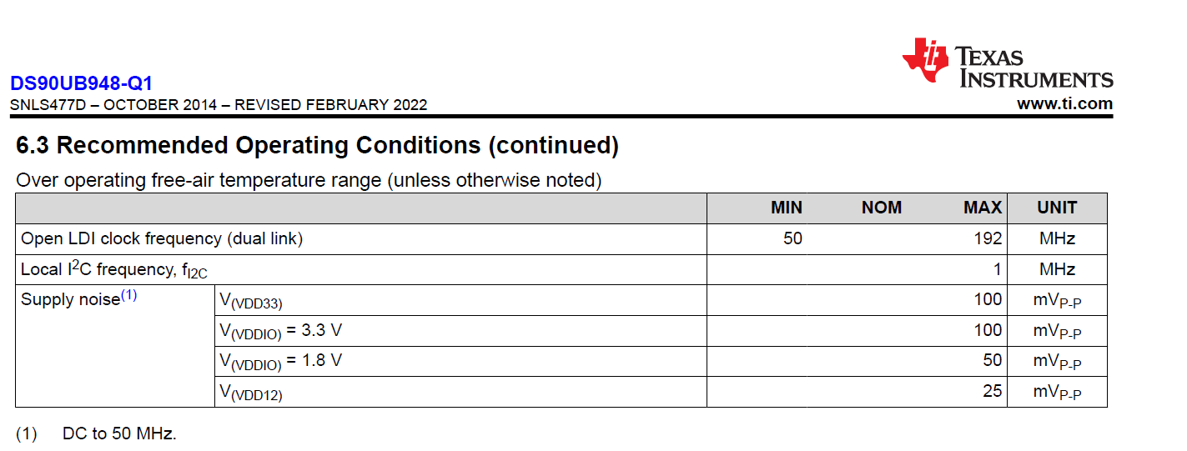
Power-Supply Noise:
You can measure noise at the power-supply pins this is for 948
Typical recommendation for 94x serializers is typically 25 mVp-p

