Slide 1
DS90UB960 Layout review

Slide 2
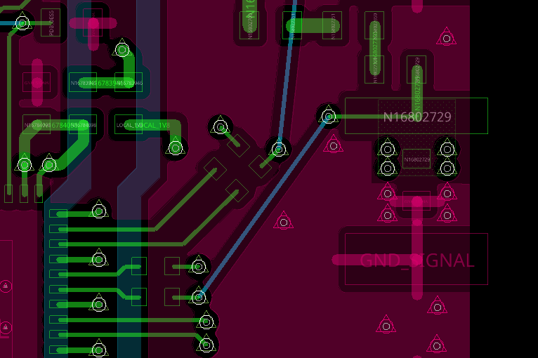
Connector Layout
Consult connector vendor for optimal connector footprint. This is critical in ensuring good signal integrity.
Since the connector’s middle pin footprint is very large, it is recommended to increase spacing to GND area. Also make sure to add anti-pad (keep-out area) underneath the Pad for impedance matching and reducing parasitic components.

Slide 3
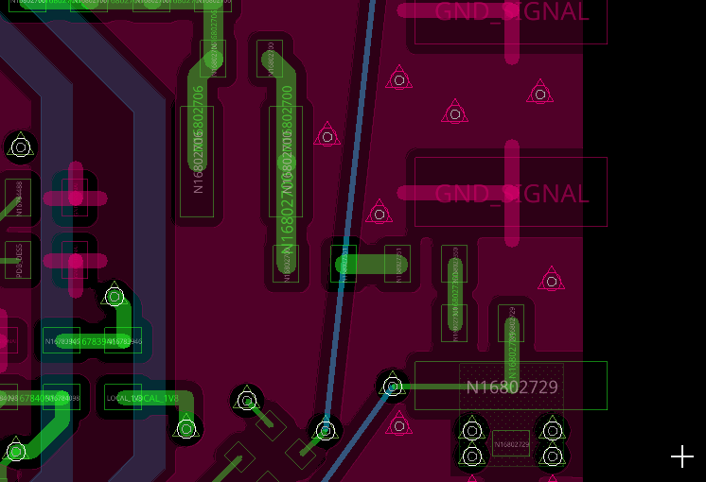
PoC Layout
Remove GND are in between FB pads and Inductor pads.
Avoid Stubs on the High-Speed traces.
It is suggested to move the first FB and place it directly on the HS trace to minimize the Stub.

Slide 4
PoC Layout
Consider adding more ground Vias around HS traces and PoC traces.
Avoid creating sharp angles within the HS signal path, which includes the PoC Filter!
All components on the PoC must be located very close to each other, connected using short traces that have 50-ohm impedance.

Slide 5
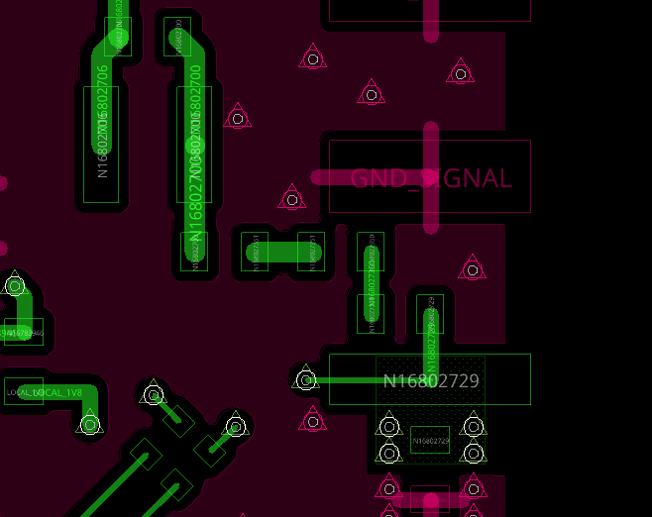
PoC Anti-Pads
Consider adding Anti-pads in the next GND layer for all FB and Inductors in the PoC Filter.

Slide 6
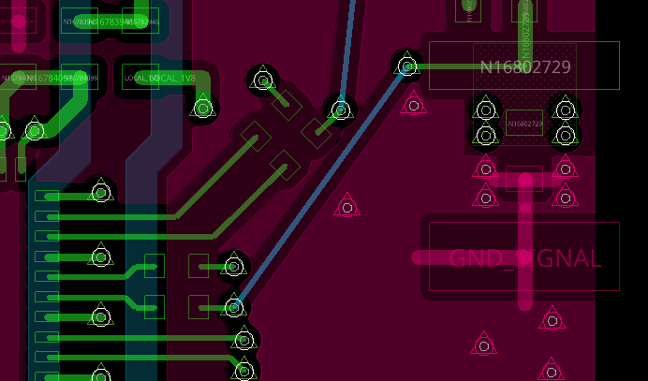
High-Speed Traces
Make sure HS traces have 50 ohm impedance from connector until RIN+/- pins.
Make sure to add anti-pads underneath the AC coupling caps for impedance matching.

