Slide 1
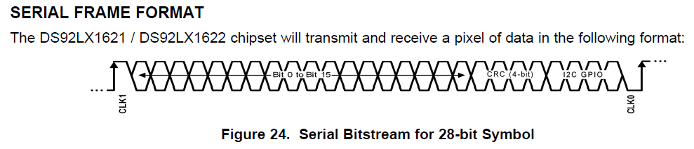
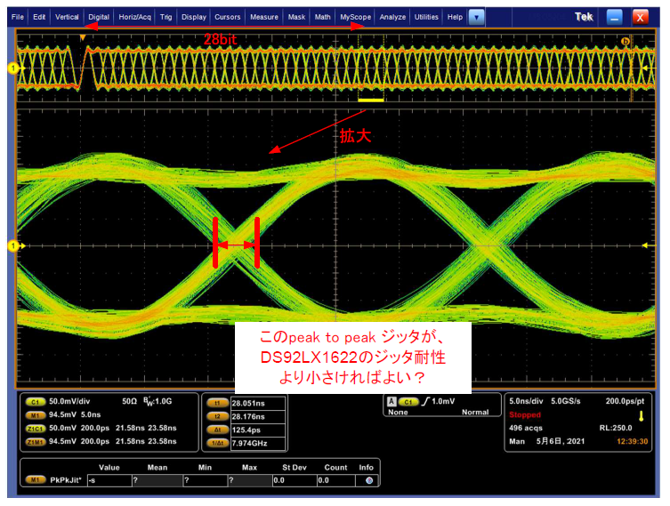
I want to verify that the input signal jitter on the DS92LX1622 is within the acceptable range (tRJIT: 0.53UI).
The input signal is triggered at point of the rising edge at CLK1, the peak to peak jitter is measured from trigger point to a point after 28 bits.
See attached diagram for details
I guess the above measurement points will be considered reasonable, because SerDes is one frame at 28 bits and the CDR plays the clock with an end of clock every 28 bits.
Is this idea correct?
Is it necessary that this jitter will be less than tRJIT?

