Slide 1
TPS2549 / TUSB211
Daesung Eltec

Slide 2
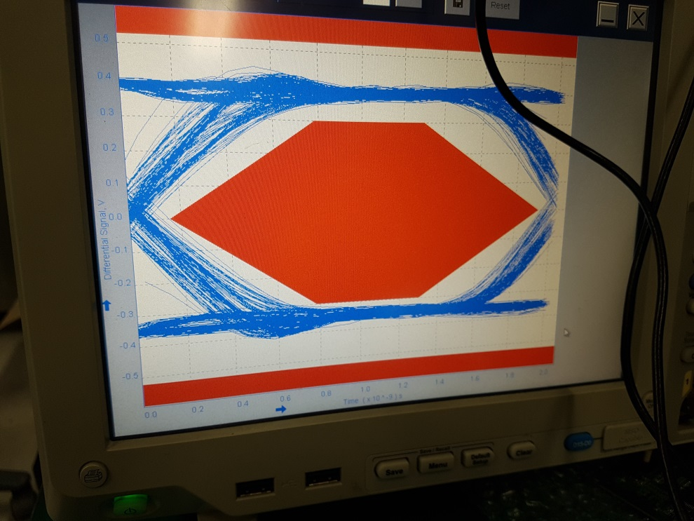
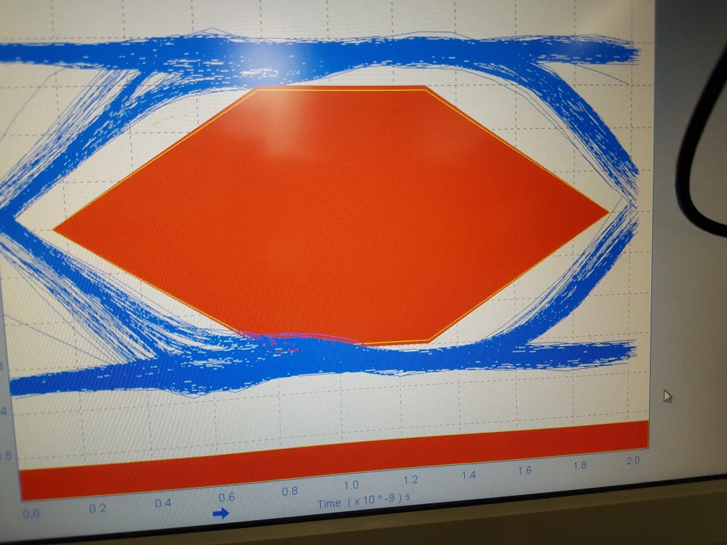
Eye-Diagram
w/o TPS2549-Q1
w/ TPS2549-Q1

Slide 3
Schematic

Slide 4
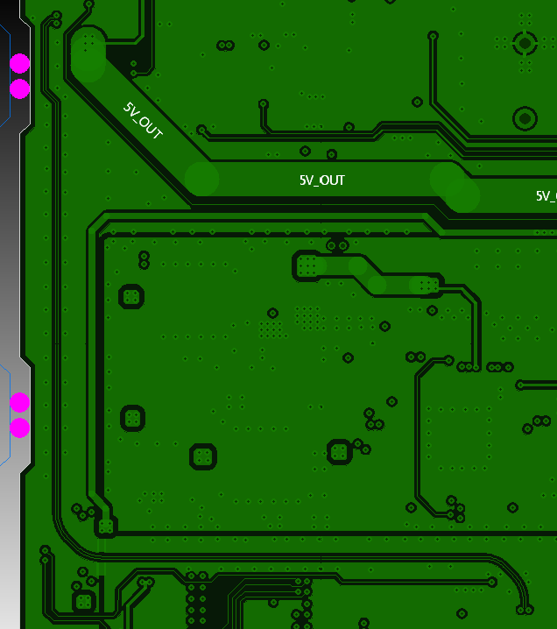
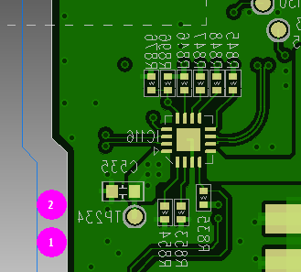
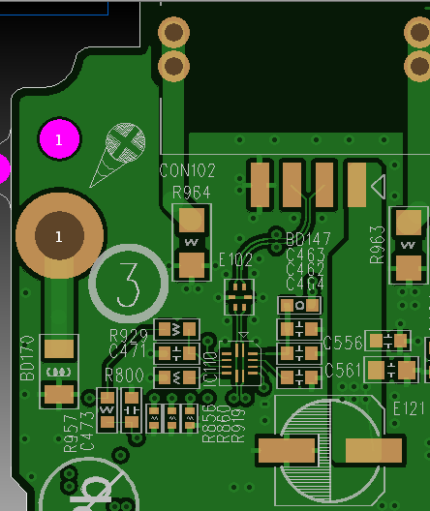
Layout – 4 layer PCB
Layer_2 DP/DM Trace
Layer_4 TPS2549-Q1
Layer_1 TUSB211

