Slide 1
EMC for FPD-Link III/IV
Mike Leister
Dec 14, 2018

Slide 2
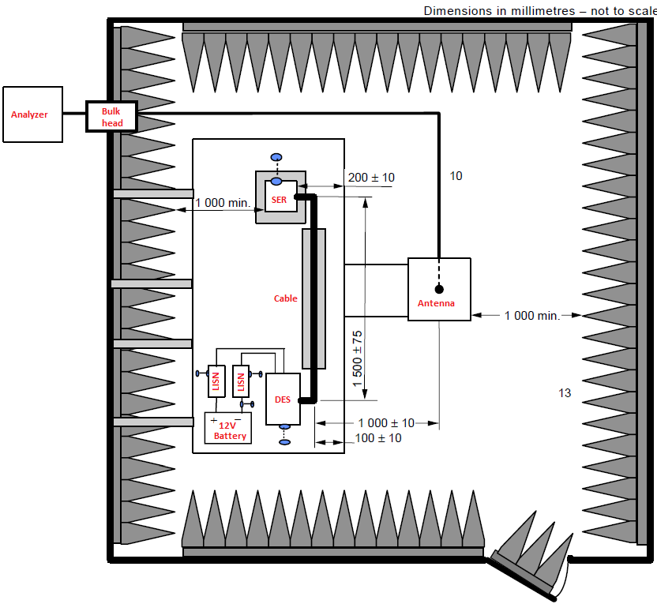
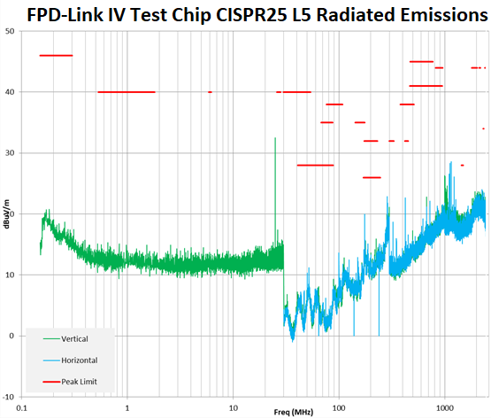
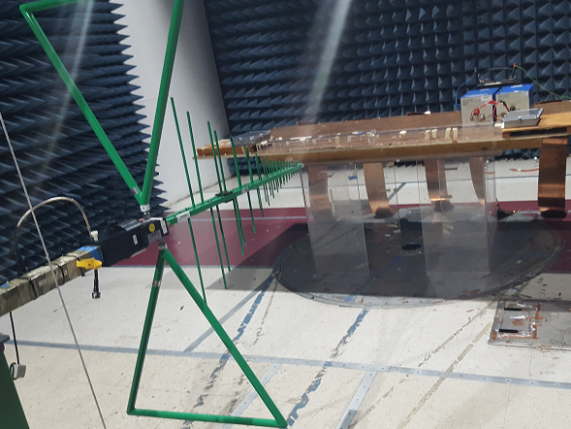
Radiated Emissions
CISPR25 L5: TI test focus
RE-310 (Ford)
IEC-60001
ISO-11452-2
3800808 (Renault)
Others
Notes:
Limits – AM/FM broadcast & GPS
3 or 4 antennas
Layout
Specifications

Slide 3
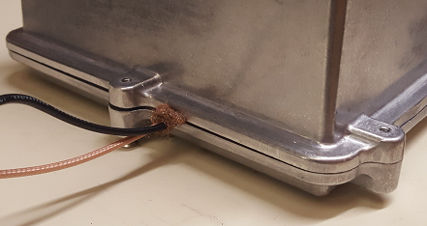
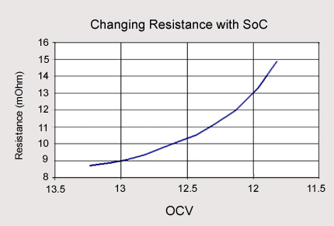
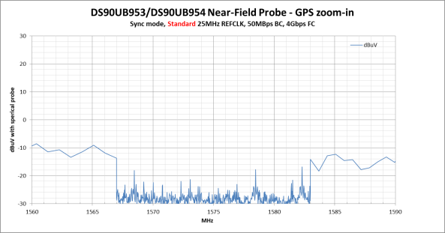
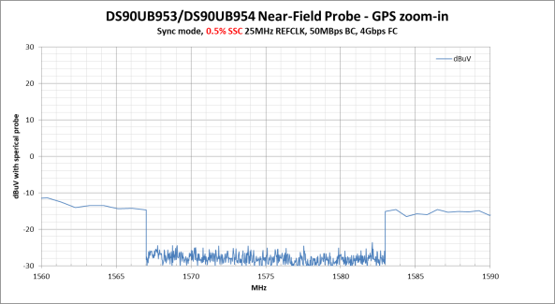
EVM Radiated Emissions Debug
Test Preparation
Pre-test with near field probes before going to the test chamber. Details on the next slide.
Use a new cable. Many major manufacturers discard FAKRA/STQ cables after 20 insertions. Tape the cable down, lower cables radiate less.
Smaller shield boxes perform better. Use the smallest possible. Make entry holes as small and low as possible. Have the power and link cable enter together. Copper wool seals small holes 2dB better than copper tape in a recent experiment (don’t have large holes).
If testing with a TI EVM, shut down USB2ANY after programming registers.
Board design & modifications
Avoid length mismatch and impedance discontinuities on PCB signals. Fix length matching prior to long straight runs.
Disable the EVM 12V to 5V buck regulator and replace with off-board LDO with a large heat sink.
Upcoming EVMs have EMC-friendly buck regulators
If a switching regulator must be used, select an EMC-optimized one and add a snubber to the switch node
Terminate differential deserializer outputs with 100 ohms (for EVM testing; customer systems should be terminated at the sink)
Cable and DC power connectors located next to each other has been observed to provide better emissions performance.
Anti-pad under inductors and larger capacitors to reduce coupling
Low inductance connection from board ground to shield box
At the test facility
Always run an ambient sweep. I once had a DeWalt battery powered drill hidden in a cardboard box cause a failure at 50MHz.
Make sure the 12V battery is charged. Measure it yourself. Make the final power connection yourself.
Mitigation & Debug steps
Small value resistor in series with REFCLK slows the edge and reduces coupling and radiation.
Temporarily turn off back channel to see if that is a major contributor
Spread-spectrum clocks for deserializer REFCLK knock peaks down 6dB to 9dB

Slide 4
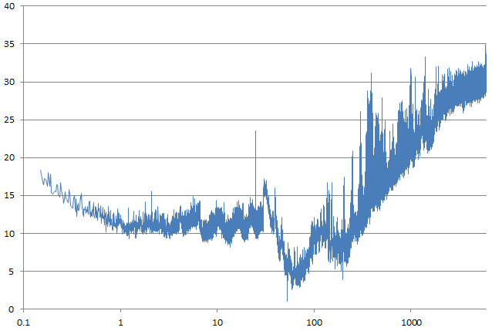
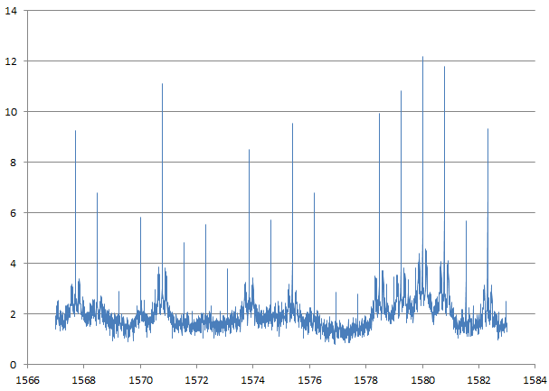
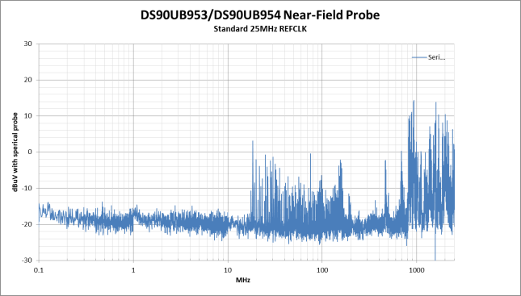
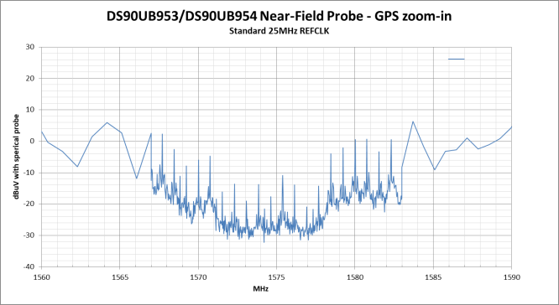
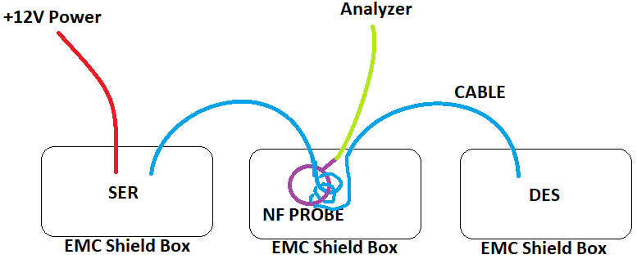
Optimize Emissions Before Chamber Testing
Full CISPR25 GPS Zoom-in
DS90UB953/954
Standard REFCLK
EMC Chamber
Standard REFCLK
DS90UB953/954
Standard REFCLK
Link margin testing shows that up to 0.5% spreading SSC can be supported
EMC Chamber testing shows 6dB to 9dB improvement in most cases. For signals that do not respond to SSC, check an ambient sweep to ensure external emitters are not present.
Near-Field Probe
Standard REFCLK
Notes:
Chamber time is expensive
Near-field probing correlates reasonably well
Chamber vs shield box noise floor differences
NF probe setup

Slide 5
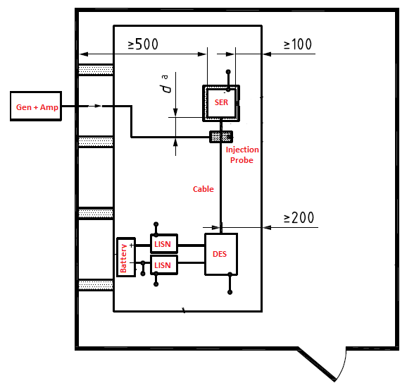
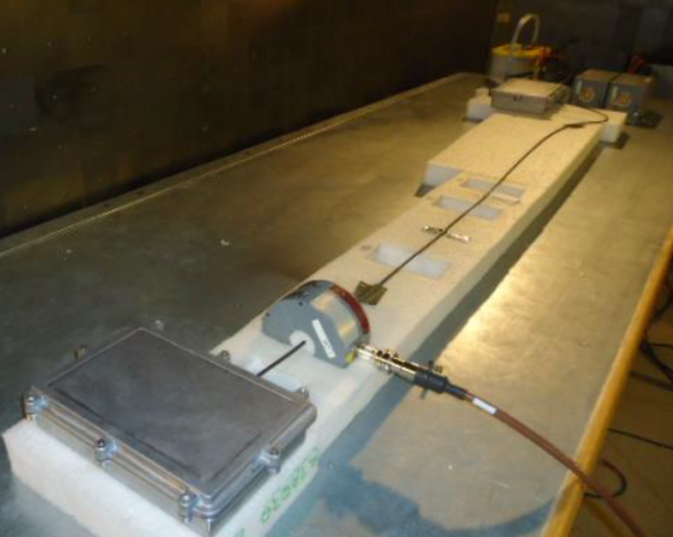
Radiated Immunity
ISO-11452-4 (BCI): TI test focus
RI-113/114/115 Radiated, reverb chamber (Ford)
BCI
Inject 200mA
Sweep from 1MHz to 400MHz
Repeat for CW and AM signals
Monitor lock change count
Repeat for various distances from the SER.
Notes:
Test Setup
Test sequence

Slide 6
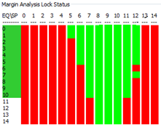
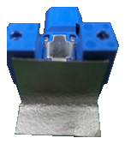
Radiated Immunity Debug
Optimize AEQ/sFILTER
Use the ALP Margin Analysis tool to determine acceptable AEQ settings. Set AEQ/sFILTER min/max limits to allow only setting near the center of the “eye”.
Use the AEQ settings to increase the LOCK tolerance to errors (95x example).
Allow lock to establish with default AEQ settings
After Lock, Set 0xB9 to 0x3F. This increases the number of errors required for LOCK to drop. If this does not work, try the next three steps, one at a time.
Set 0x42(4) to 0x0. This stops parity errors from causing LOCK drop and is in line with how later parts operate.
Set 0x42(5) to 0x0. This stops packet encoding errors from causing LOCK drop.
Set 0x42(6) to 0x0. This stops FPD-Link Clock errors from causing LOCK drop.
We have seen immunity failures caused by power supply current limits. Check the voltage rails to make sure they stay in spec during the test. An optical probe is useful for this.
Try a common mode choke on the serial path if using STP/STQ. We use DLW21SZ900HQ2L.
Try adding a 10uF to 22uF ceramic cap from DC power to ground right at the DC connector.
Try a 2pF ceramic cap across the differential serial path near the AC blocking caps. If this works, check link margin to be sure it will work in the customers design.
Try a ferrite bead between cable shield and board ground. We have an experiment planned to quantify the effect.
Most of the time, you can get better BCI results without the EMC shield boxes.
Use EMC absorption sheets to narrow down where the vulnerable area is.
Use shielded connectors.
Notes:
Optimize AEQ/sFilter from margin analysis tool results
Less stringent error limits controlling the lock status
Make sure DC power is healthy
CMC
Good filtering at DC input
Very small cap across Rin. For 98x this may not be an option.
Loosely couple cable shield to board ground
EMC absorption sheet
Don’t save pennies on components only to spend $$$ on debug and mitigation

Slide 7
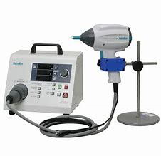
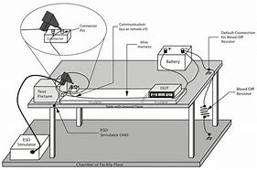
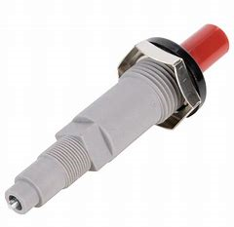
System Level ESD Testing & Debug
Most debug advice for radiated immunity can be applied to ESD testing
TVS across RIN/ROUT has been helpful
In IVI cases you can use the system SW to freeze the image when lock drops and resume after lock is reestablished. ESD is a quick event, and many customers are satisfied with masking the dropped lock so their customer does not notice.
Don’t try holding the ESD gun, you will likely get inconsistent results. Use an articulated arm and fire it remotely.
Many customers pre-test ESD and immunity with a piezo BBQ igniter. Click it at various locations around the system and monitor for dropped lock.
Run System Level ESD tests with
Use connectors that offer 360 degree transition from Shield to Board Ground so the Ground transition is smooth and continuous.
Well-balanced STP cable;
Identical metal enclosures,
Use CM chokes on the board to mitigate any cable Imbalance
Good connection between shield and the Chassis at the connector. Ensure that all supplies within the board are well-coupled to the system ground so supply and ground track transient injected signals well
Snap ferrites around the cable shield at the connector (where cable connects into the system)
Notes:
Most immunity mitigation can be applied to system level ESD
TVS
SW mitigation for IVI
Mechanical arm
Piezo igniter
Run with…
GND connections
Ferrites

Slide 8
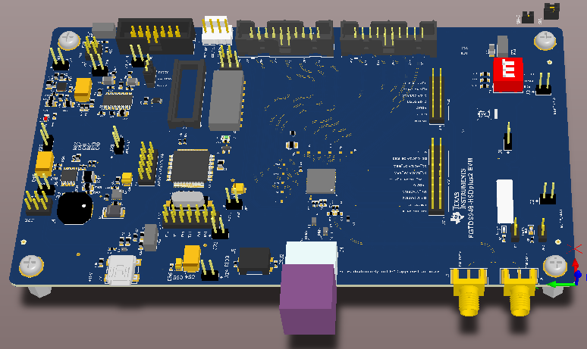
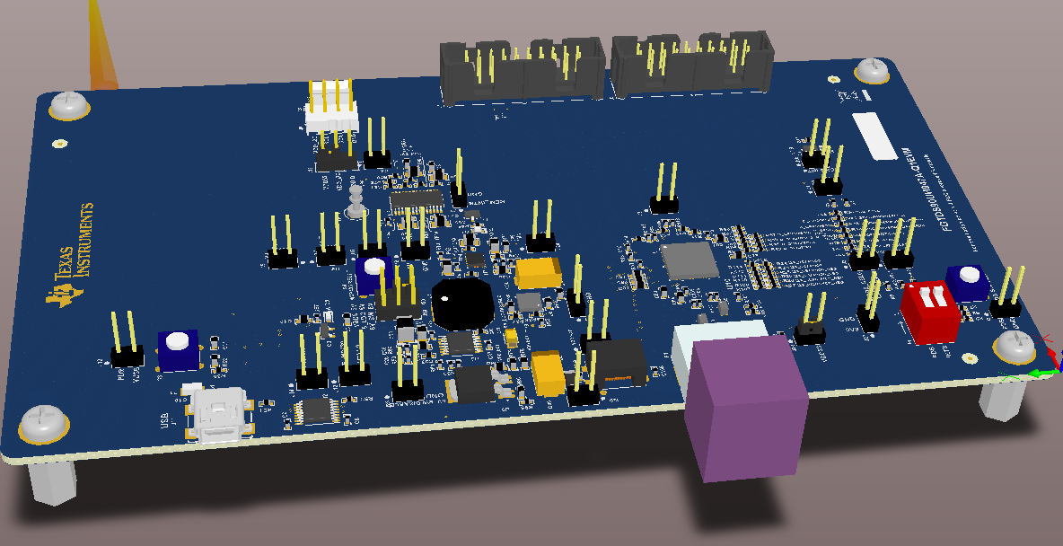
FGTDS Board EMC Improvements
We engaged with the Ford FGTDS program using EMI-optimized EVMs.
Place 30 mil poly keep-outs around the FPD high speed traces around the RF connector pins.
Place continuous GND pours between digital signals with large gaps between them.
Make sure that any AC coupling caps, chokes are used on the high speed traces are not placed adjacent/parallel to each other.
Follow connector vendor recommended footprint. Maintain 3 trace widths spacing for signals routed around the RF connectors.
Add “symmetrical” GND vias near the vias. A ground via should be added as close as possible to where the differential signal lines change layers. These ‘matching ground’ vias should be placed equal distance above and below the transition vias.
Ensure that high-speed signals enter coupling devices at 90 degree angles.
It is recommended to remove GND area underneath the inductor at switcher on all layers to minimize the emission and coupling effect.
Notes:
Spacing from high speed nets to other nets
GND buffers between
Spacing between AC coupling caps, CMC
Vendor recommended footprint – H-MTD example
Via stitching around high speed traces. GND via next to each high speed via.
Stub cutter for PoC
Antipad under large inductors

Slide 9
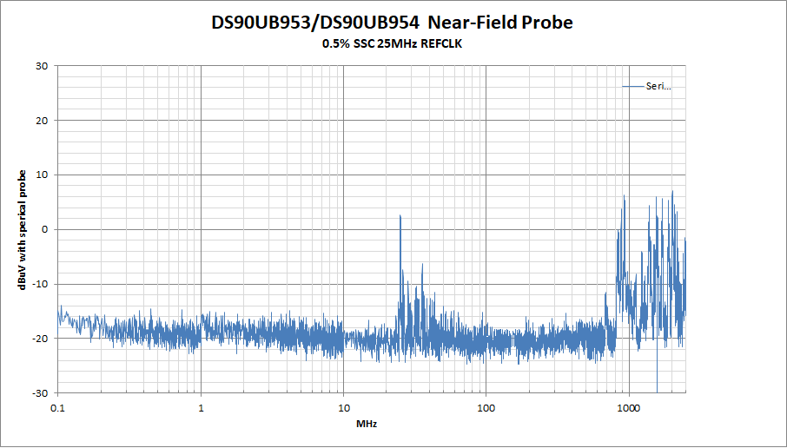
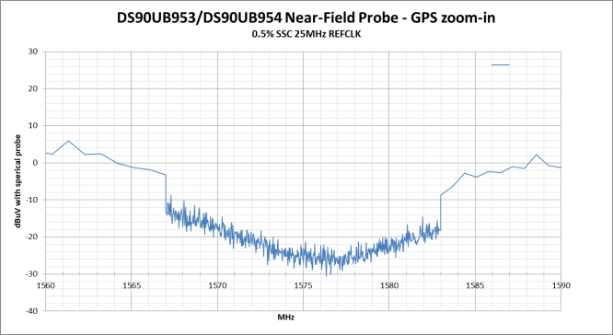
Advantages of Deserializer SSC REFCLK
Full CISPR25 GPS Zoom-in
DS90UB953/954
Standard REFCLK
EMC Chamber
Standard REFCLK
DS90UB953/954
Standard REFCLK
Link margin testing shows that up to 0.5% spreading SSC can be supported
EMC Chamber testing shows 6dB to 9dB improvement in most cases. For signals that do not respond to SSC, check an ambient sweep to ensure external emitters are not present.
Near-Field Probe
Standard REFCLK
Near-Field Probe
0.5% SSC REFCLK

