Slide 1

FUXI MLVDS Failure Analysis
2022.10.17

Slide 2
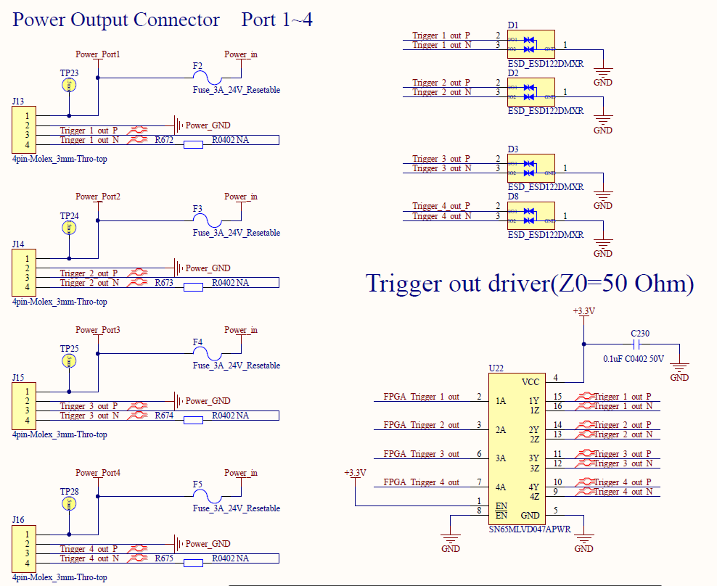
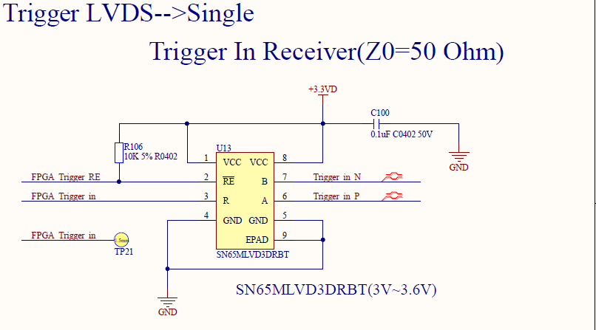
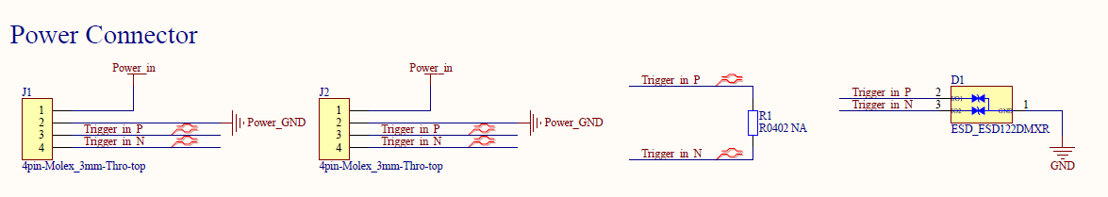
Schematic:
Tx Side:
Rx Side:
Tx Side: 50 Ohm resistor is un-mounted;
Rx Side: 50 Ohm resistor is un-mounted;

Slide 3
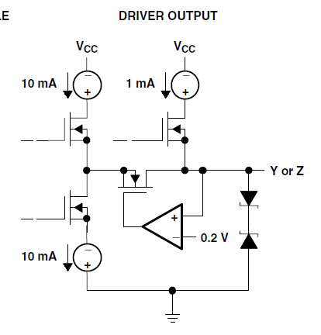
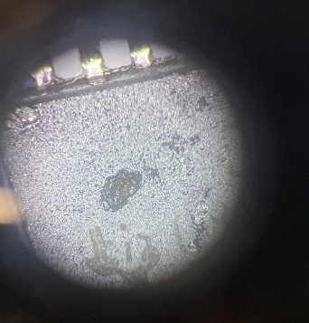
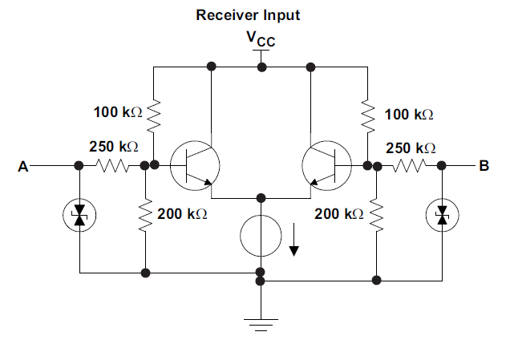
System Structure:
Rx Side
Rx Side
Rx Side
Rx Side
Rx Side
Rx Side
Rx Side
Rx Side
Tx Side
Cable length :1m~2m
Cable length :10cm
50 Ohm
SN65MLVD47APWR Failure Status：
Signal name:~N[SN65MLVD47APWR Z pin] to GND resistor:0 Ohm;
Signal name:~ P[SN65MLVD47APWR Y pin] to GND resistor:0 Ohm;
Signal name:~ N[SN65MLVD47APWR Z pin] to GND diode status: 0.7V;
Signal name:~ P[SN65MLVD47APWR Y pin] to GND diode status: 0.7V;
Tx Side ESD device: ESD122DMXR is break down[can be measured 0.8V to GND using Multimeter]
4 port is not worked;[see the right picture]
SN65MLVDDRBT Failure Status:
1) Signal name:~N[SN65MLVDDRBT B pin] to GND resistor:25 Ohm;
2) Signal name:~N[SN65MLVDDRBT B pin] to GND resistor:48 Ohm;
3) Signal name:~N[SN65MLVDDRBT B pin] to GND resistor:133 Ohm;
4) Signal name:~P & ~N[SN65MLVDDRBT A&B pin] resistor:0 Ohm;
5) Signal name:~P[SN65MLVDDRBT A pin] to GND diode status: 0.7V;
6) ESD122DMXR is OK

Slide 4
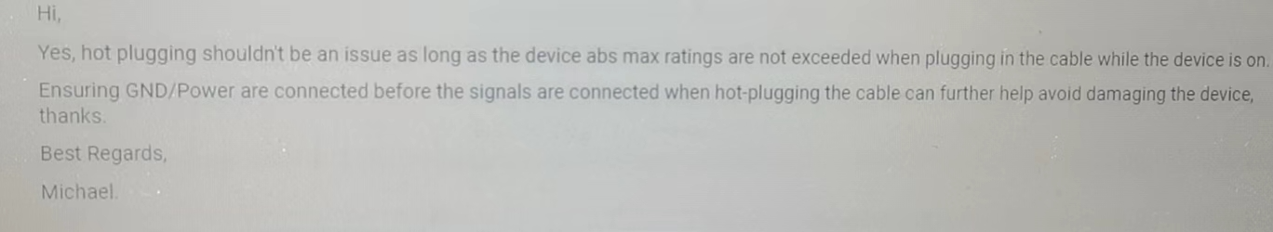
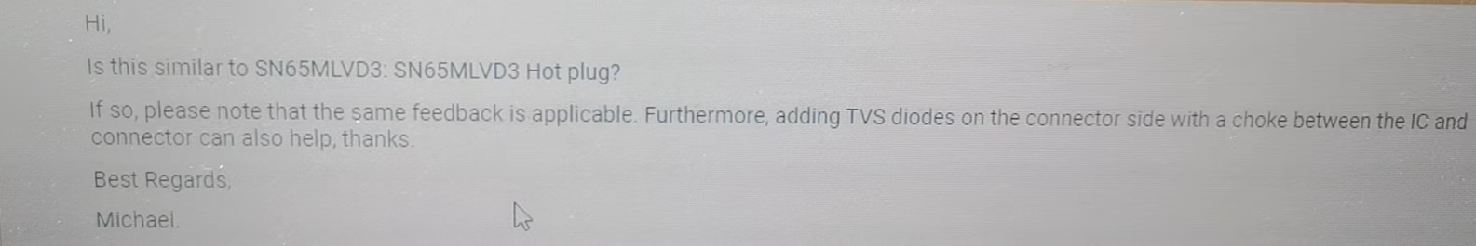
Question:
Help to check the schematic defect;
If the terminal resistor 50 Ohm is un-mounted at the “System Structure”, will the IC be easily breakdown?
Based on the failure status, is it by ESD, or other reason, Can you help to give more guides?
The Failure IC is reserved, can we do more analysis?
Other suggestion for analysis?

Slide 5
谢谢！
同源微（北京）半导体技术有限公司

