Slide 1
FUXI MLVDS Failure Analysis
2022.10.17

Slide 2
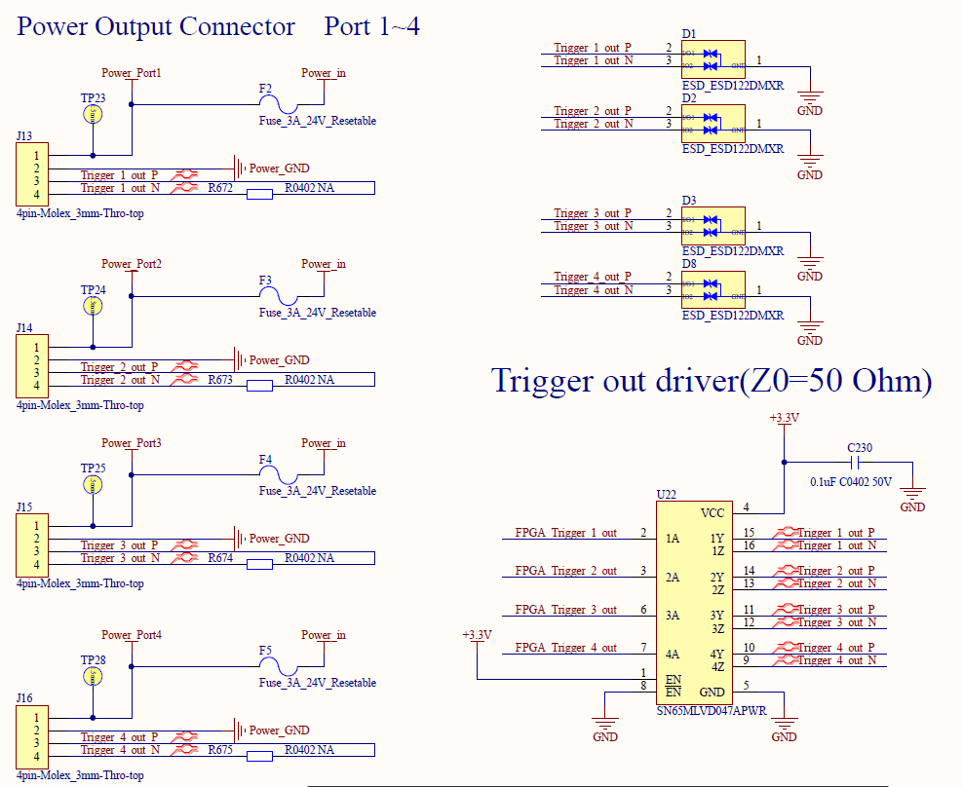
Schematic:
Tx Side:
Rx Side:
Tx Side: 50 Ohm resistor is un-mounted;
Rx Side: 50 Ohm resistor is un-mounted;

Slide 3
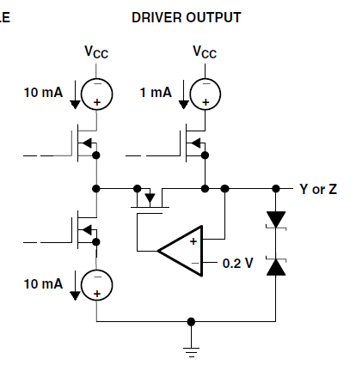
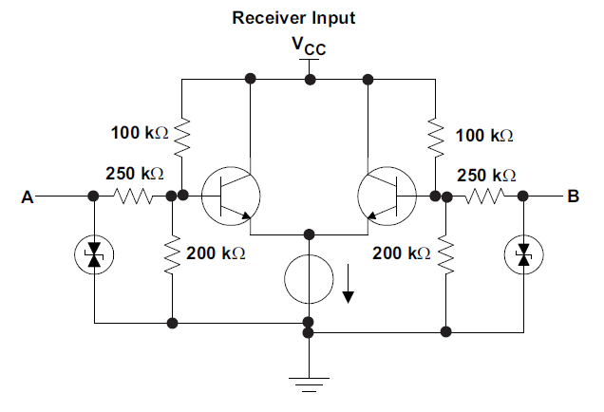
System Structure:
Rx Side
Rx Side
Rx Side
Rx Side
Rx Side
Rx Side
Rx Side
Rx Side
Tx Side
Cable length :1m~2m
Cable length :10cm
50 Ohm
SN65MLVD47APWR Failure Status：
Signal name:~N[SN65MLVD47APWR Z pin] to GND resistor:0 Ohm;
Signal name:~ P[SN65MLVD47APWR Y pin] to GND resistor:0 Ohm;
Signal name:~ N[SN65MLVD47APWR Z pin] to GND diode status: 0.7V;
Signal name:~ P[SN65MLVD47APWR Y pin] to GND diode status: 0.7V;
Tx Side ESD device: ESD122DMXR is break down[can be measured 0.8V to GND using Multimeter]
4 port is not worked;[see the right picture]
SN65MLVDDRBT Failure Status:
1) Signal name:~N[SN65MLVD3DRBT B pin] to GND resistor:25 Ohm;
2) Signal name:~N[SN65MLVD3DRBT B pin] to GND resistor:48 Ohm;
3) Signal name:~N[SN65MLVD3DRBT B pin] to GND resistor:133 Ohm;
4) Signal name:~P & ~N[SN65MLVD3DRBT A&B pin] resistor:0 Ohm;
5) Signal name:~P[SN65MLVD3DRBT A pin] to GND diode status: 0.7V;
6) ESD122DMXR is OK

Slide 4
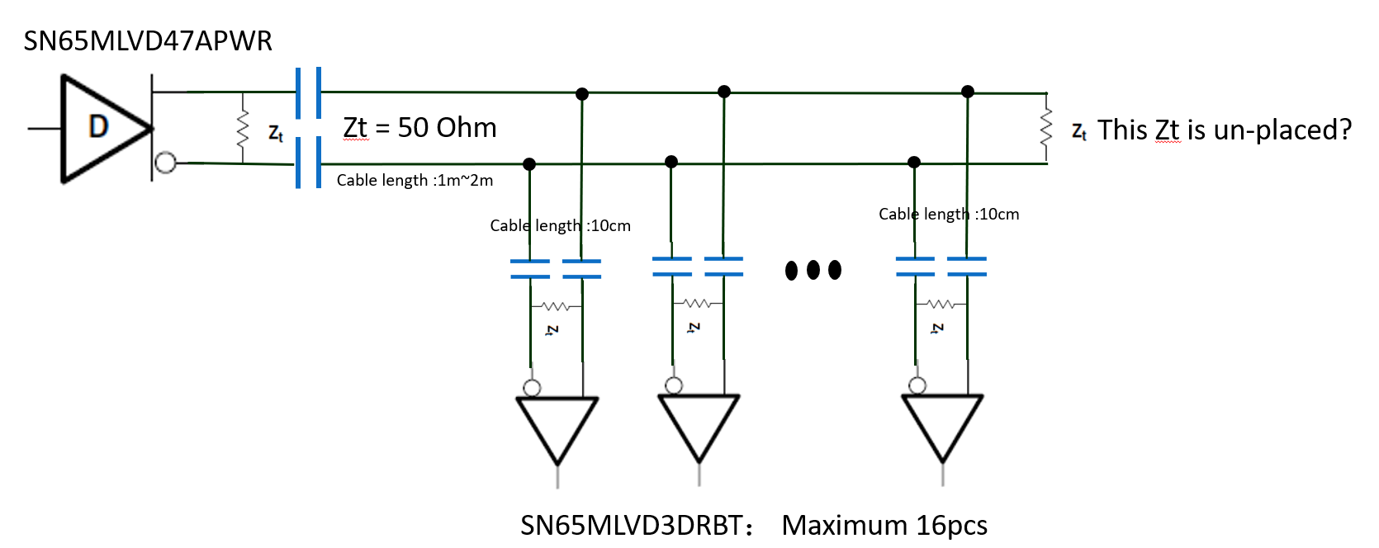
Question:
Help to check the schematic defect;
If the terminal resistor 50 Ohm is un-mounted at the “System Structure”, will the IC be easily breakdown?
Based on the failure status, is it by ESD, or other reason, Can you help to give more guides?
The Failure IC is reserved, can we do more analysis?
Other suggestion for analysis?
How about AC coupling structure like Below? [in our system: one point send data, about 16 point receive data]

Slide 5
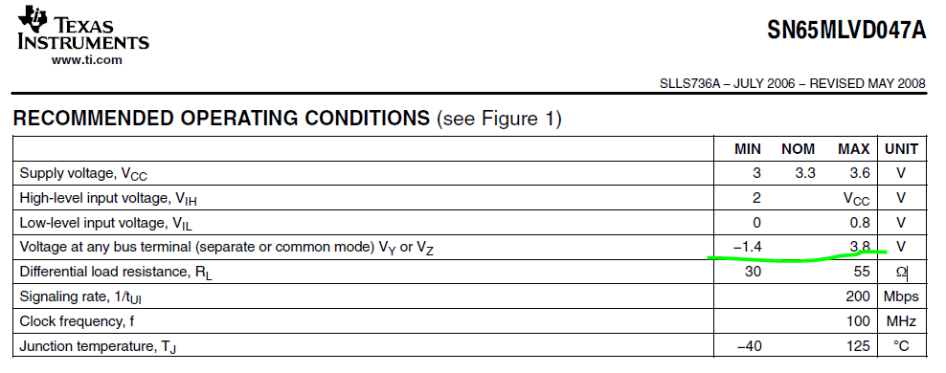
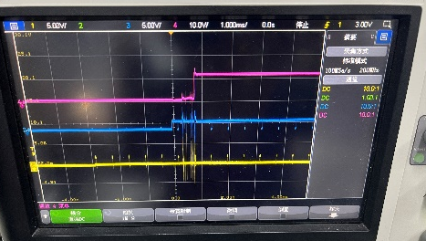
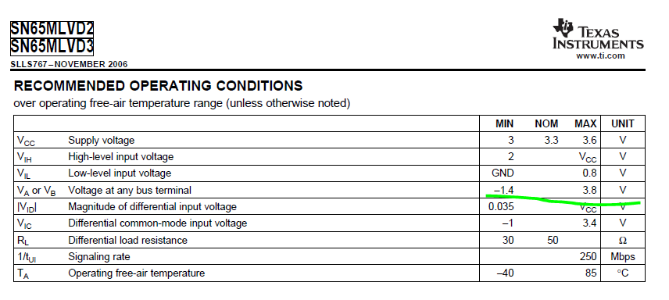
I try to do hot-plug many times, sometimes the LVDS P or N Side is overstress the spec in short time, But the IC is still worked.
I was afraid of the short from P/N side to Power line in-using, So how do you think about the AC coupling of MLVDS? It seems still works in the spec. But I did not found AC coupling information of MLVDS.

Slide 6
SN65MLVD47APWR
Zt = 50 Ohm
This Zt is un-placed?
Cable length :1m~2m
Cable length :10cm
Cable length :10cm
SN65MLVD3DRBT： Maximum 16pcs

Slide 7
谢谢！
同源微（北京）半导体技术有限公司

