Slide 1
GTK schematic review

Slide 2
TUSB8041 Hub2 review
1: if there is no AC cap on hub 1 downstream port, C8113/C8114 should be 100nf.

Slide 3
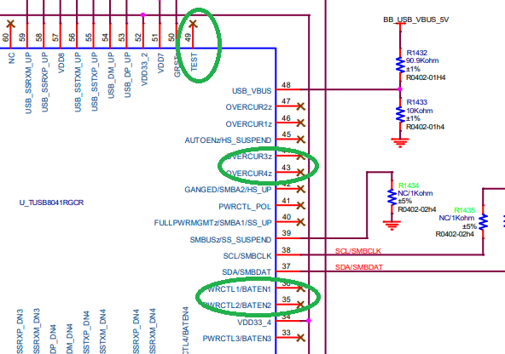
TUSB8041 hub2 review
1: Test pin should be grounded
2: Power switching and overcurrent is not implemented

Slide 4
TUSB8041 hub2 review
1: USB_vbus0, USB_vbus1 are for Device0-Device1 VBUS? What is max current for USB_vbus0, USB_vbus1

