Slide 1
Scope trace measurement synopsis
We made a comparison signal measurement using 4GHz bandwidth scope between a reference board (PHY chip: DP83867IRPAP 64 pin package) and GigE board (PHY chip: DP83867IRRGZ 48 pin package)
There are some signal integrity issue observed on GigE board, especially on RX_CLK signal.
Please take a close look of the scope signal shot

Slide 2
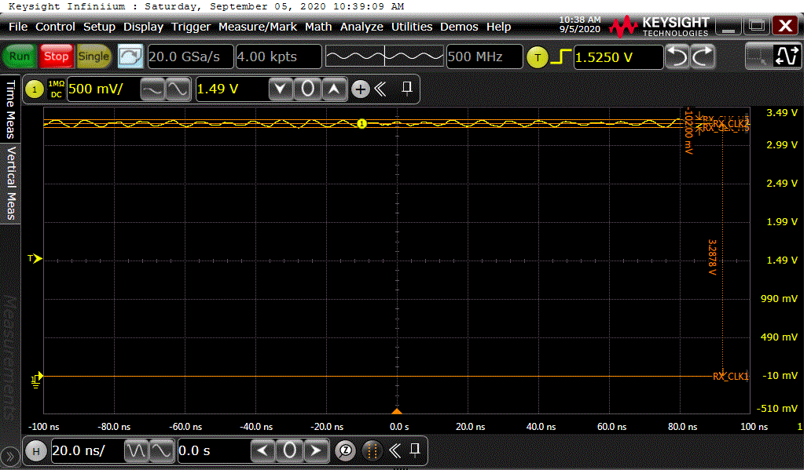
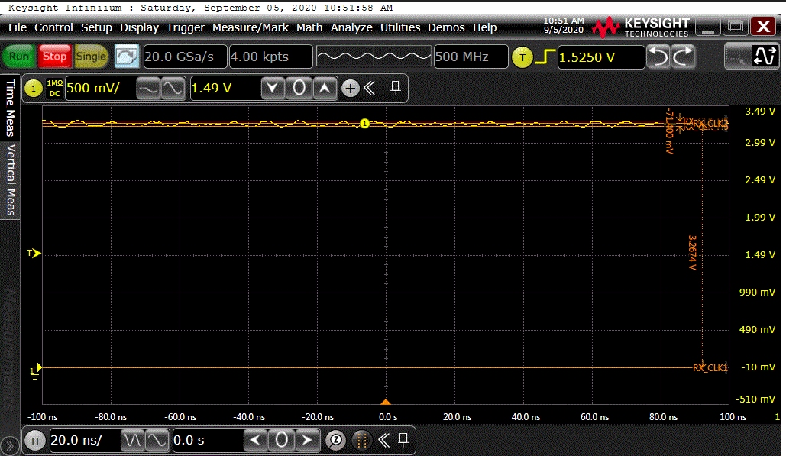
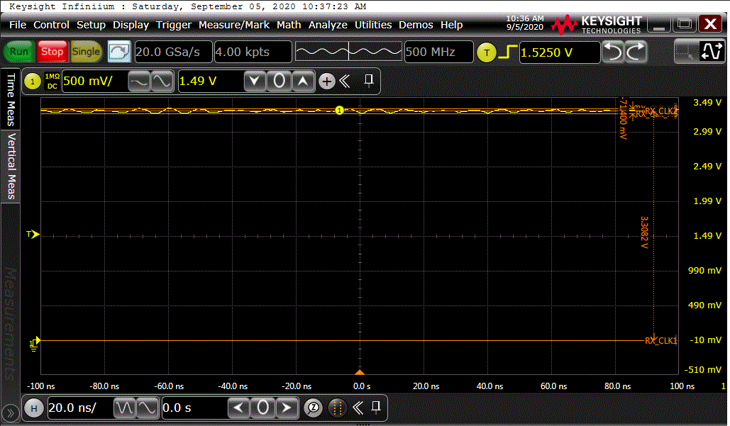

VMIO3.3V and +3.3V (left: 64-pin, right: 48-pin)
Reference board +VMIO3.3V power supply (ripple: 102mV)
GigE board +VMIO3.3V power supply input from CN1 (ripple: 71.4mV)
Reference board +3.3V power supply output (ripple: 71.4mV)
GigE board +3.3V power supply U1 output (ripple: 81.6mV)

Slide 3
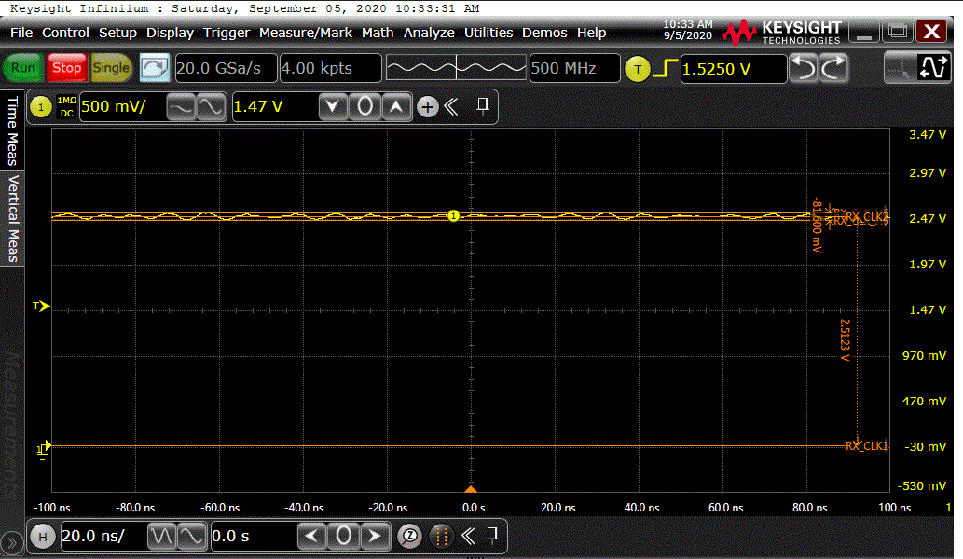

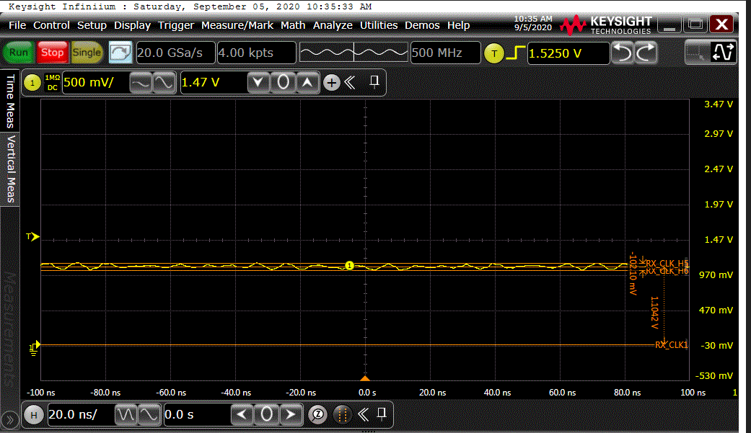
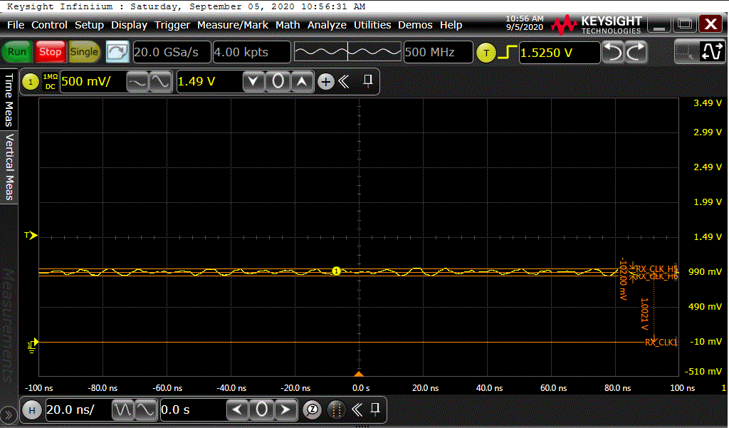
+2.5V and +1.1V/1.0V (left: 64-pin, right: 48-pin)
Reference board +2.5V power supply output (ripple: 81.6mV)
GigE board +2.5V power supply output (ripple: 102mV)
Reference board +1.1V power supply output (ripple: 102.1mV)
GigE board +1.0V power supply output (ripple: 102mV)

Slide 4
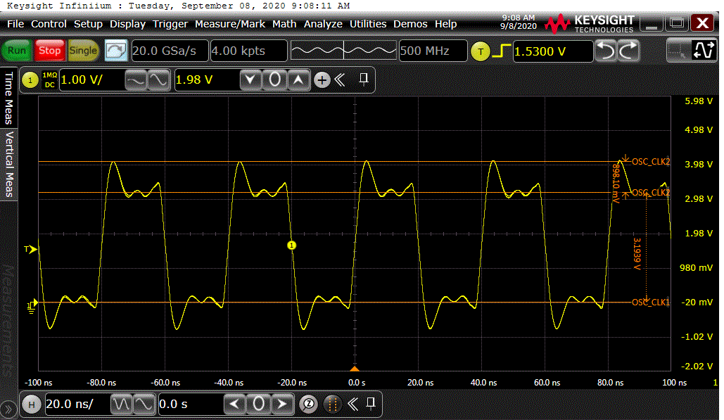
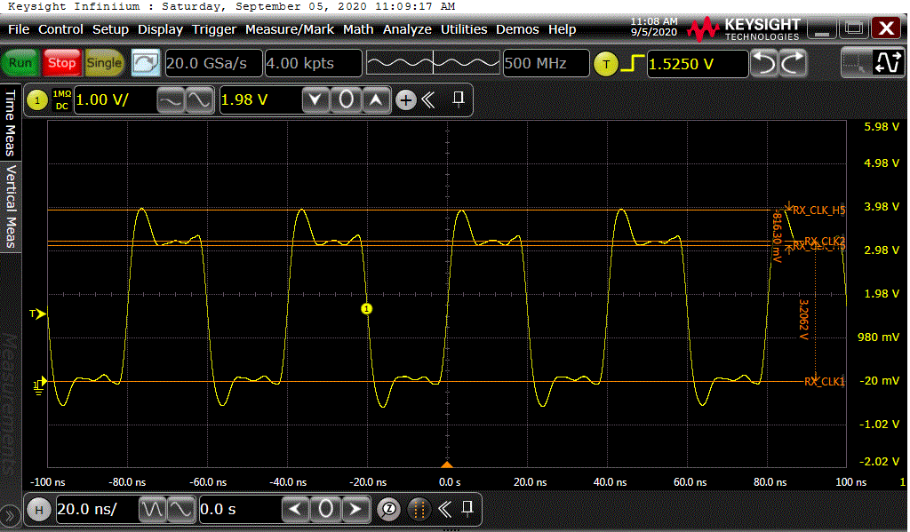
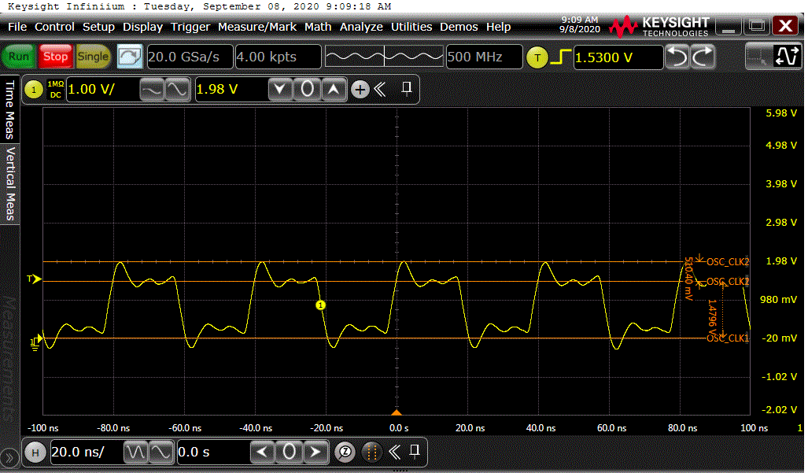
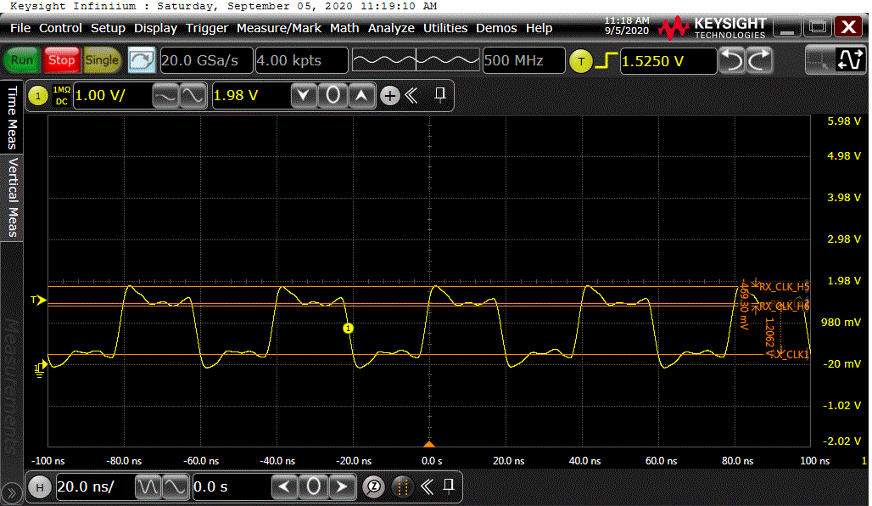
25MHz OSC probed at two end of cap (left: 64-pin, right: 48-pin)
Reference board 25MHz oscillator out signal
GigE board 25MHz oscillator out signal (OSC1 pin3)
Reference board 25MHz oscillator signal to XI pin of PHY
GigE board 25MHz oscillator signal to PHY chip XI pin15

Slide 5
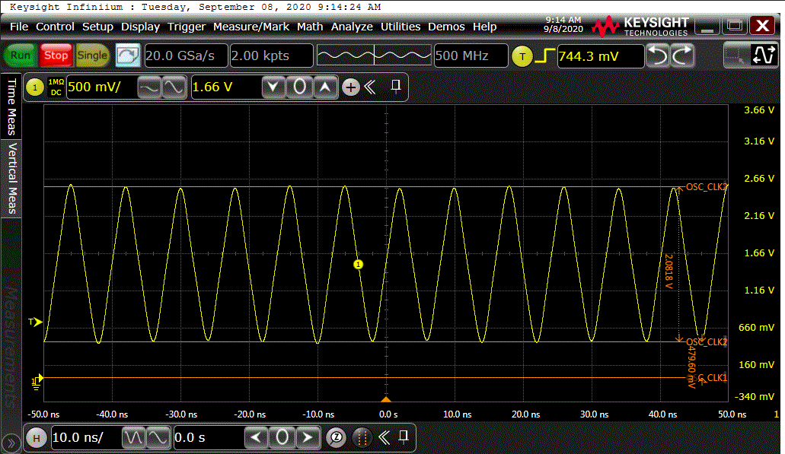
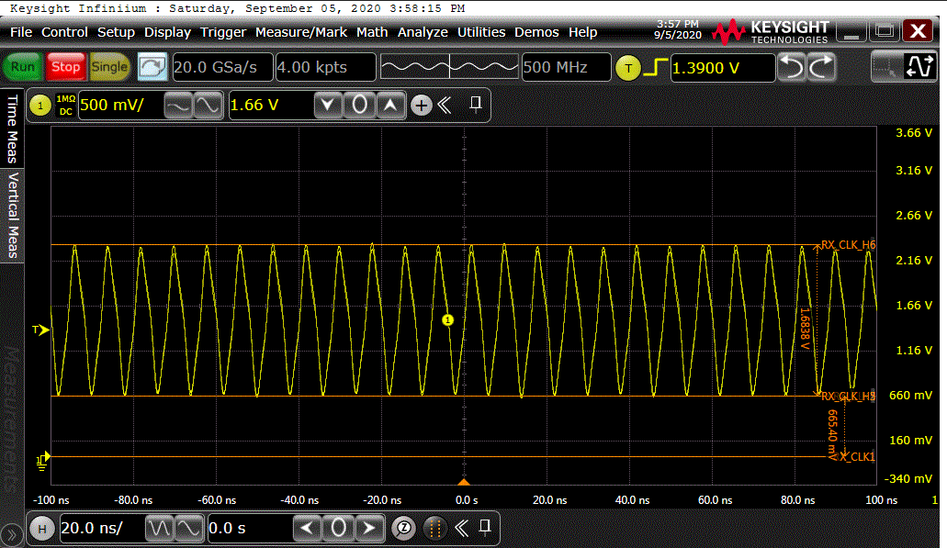
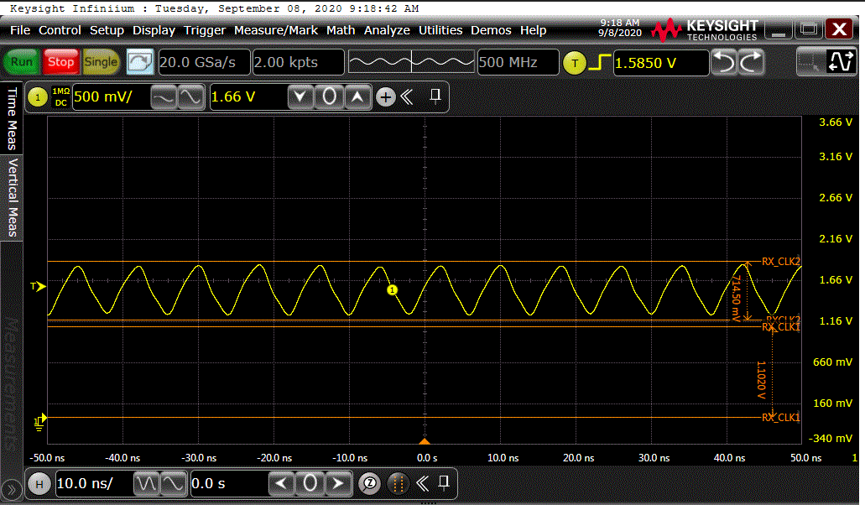
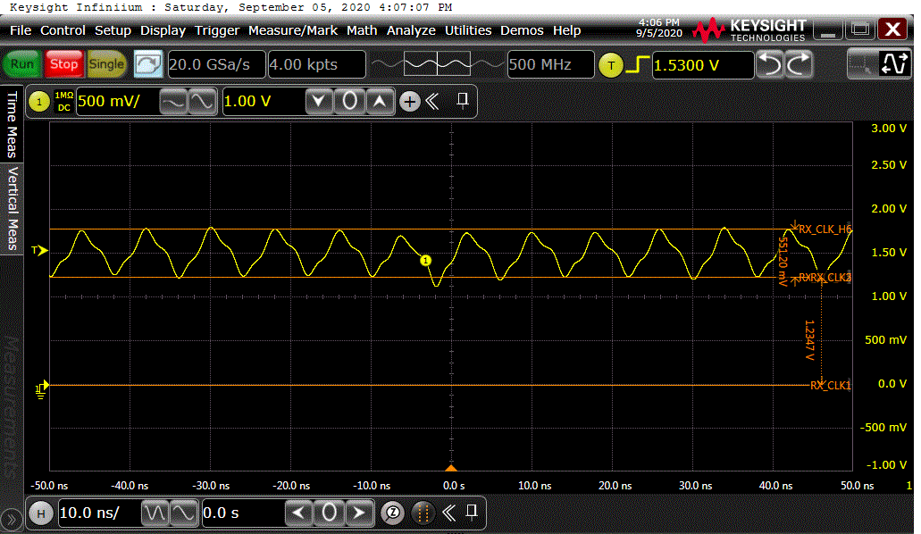
RX_CLK at two ends of serial resistor (left: 64-pin, right: 48-pin)
Reference board 125MHz RX_CLK signal out of PHY chip
GigE board 125MHz RX_CLK signal out of PHY chip
Reference board 125MHz RX_CLK signal to MAC
GigE board 125MHz RX_CLK signal measured at R9 end to MAC

Slide 6
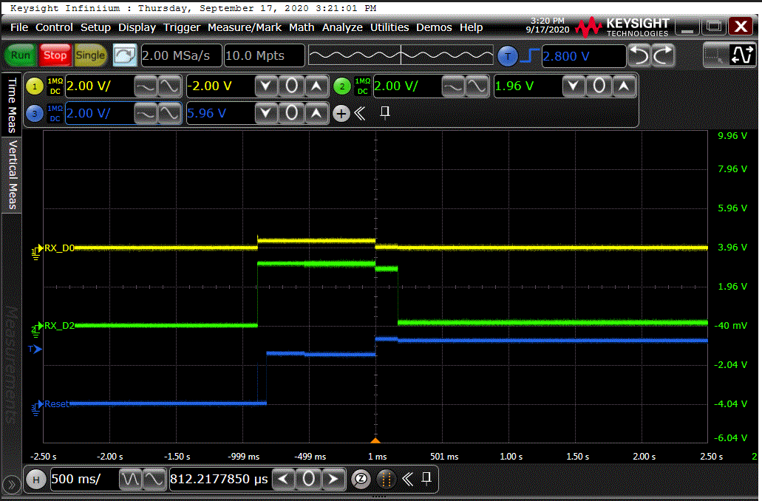
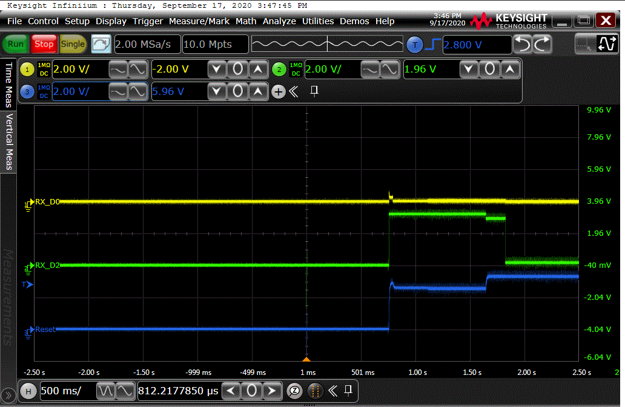
Reset_RX_D0_RX_D2 at powerup (left: 64-pin, right: 48-pin)

Slide 7
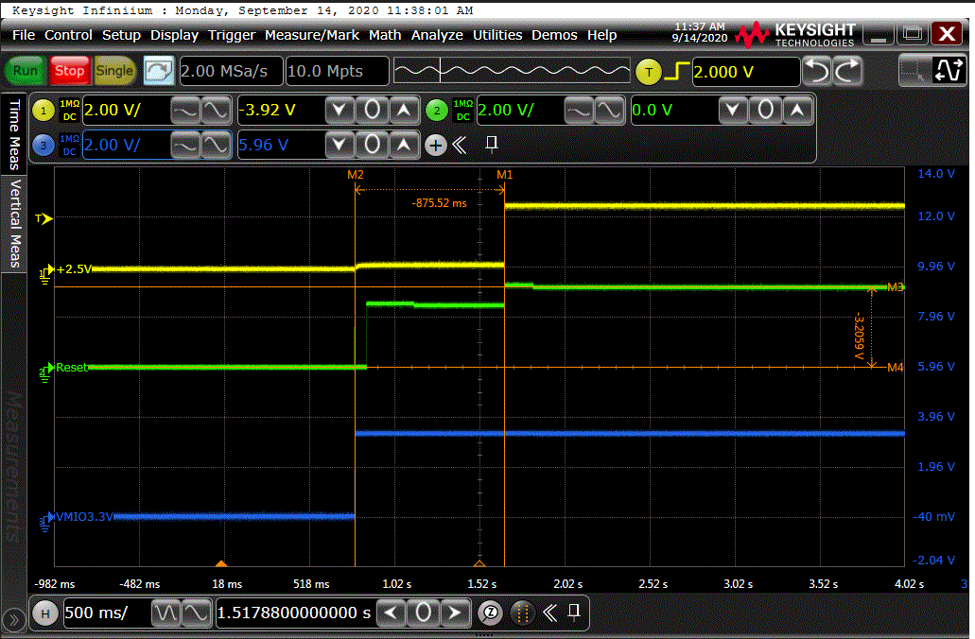
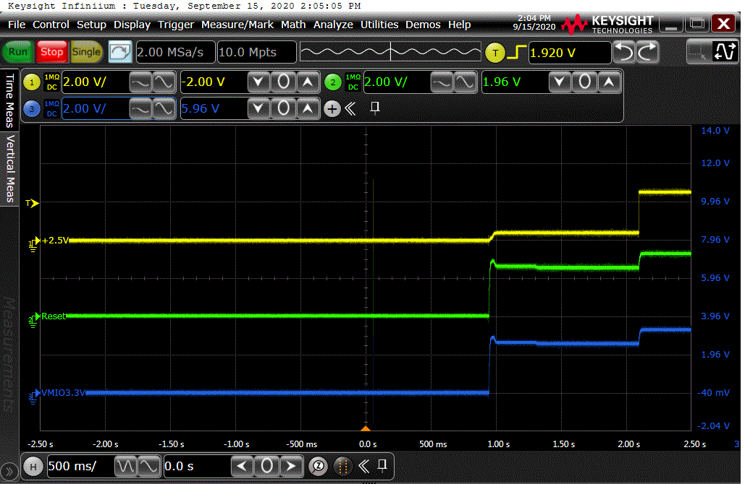
+2.5V, Reset, VMIO3.3V (left: 64-pin, right: 48-pin)

Slide 8
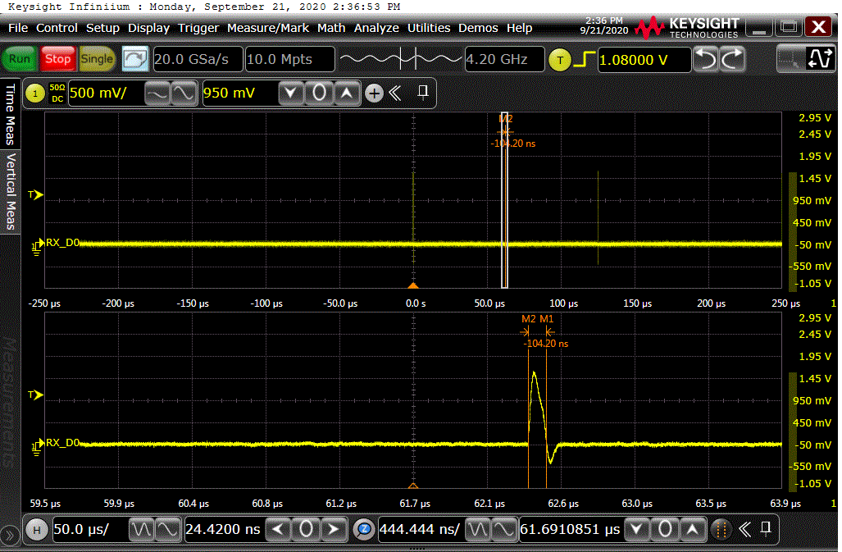
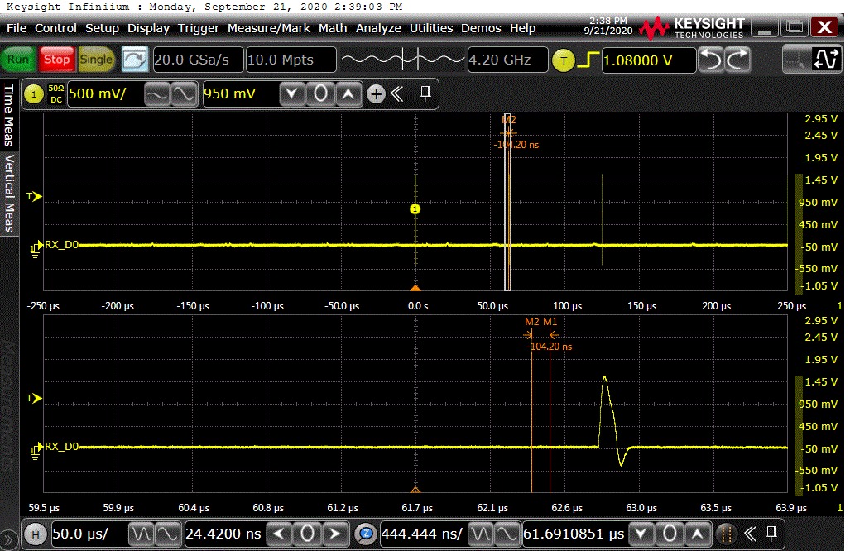
MDI signal (left: 64-pin, right: 48-pin)

