Slide 1
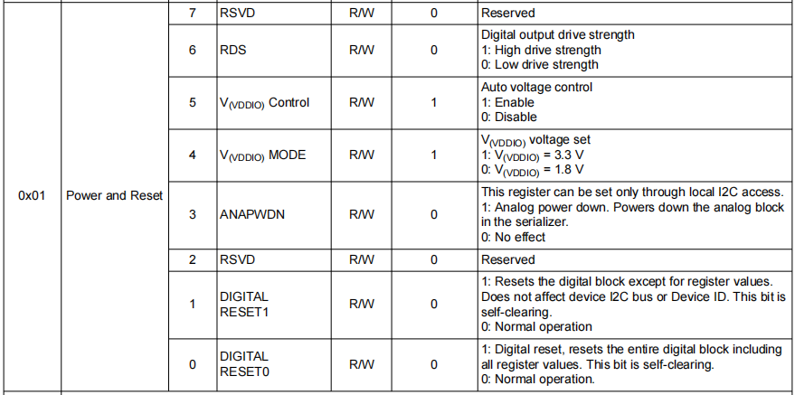
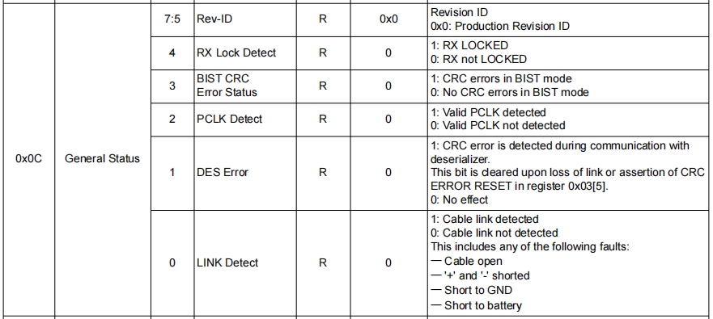
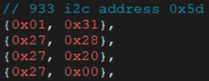
串行器初始化流程
Serializer initialization process
1）初始化933寄存器（0x01和0x27）
1) Initialize the 933 register (0x01 and 0x27
2）检查933寄存器（0x0C）
初始化后，检查0x0C无错误位，否则重新初始化（最多检查5次）
2) Check the 933 register (0x0C)
After initialization, check 0x0C no error bit, otherwise re-initialize (check up to 5 times)

Slide 2
Abnormal monitoring
监控机制：每秒查询一下0x0C寄存器；
异常处理：出现Link Detected丢失，报诊断故障；
Monitoring mechanism: Query the 0x0C register every second;Exception handling: If Link Detected is lost, a diagnostic fault will be reported;
Log and location
log关键字：lvds_Link Reg status
log打印位置：独立线程
Log keyword: lvds_ Link Reg status
log printing location: independent thread

Slide 3
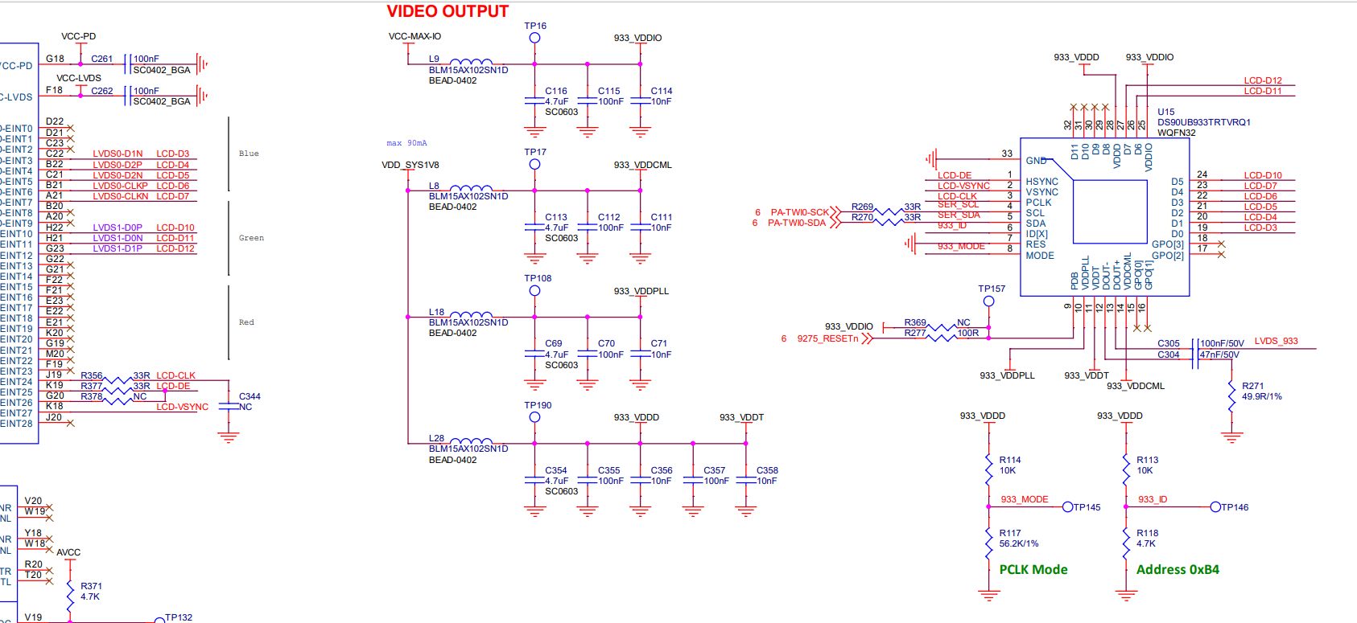
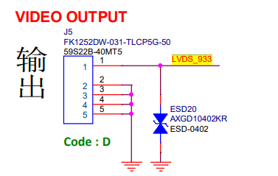
串行器原理图
Serializer schematic diagram

Slide 4
AVM 视频输出配置
AVM video output configuration
APA 视频输出配置
APA Video Output Configuration

