Slide 1
SN65HVD33 load tests
ASC/INT/TRX
Aug 2018

Slide 2
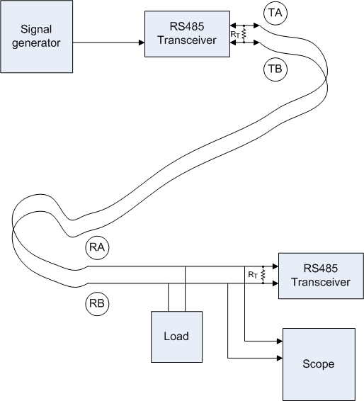
Test condition
Device: SN65HVD65
Vcc=3.3V
Room temperature
Termination: 120Ohm
PRBS data (26Mbps)
CAT5 cable (1 feet)
Load: 200Ohm
(equivalent to about 100 RX nodes)

Slide 3
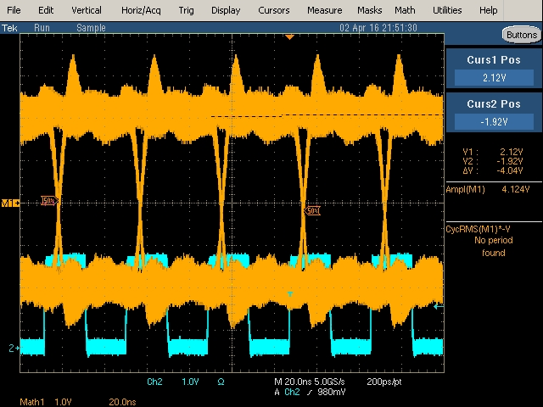
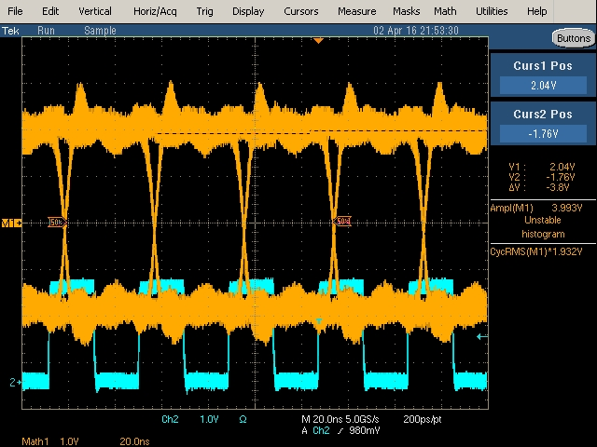
Vpp of A-B
With no load
With load

Slide 4
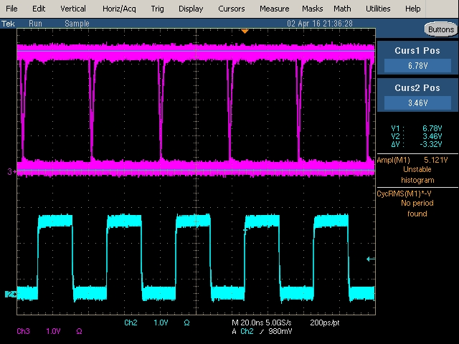
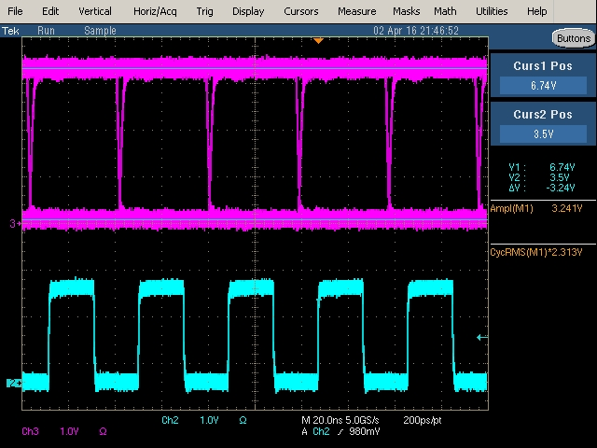
Vpp of Rout
With no load
With load

