Slide 1
INI-VG NETWORKING ISSUE POST 3/25 BOARD BUILDS: DEBUGGING RESULTS
CONNECTING WIRE, FIBER, AND RIBBON CABLES SUGGESTED ISSUE IS ON WIRE FRONT END
RIBBON CABLES BYPASSES ALL FRONT ENDS AND FPGA – THIS WORKED FINE WITH NO ERRORS AND IS USED WITHIN THE ENCLOSURE ITSELF.
FIBER IS STABLE COMPARED TO WIRE – RAN ALL WEEKEND WITH 36 RECONNECTS, WIRE WILL NOT CONNECT AT ALL
RECONNECTS FOR FIBER/WIRE WILL BE FIXED IN NEXT RELEASE OF FPGA SOFTWARE DETAILED BELOW IN YELLOW AND IS UNDERCONSTRUCTION
REPEATER FPGA SOFTWARE THEAT IS UNDER DEVELOPMENT TESTED(IMPROVED BUT NOT FLAWLESS YET)
RX LEDs SOLID, BUT NODE CANNOT BE QUERIED, IN AND OUT TRAFFIC WORKS FINE NOT LOCAL TRAFFIC
3/25 BOARDS CANNOT EVEN LOCK AND CONTINUOUSLY RECON
WIRE RS485 RECEIVER (TI AM26LV32 6K Ohms INPUT IMPEDANCE) Really need 12K for optimal operation
A AND B INPUTS REFERENCED TO THRESHOLD VOLTAGE TO GND
REPEATER CHANGED TO PIN COMPATIBLE MAXIM MAX3094 WITH 45K Ohms INPUT IMPEDANCE
REPLACED TI CHIP WITH MAXIM CHIP AND CONNECTION WORSE
RS485 PURPOSE IS ANALOG TO DIGITAL REPRESENTATION – PACKETS GET THROUGH 485 FRONT END FINE
PACKETS INTO AND OUT OF FPGA FINE
LOCAL RS485 CHIPS OPERATE FINE
LOCAL TOKEN GENERATION STOPS FROM ARCNET CHIP – ONLY ON WIRE CONNECTS
ONLY WAY THIS MAKES SENSE IS IF 485 DELAYS BITS THAT FOOLS ARCNET CHIP INTO SEEING WRONG NODE ON TOKEN
20 SALEAE CAPTURES OF FRONT END AND LOCAL RS485s WITH WIRE/FIBER/RIBBON/RPT FIX FPGA CODE
EXAMPLES ON NEXT 2 PAGES OF GOOD TRANSMISSIONS AND TRANSMISSIONS STOPPING AND STARTING

Slide 2
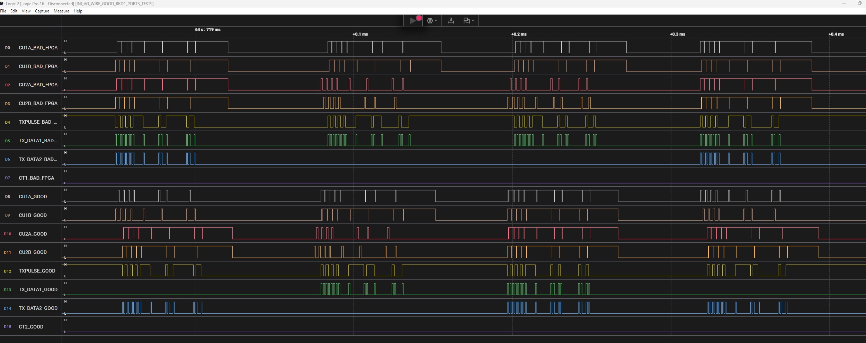
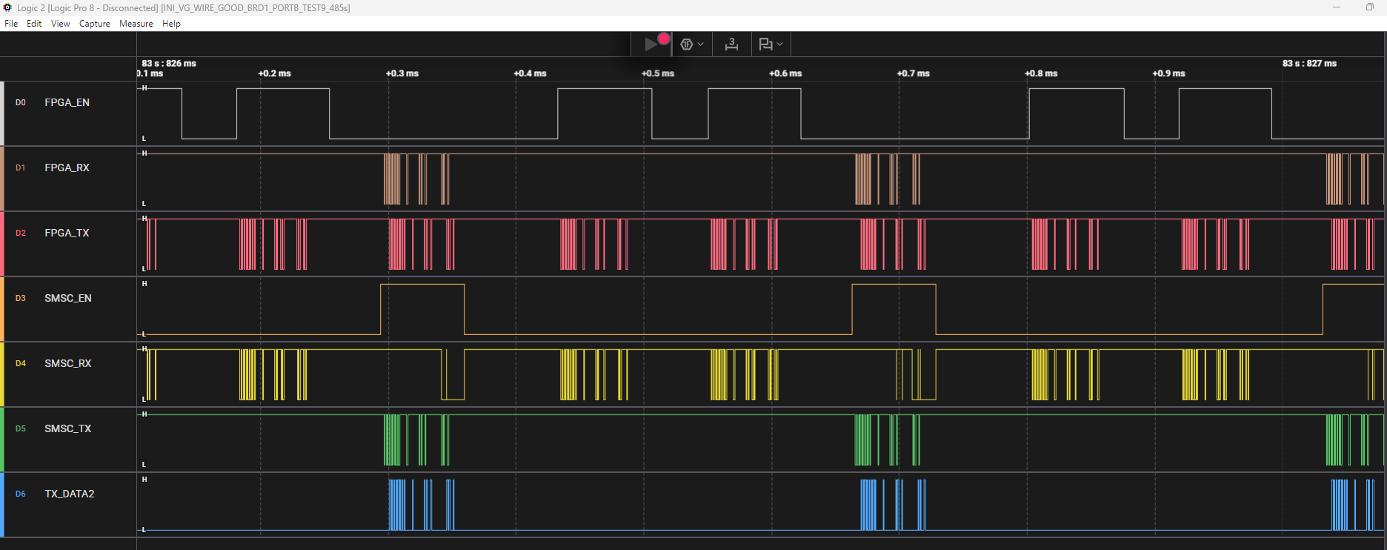
THIS IS GOOD TRANSMISSION – 2 GOOD BOARDS COMMUNICATING WITH RPT:
WIRE FRONT END:
U24 - LTC487 TX
U25 - AM26LV32 RX
SIGNALS
FPGA TO ARCNET:
U21 – LTC1480
(FPGA RS485)
U19 – LTC1480
(SMSC RS485)

Slide 3
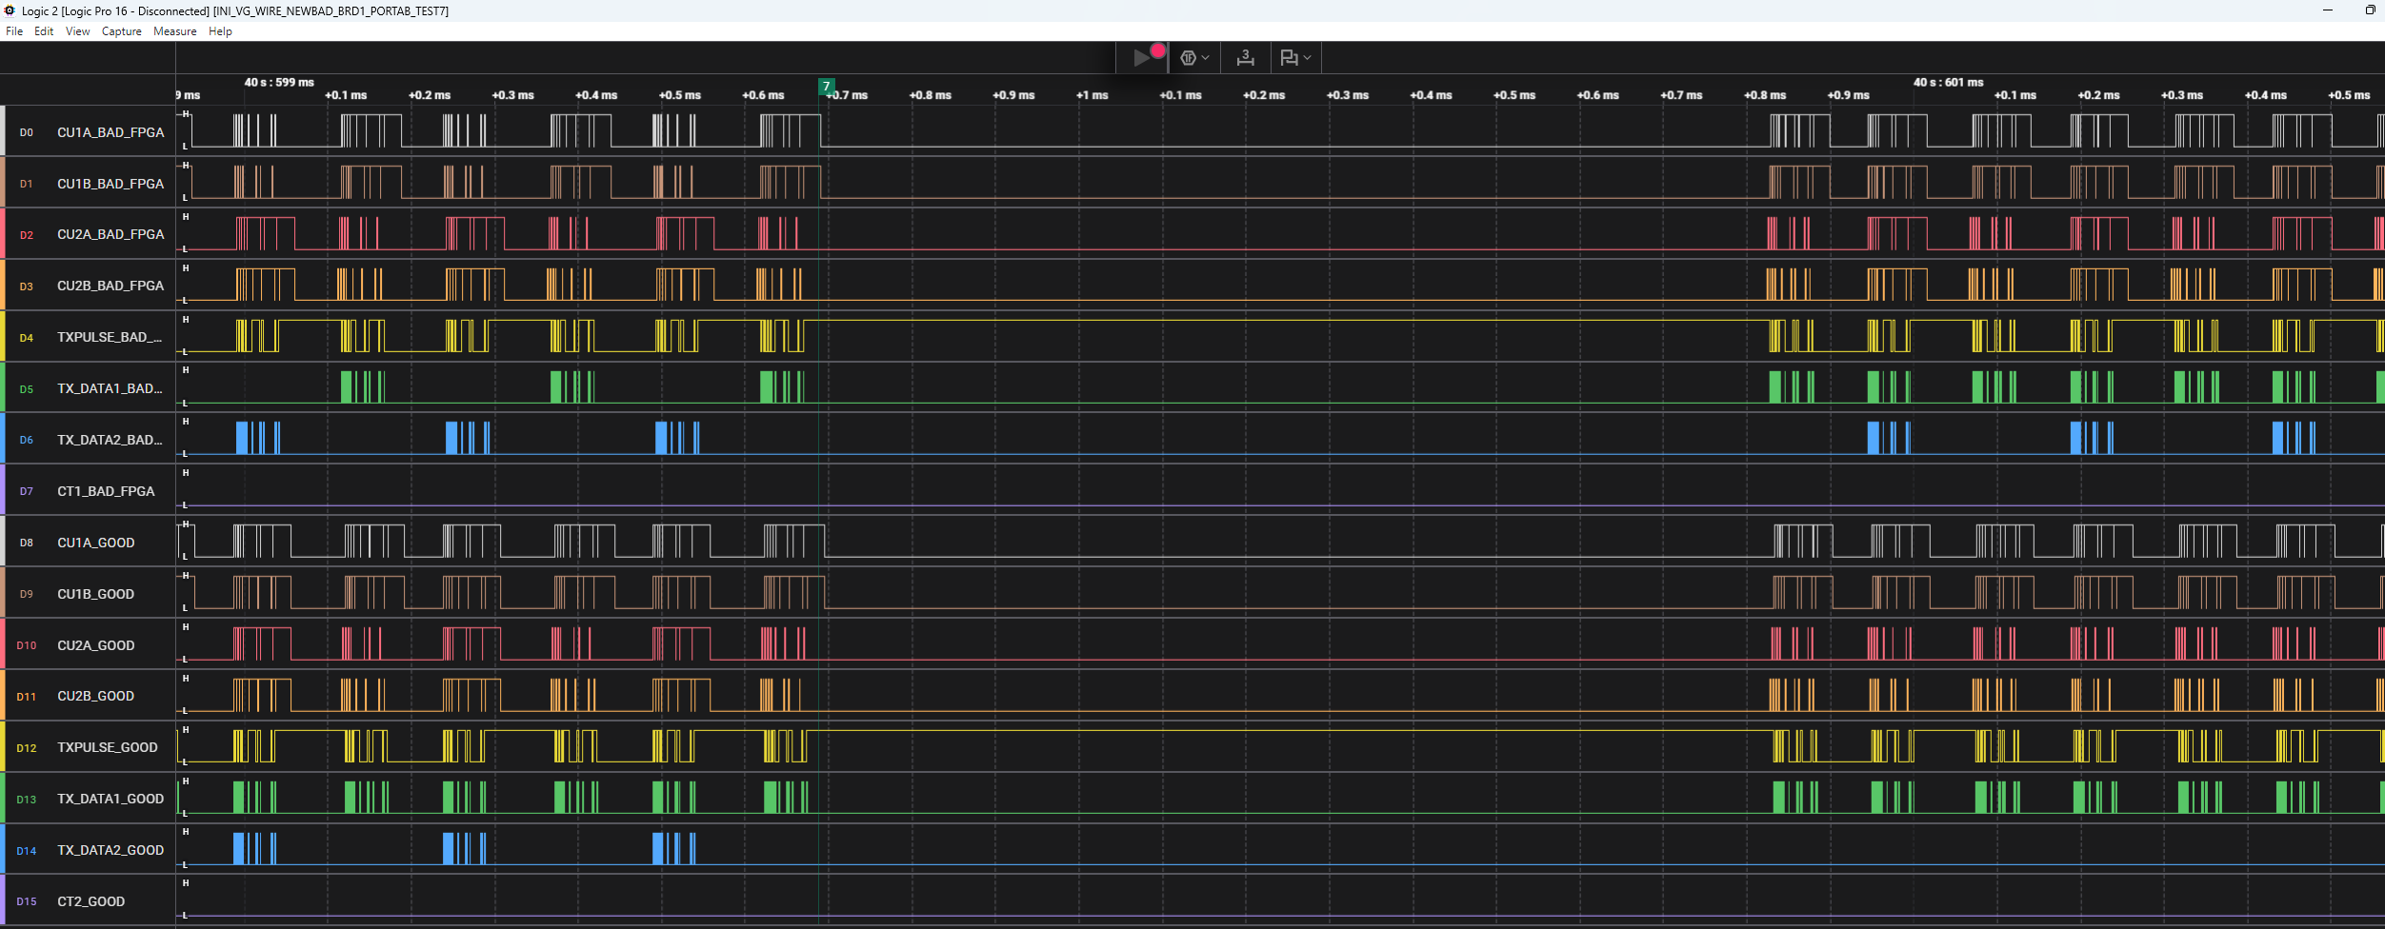
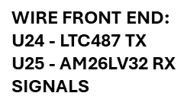
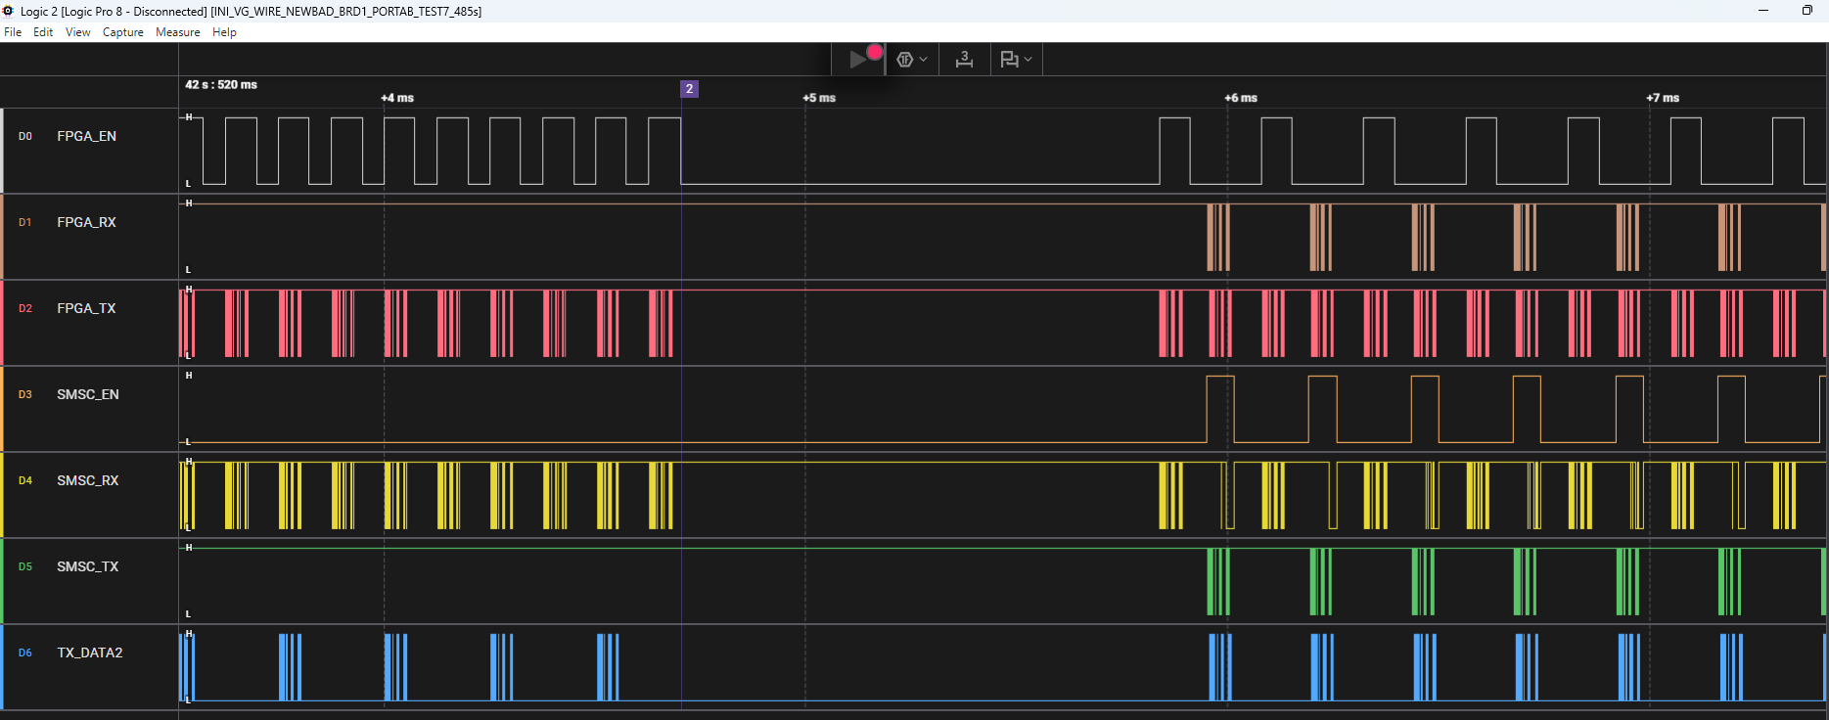
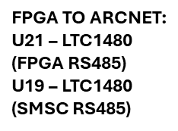
ARCNET CHIPS START AND STOP GENERATING LOCAL PACKET:

