Slide 1
Industrial CAN / CAN FD Transceivers
Transceiver Interface (TRX)
www.ti.com/can

Slide 2
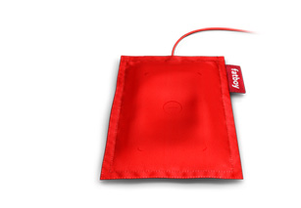
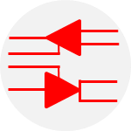
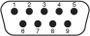



Transceiver Interface portfolio overview
RS-485
RS-422
RS-232
I2C
Industry leader with largest portfolio of RS-485 transceivers
Both Half-duplex and Full-duplex devices with high ESD performance and broad range of bus fault protection
Over 115 RS-232 drivers, receivers, and transceivers available today
Low power modes and support for voltages as low as 1.8V
First to market with 1.8V Charge Pump
Complete line of I2C repeaters, expanders, switches, and special function devices
Wider voltage range and lower power consumption than competitive solutions
IO-Link / SIO
CAN / LIN / SBC
UART / Other
Best-in-class IO-Link and SIO (digital output switch) transceivers with fully integrated IEC, ESD, EFT and surge protection
Optimized solution provides smallest size, lowest power, and drives reduced BOMs
Industry leading 3.3V portfolio
Best performance, most robust 5V portfolio
High immunity, low emission, Fault protected solutions
CAN FD up to 5Mbps
SBC w/ integrated regulators
Broad portfolio of single and multi-channel UART devices
FIFO and No FIFO UART options
Basic Line Drivers
AISG 1.0/2.0 Modems Transceiver
Notes:
2
2
2
2
2

Slide 3
TI: History of CAN Innovations
TCAN1042/1051
High Bus Fault Protected CAN Transceivers
SN65HVD25x/26x
Turbo CAN for loaded networks
ISO1050
First galvanic isolated CAN for industrial
SN65HVD1050
Low EMI CAN transceiver
SN65HVD251
Popular Industrial CAN Transceiver
SN65HVD23x
First 3.3V supply CAN transceivers
2Mbps CAN FD
5Mbps CAN FD
3.3V Supply
Standby Power
Improved EMI
Isolated
Redundant CAN
Fault Protected

Slide 4
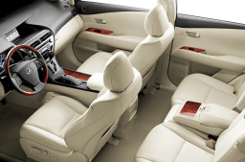
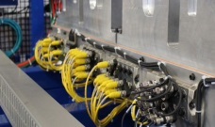


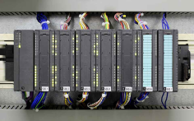
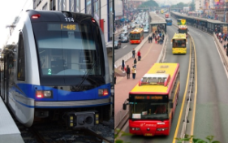
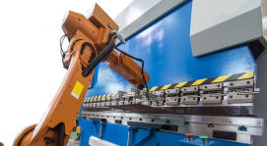
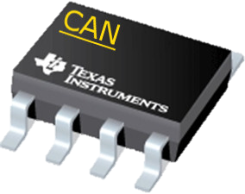
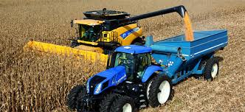
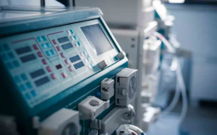
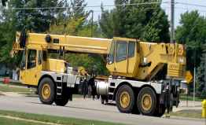
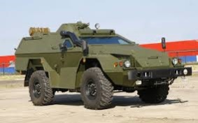

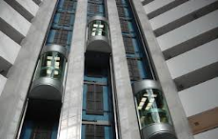
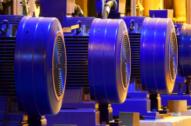
End Applications for CAN
Automotive
Networked
Sensors / Actuators
Robotics
Telecommunications
Industrial Automation
Mass Transit
Factory Automation /
Robotics
Farm Equipment
Medical
Construction Equipment
Military Vehicles
Building Automation
Elevators / Lifts
Motor/Motion Control

Slide 5
3.3V CAN Transceivers

Slide 6
Top 5 reasons to move to 3.3V CAN
1. Customers and uC providers are quickly moving to 3.3V solutions
2. 3.3V and 5V CAN transceivers are fully interoperable
3. Reduce BOM, board space and cost
4. At least 33% less power consumption
5. 3.3V package pinouts are compatible with 5V devices

Slide 7
TCAN330 / 332 / 334 / 337
3.3V Industrial CAN Transceivers
Features
Benefits
ISO 11898-2 Compatible
Common-Mode Range: ±12V
Speed: 1Mbps (standard), 5Mbps (optional)
Protection Features:
  ±14V Bus-Fault Protection
  ±25kV HBM ESD Protection
  ±12kV IEC61000-4-2 Contact Discharge
  Special Features: FAULT output pin for fault indication to host processor (TCAN337)
  RXD & TXD Dominant State Time Outs
Packages:
  SOT23-8 (3mm x 3mm)
  SOIC-8 (5mm x 6mm)
Direct interface to 3.3V MCU's and DSPs with simplified system voltage rails and regulation design
3.3V CAN requires less power and excellent for low power applications while still monitoring the bus
EMC Performance yields high reliability in harsh environments
Wide temp. range to accommodate harsh industrial environment
Small footprint SOT-23 package saves >70% PCB space
Footprint Replacement to MAX3051
  TCAN330: Shutdown and Silent Modes
  TCAN332: Normal Mode Only
  TCAN334: Shutdown and Standby with Wake Modes
  TCAN337: Silent Mode
Applications
“Classic CAN Applications”: Supports CAN
Telecom & Backplanes
Factory Automation / Control
Smart Grid
Building Automation

Slide 8
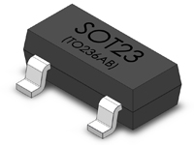
TI TCAN33x vs MAX3051
Drop-in TCAN33x provides higher performance with no risk
Vendor | Texas Instruments | Texas Instruments | Maxim
Part Number | TCAN33x | HVD232 | MAX3051
Packages | SOIC, SOT23 | SOIC | SOIC, SOT23
Ambient Temperature | -40 to 125° C | -40 to 85° C | -40 to 85° C
Supply Range | 3.0 to 3.6V | 3.0 to 3.6V | 3.135 to 3.465V
Standoff | ±14V | -4V to 16V | -7.5 to +12V
Common Mode Range | ±12V | -2V to 7V | -7 to +12V
TXD & RXD Dominant State Timeouts | TXD and RXD | None | None
Bus IEC ESD Protection | ±12kV | None | None
Bus HBM ESD Protection | ±25kV | ±16kV | ±12kV
Flexible Data Rate | 1Mbps (5Mbps – opt) | 1Mbps | 1Mbps
Icc Standby Current | <15µA (with wake) <1µA(without wake) | <1µA(without wake) | <15µA (with wake) <1µA(without wake)
More Robust
Saves Cost
Faster
IEC ESD Protection allows customer to save cost by removing protection diodes
2x Data Rate allows for faster communication in the future
Wider Standoff allows for more robust designs
Wider Common Range allows for more robust designs

Slide 9
SN65HVD230/231/232
3.3V Industrial CAN Transceivers with High Bus-Fault Protection
Features
Benefits
ISO 11898-2 Compatible
Common-Mode Range: -2 to +7V
Protection Features:
  -4 to +16V Bus-Fault Protection
  ±16kV HBM ESD Protection
  ±16kV IEC61000-4-2 Contact Discharge
Specialized Modes:
  SN65HVD230: Low Power Standby Mode with bus monitoring and Slope Control Mode
  SN65HVD231: Sleep Mode (40nA typ.)
  and Slope Control Mode
  SN65HVD232: Normal Mode Only
Temperature Range: –40° to +125°C
Package: SOIC-8 (5mm x 6mm)
Easy transition path to 3.3V CAN transceiver from 5V CAN transceiver systems
3.3V CAN requires less power
Interoperable with 5V CAN standard physical layer
Direct interface to 3.3V MCU's and DSPs. Simplified system voltage rails and regulation design
High reliability in harsh environments
Excellent for low power applications while still monitoring the bus
Footprint Replacement to MAX3051
SN65HVD230/231
SN65HVD232
TXD
GND
V_{CC}
RXD
Rs
CANH
CANL
Vref
TXD
GND
V_{CC}
RXD
NC
CANH
CANL
NC
Applications
Industrial
Transportation
Construction
Computing and Telecom
V_{CC}/2

Slide 10
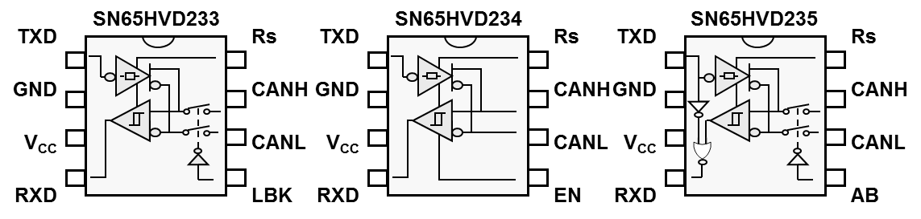
SN65HVD233/234/235
3.3V High Speed CAN Transceivers with High Bus-Fault Protection
Features
Benefits
ISO 11898-2 Compatible
Common-Mode Range: -7 to +12V
Protection Features:
  ±36V Bus-Fault Protection
  ±16kV HBM ESD Protection
Specialized Modes:
  SN65HVD233: Loop-back for diagnostics & Standby Mode and Slope Control Mode
  SN65HVD234: Sleep Mode, Standby Mode, and Slope Control Mode
  SN65HVD235: Auto-baud Loop-back & Standby Mode and Slope Control Mode
Temperature Range: –40° to +125°C
Package: SOIC-8 (5mm x 6mm)
Easy transition path to 3.3V CAN transceiver from 5V CAN transceiver systems
3.3V CAN requires less power
Interoperable with 5V CAN standard physical layer
Direct interface to 3.3V MCU's and DSPs. Simplified system voltage rails and regulation design.
High reliability in harsh environments
Excellent for low power applications while still monitoring the bus
Footprint Replacement to MAX3051
Applications
Industrial
Transportation
Construction
Computing and Telecom

Slide 11

3.3V CAN Portfolio
 | SN65HVD230 SN65HVD231 SN65HVD232 | SN65HVD233 SN65HVD234 SN65HVD235 | TCAN330 TCAN332 TCAN334 TCAN337 | TCAN330G TCAN332G TCAN334G TCAN337G
CAN / CAN FD | CAN | CAN | CAN | CAN FD
Data Rate | 1Mbps | 1Mbps | 1Mbps | 5Mbps
Common mode range | -2 to 7V | -7 to 12V | -12 to 12V | -12 to 12V
Bus pin fault protection | -4 to 16V | -36 to 36V | -14 to 14V | -14 to 14V
ESD protection | ±16kV HBM | ±16kV HBM | ±25kV HBM | ±25kV HBM
IEC-61000-4-2 ESD (C/D) | N/A | N/A | ±12kV | ±12kV
Enhanced features | Slope Control | Slope Control, Loopback, Autobaud, | Short Prop Delay, Fault Indication | Short Prop Delay, Fault Indication
Low Power Modes | Standby, Sleep, or none | Standby, Sleep | Silent, Standby, Shutdown | Silent, Standby, Shutdown
Temperature | -40 to 125C (Q) | -40 to 125C | -40 to 125C | -40 to 125C
Automotive Qualified | ✓ | ✓
Package | 8-pin SOIC (5x4mm) | 8-pin SOIC (5x4mm) | 8-pin SOIC (5x4mm) 8-pin SOT23 (3x3mm) | 8-pin SOIC (5x4mm) 8-pin SOT23 (3x3mm)
Lowest 1K Price | $0.70 | $0.95 | $0.69 | $0.83
Feature
Device

Slide 12
5V CAN Transceivers

Slide 13
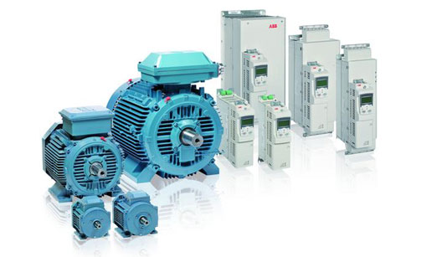
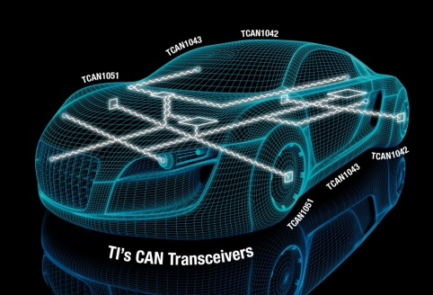
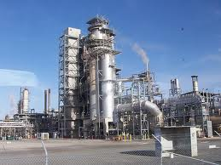
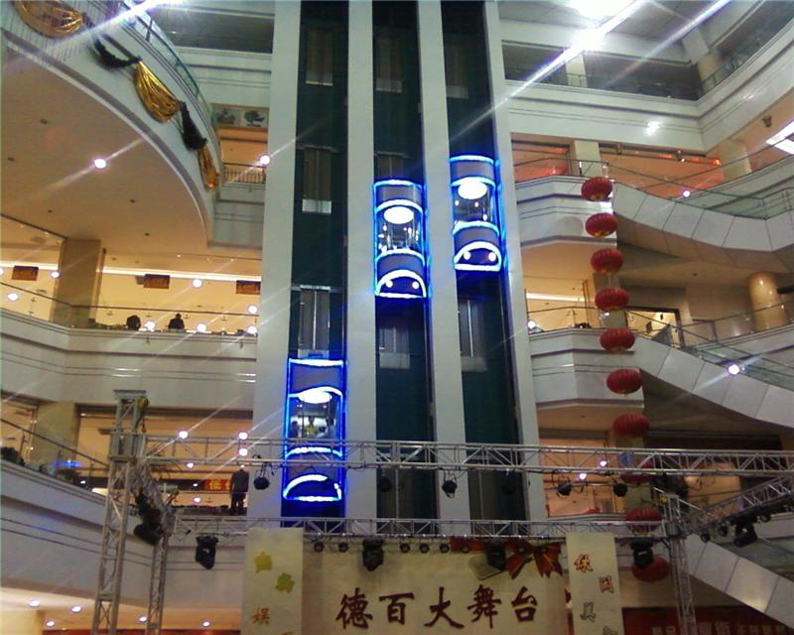
TCAN Ideal for Automotive and Industrial Applications
High Immunity: Deterministic communication in electromagnetic noisy applications
Automotive: Communicate while switching on GPS
Industrial: Communicate while switching on AC motor in Motor Drive applications
Low Emissions: Reduced electromagnetic noise emission enabling more reliable system communications
Automotive: Reduce interference with radio
Industrial: Reduce interference with communications equipment
Fault Protected: Protection against short circuits to high voltage power supplies
Automotive: Short Circuit to 48V battery vehicles
Industrial: Short Circuit to 24V DC power supplies
Fast Operation: 5Mbps operation for high bandwidth applications; faster downloads; faster communication
Automotive: Faster programing during manufacturing or diagnostics during repair
Industrial: Faster communication between systems
System Flexibility: Low loop delay for long or crowded network designs
Automotive: Design margin for adding isolation
Industrial: maintain speeds on highly loaded or long cable runs
Low BOM: No external TVS diodes, No common mode choke per system design
Automotive: Passes US/EU OEM Requirements
Industrial: IEC 61000-4-2 ESD protection

Slide 14
TCAN1042H / TCAN1051H
± 70V CAN XCVRs with optional Bus Wake Up and Flexible Data (FD)
Features
Benefits
ISO 11898-2 and -5 compliant and Draft CAN FD
Signaling Rate Optimized for up to:
  Standard: 2Mbps
  CAN FD: 5Mbps (“G” Version)
DC Bus-Fault Protection: ± 70V (“H”)
Common mode range: ±30V
Fast Loop Times: <175ns
V_{IO} Supply: 2.8 - 5.5V (“V” version)
Ultra-Low Power Standby Mode with Bus Wakeup (TCAN1042)
Low Power Silent Mode (TCAN1051)
±16kV HBM ESD and ±15kV IEC for bus pins
Ideal Passive – High impedance I/Os when unpowered
TXD dominant state time out
Under-voltage Protection
Thermal Shutdown
Package: 8-SOIC (D) 5mm x 4mm and 8-VSON (DRB) 3mm x 3mm
Common Mode Choke not required (per OEM)
Wide V_{CC} Range (4.5V to 5.5V) for start/stop w/out boost
  Wide I/O voltage level adapting reduces external components
  Extended Bus-Fault Protection supporting 48V systems
  Hot swap support with glitch free bus I/O on power-up / down
  Industry Standard Packaging: P2P compatible
TCAN10xxHGV
xx = numerical part number
H = ±70V Bus Fault Protection
G = 5Mbps Flexible Data Rate Capable
V = 3V Level Shifter Integrated (V_{IO} pin)
TCAN1051
TCAN1042
TXD
S
TXD
STB
Applications
DTO
DTO
GND
CANH
GND
CANH
Body Electronics
Power Train
Infotainment / ADAS
Building Automation
Factory Automation
V_{CC}
CANL
V_{CC}
CANL
M
U
X
WU
RXD
NC/V_{IO}
RXD
NC/V_{IO}

Slide 15
TCAN1042-Q1 / TCAN1051-Q1
± 70V CAN XCVRs with optional Bus Wake Up and Flexible Data (FD)
Features
Benefits
ISO 11898-2 and -5 compliant and Draft CAN FD
Signaling Rate Optimized for up to:
  Standard: 2Mbps
  CAN FD: 5Mbps (“G” Version)
DC Bus-Fault Protection: ±58V, ± 70V (“H”)
Common mode range: ±30V
Fast Loop Times: <175ns
V_{IO} Supply: 2.8 - 5.5V (“V” version)
Ultra-Low Power Standby Mode with Bus Wakeup (TCAN1042)
Low Power Silent Mode (TCAN1051)
±16kV HBM ESD and ±15kV IEC for bus pins
Ideal Passive – High impedance I/Os when unpowered
TXD dominant state time out
Under-voltage Protection
Thermal Shutdown
Package: 8-SOIC (D) 5mm x 4mm and 8-VSON (DRB) 3mm x 3mm
Common Mode Choke not required (per OEM)
Wide V_{CC} Range (4.5V to 5.5V) for start/stop w/out boost
  Wide I/O voltage level adapting reduces external components
  Extended Bus-Fault Protection supporting 48V systems
  Hot swap support with glitch free bus I/O on power-up / down
  Industry Standard Packaging: P2P compatible
TCAN10xxHGV
xx = numerical part number
H = ±70V Bus Fault Protection
G = 5Mbps Flexible Data Rate Capable
V = 3V Level Shifter Integrated (V_{IO} pin)
TCAN1051
TCAN1042
TXD
S
TXD
STB
Applications
DTO
DTO
GND
CANH
GND
CANH
Body Electronics
Power Train
Infotainment / ADAS
Building Automation
Factory Automation
V_{CC}
CANL
V_{CC}
CANL
M
U
X
WU
RXD
NC/V_{IO}
RXD
NC/V_{IO}

Slide 16
SN65HVD255/256
5V “Turbo” CAN Transceivers
Features
Benefits
ISO 11898-2 Compliant
“Turbo” CAN:
  Signaling Rates: 9.4Kbps to 1Mbps
  Short Propagation Delay Time (40ns Typical)
  Fast Loop Time (<150ns)
  Ideal Passive – High impedance I/Os when unpowered
Common-Mode Range: -2 to 7V
Protection Features:
  -27V to +40V Bus-Fault Protection
  ±12kV HBM ESD Protection
  TXD Dominant Time-out Protection
Digital I/O: TTL input thresholds for 3V µC (TXD, S)
  SN65HVD255: 5V V_{CC} (RXD output 5V)
  SN65HVD256: 5V V_{CC} & V_{RXD} from 2.8V to 5.5V
Temperature Range: -40° to +125°C
Package: SOIC-8 (5mm x 6mm)
Compliant with CAN physical layer standard
“Turbo” CAN: high data rates in long & loaded CAN Networks – adds timing margin for CAN systems
Extensive system fault protections in transceiver
  TXD Dominant Time-out Protection
  Unpowered device doesn’t load network or other system components
  Failsafe biasing for floating input pins
V_{RXD} input for level shifting RXD output voltage. (HVD256)
Footprint Replacement to PCA82C250 / 251, TJA1050 / 1051, SN65HVD251
SN65HVD255
SN65HVD256
TXD
GND
V_{CC}
RXD
S
CANH
CANL
NC
TXD
GND
V_{CC}
RXD
S
CANH
CANL
V_{RXD}
DTO
DTO
Applications
Industrial
Transportation
Construction
Computing and Telecom
Output
Buffer
Notes:
http://www.ti.com/lit/ds/symlink/sn65hvd255.pdf

Slide 17
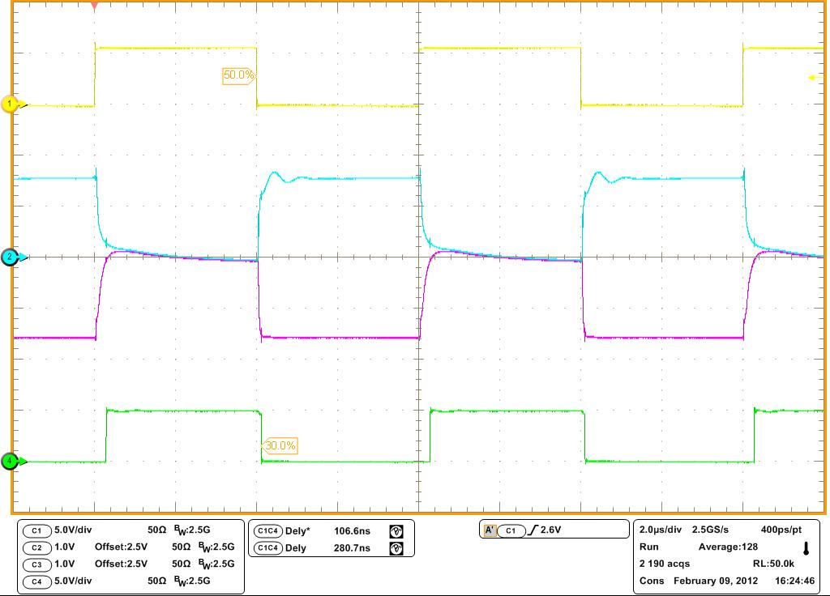
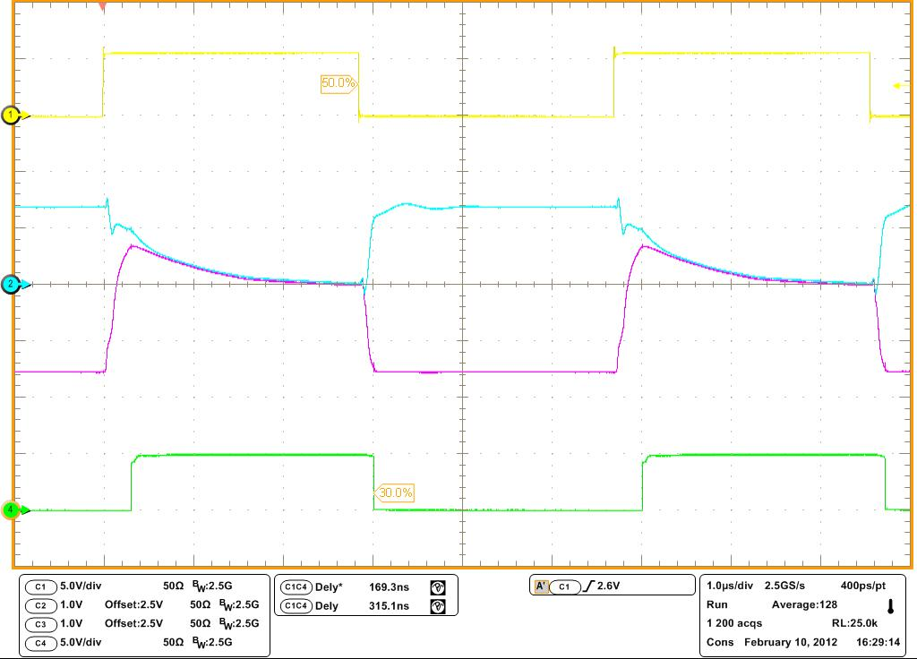
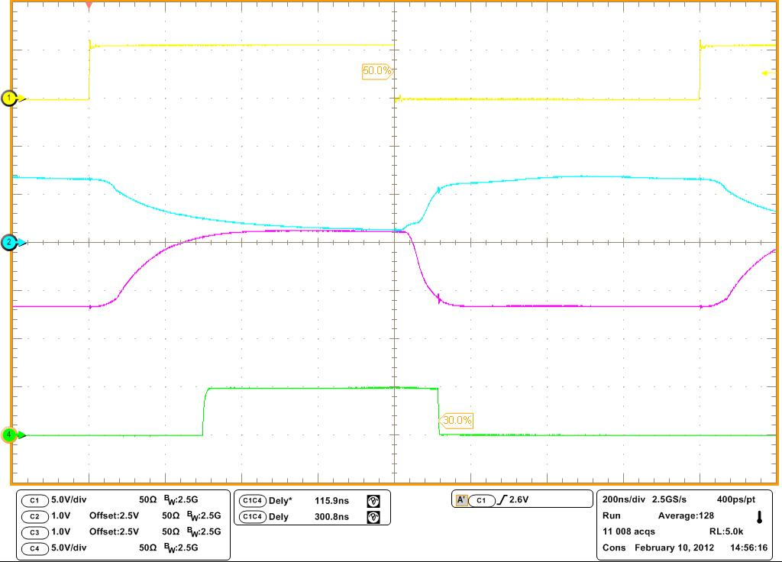
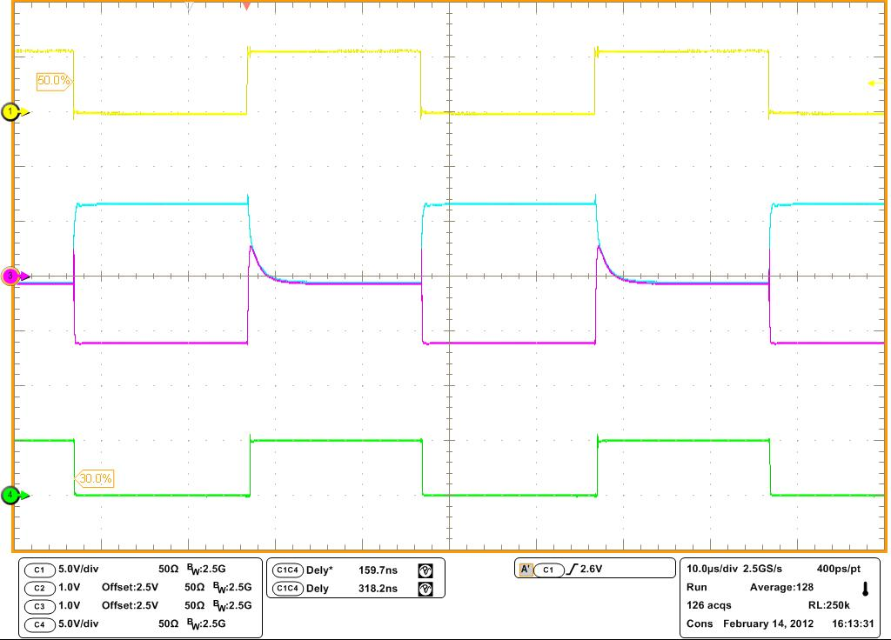
“Turbo CAN” Examples: R_{L} = 120Ω & 1nF
SN65HVD255
Loop time = 281ns
Competitor A
Loop time = 315ns
HVD255 “Turbo CAN”: maintains CAN timing margin, waveforms even under non-standard and far less ideal bus conditions
Competitor B
Loop time = 301ns
Competitor C
Loop time = 318ns

Slide 18
SN65HVD257: Functional Safety & Redundancy
5V “Turbo” CAN Transceiver for Redundant & Multi-Topology Networks
Features
Benefits
ISO 11898-2 Compliant
“Turbo” CAN:
  Signaling Rates: 9.4Kbps to 1Mbps
  Short Propagation Delay Time (40ns Typical)
  Fast Loop Time (<150ns)
  Ideal Passive – High impedance I/Os when unpowered
Common-Mode Range: -2 to 7V
Protection Features:
  -27V to +40V Bus-Fault Protection
  ±12kV HBM ESD Protection
  TXD Dominant Time-out Protection
  RXD Dominant Time-out Protection
  FAULT output pin for fault indication to host processor
Digital I/O: TTL input thresholds for 3V µC (TXD, S)
Temperature Range: -40° to +125°C
Package: SOIC-8 (5mm x 6mm)
Compliant with CAN physical layer standard
“Turbo” CAN: high data rates in long & loaded CAN Networks – adds timing margin for CAN systems
Extensive system fault protections in transceiver
  TXD and RXD Dominant Time-out Protection
  Unpowered device doesn’t load network or other system components
  Failsafe biasing for floating input pins
FAULT output for use in redundant & multi-topology CAN networks
Footprint Replacement to PCA82C250 / 251, TJA1050 / 1051, SN65HVD251
SN65HVD257
TXD
GND
V_{CC}
RXD
S
CANH
CANL
FAULT
DTO
Applications
Industrial
Transportation
Construction
Computing and Telecom
DTO

Slide 19
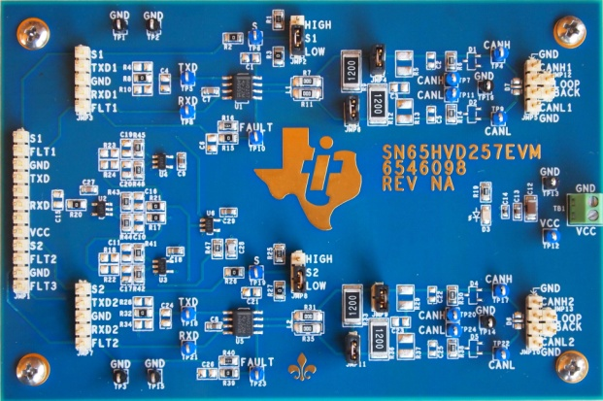
SN65HVD257: Redundant Network Example
SN65HVD257 Evaluation Module:
Configured for Redundant Network
http://www.ti.com/tool/sn65hvd257evm

Slide 20
SN65HVD257: Redundant Node
A parallel and redundant CAN network with fault detection is easily designed using the SN65HVD257
2 parallel HVD257 transceivers are used
TXDs are wired together so both busses will transmit in parallel
RXDs are logically combined via an AND gate which is logical equivalent of the bus operation
Parallelism is protected via the RXD DTO in the transceiver which will return an offending bus RXD output to recessive (high)
Direct faults with the transceiver or bus are indicated by HVD257 FAULT pin (TXD or RXD DTO, over temp, under voltage)
Bus Open Detection: to detect one of the buses having an open fault the RXDs are XORed logically with a filter (removes minor timing differences in busses). Together with s/w routine using silent mode the open bus may be determined
Redundant media network with only adding PHY circuit features, AND gate and duplicate wiring.
CAN works normally with this Network topology while offering full media redundancy and robust fault detection and identification

Slide 21
5V CAN Portfolio
 | TCAN1042 | TCAN1051 | SN65HVD25x | SN65HVD1040 SN65HVD1040A | SN65HVD1050 SN65HVD1050A
CAN / CAN FD | CAN FD | CAN FD | CAN - Turbo | CAN | CAN
Data Rate | 2Mbps or 5Mbps | 2Mbps or 5Mbps | 1Mbps | 1Mbps | 1Mbps
Common mode range | -30 to 30V | -30 to 30V | -7 to 12V | -12 to 12V | -12 to 12V
Bus pin fault protection | ±58 or ±70V | ±58 or ±70V | from -36 to 40V | -27 to 40V | -27 to 40V
ESD protection | ±16kV HBM | ±16kV HBM | up to ±14kV HBM | ±12kV HBM | ±4kV HBM
IEC-61000-4-2 ESD | ±15kV | ±15kV | up to ±8kV | ±6kV | N/A
Enhanced features | Bus wake up, EMC performance | Short prop delay, EMC Performance | Slope control, VIO/Vref Pins | Bus wake up, VIO pin (V) | Time-out circuit, VREF pin
Low Power Modes | Standby | Silent | Silent | Silent, Standby | Silent
Temperature | -55 to 125C | -55 to 125C | from -40 to 125C | -40 to 125C | from -55 to 125C
Automotive Qualified | ✓ | ✓ | ✓ | ✓ | ✓
Package | 8-pin SOIC (5x4mm) 8-pin VSON (3x3mm) | 8-pin SOIC (5x4mm) 8-pin VSON (3x3mm) | 8-pin SOIC (5x4mm) 8-pin PDIP (10x6mm) | 8-pin SOIC (2.6 x 5mm) | 8-pin SOIC (5x4mm)
Lowest 1K Price | $0.48 | $0.48 | $0.50 | $0.50 | $0.40
Feature
Device

Slide 22
CAN Transceivers Design Resources

Slide 23
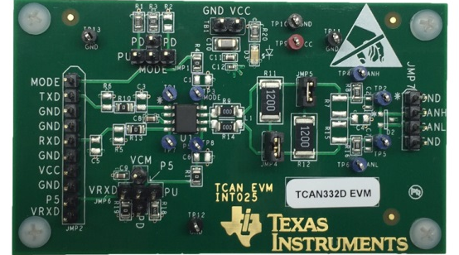
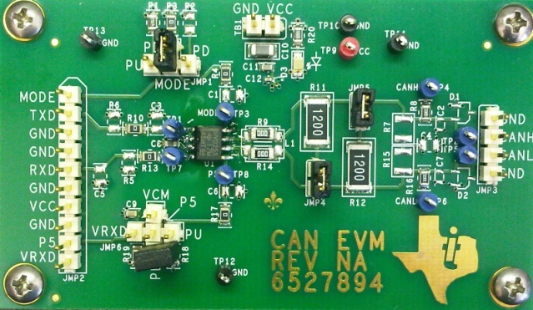

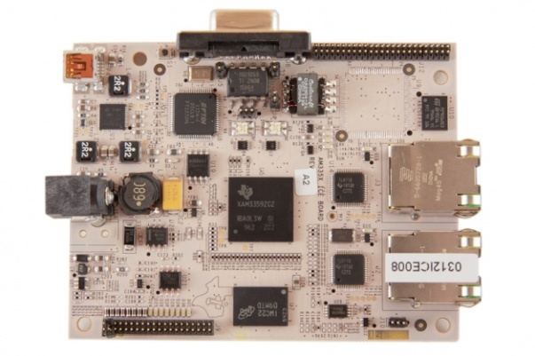
Evaluation Boards and Reference Designs
Evaluation Modules (Schematics, Layout, and BOM)
TCAN332D CAN EVM (TCAN332DEVM)
  3.3V CAN
  Dual Site Industrial EVM
TCAN1042D CAN EVM (TCAN1042DEVM)
  5V CAN
  CAN FD (2Mbps)
SN65HVD255 CAN EVM (SN65HVD255DEVM)
  General CAN EVM – HVD255 pre-installed
  Configurable to support all TI SN65HVD25x, HVD23x and HVD10x0 CAN transceivers
SN65HVD257 CAN EVM (SN65HVD257EVM)
  2x HVD257 installed and EVM configured to support redundant / parallel CAN networks
  Configurable to support 2 independent CAN channels
ISO1050 Isolated CAN EVM (ISO1050EVM)
TI Reference Design Schematics and Links
Sitara™ AM3359 Industrial Communications Engine (ICE)
Hercules™ TMS570LS31x Development Kit
SN65HVD255 EVM
(General CAN EVM)
TCAN332D EVM
(Dual Site Industrial
CAN EVM)
AM3359 Industrial
Communications Engine (ICE)
SN65HVD257 EVM
(Redundant CAN and 2 CAN channel EVM)
Notes:
23
23

Slide 24
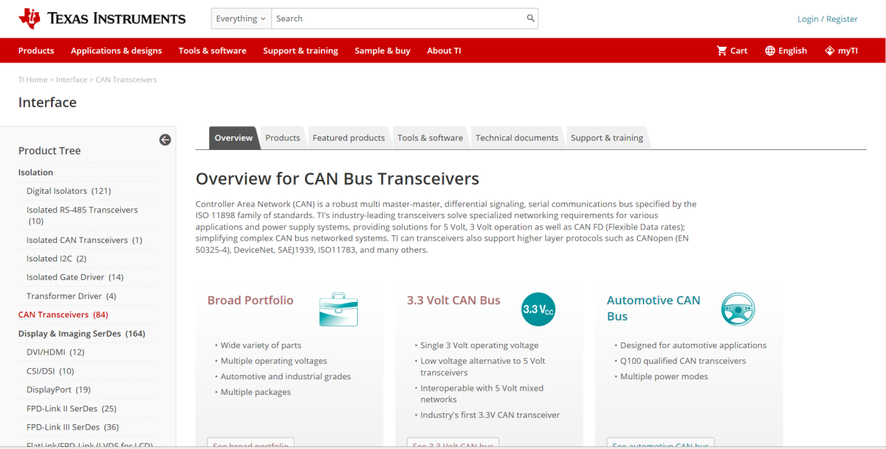
Resources: www.ti.com/can
Design Resources:
  Selection Tables
  Application Notes
  Evaluation Boards
  Reference Boards
  Competitor Cross Ref
  Models
  Videos
  and more!
Delivering MORE Together - TI’s Engineer to Engineer Community:
  http://e2e.ti.com
Notes:
24
24

Slide 25
CAN application notes
SLOA101A: Introduction to the Controller Area Network (CAN)
SLLA270: Controller Area Network Physical Layer Requirements
SLLA337: Overview of 3.3V CAN (Controller Area Network) Transceivers
SLLA271: Common Mode Chokes in CAN Networks: Source of Unexpected Transients
SLLA279A: Critical Spacing of CAN Bus Connections
SLLA109: A System Evaluation of CAN Transceivers
SLLA123: Using CAN Arbitration for Electrical Layer Testing
SLLA298B: Isolated CAN Reference Design
SLLA107: Live Insertion With Differential Interface Products
SLLA067B: Comparing Bus Solutions
Article: “Signaling rate versus cable length: the CAN-bus timing trade-off” – CAN loop timing and arbitration
Blog: TI Analog Wire, “How "CAN" you make safe circuits safer? Redundancy!”
Blog: TI Analog Wire, “The need for speed - Turbo Charged CAN”
Titles are hyperlinked to www.ti.com for download

Slide 26
Thank you

Slide 27
Backup

Slide 28
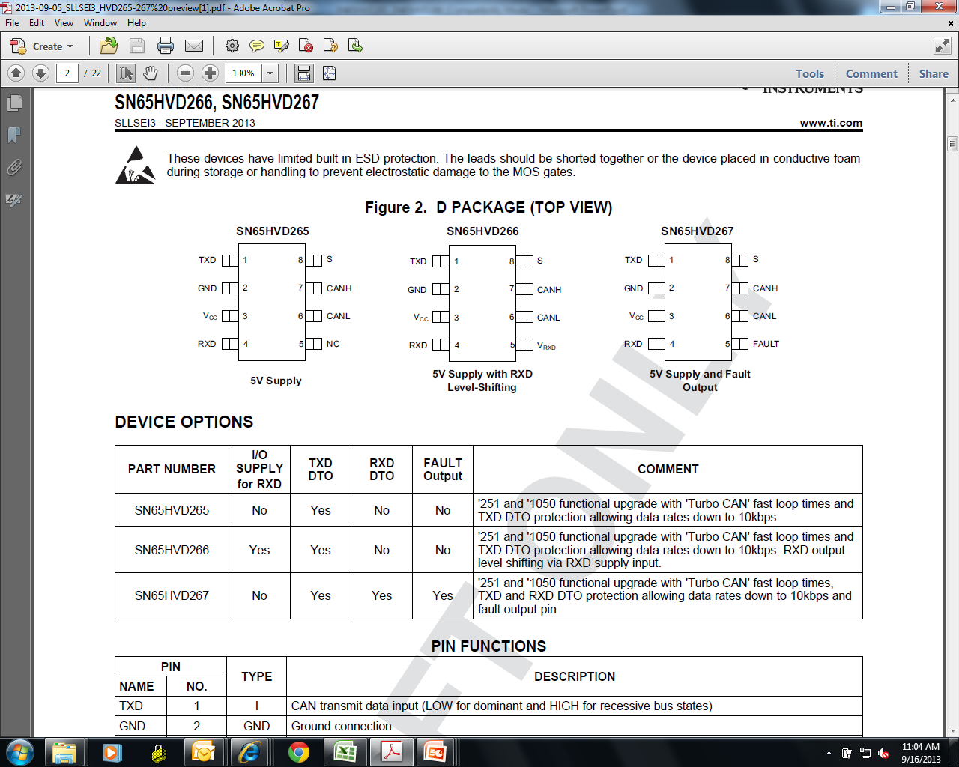
SN65HVD265/SN65HVD266
5V “Turbo” CAN Transceivers for Flexible Data Rate (FD)
Features
Benefits
ISO 11898-2 Compliant and Draft CAN FD
“Turbo” CAN:
  Signaling Rates: 8Kbps to 2Mbps CAN with Flexible Data Rate
Ideal Passive – High impedance I/Os when unpowered
Common-Mode Range: -2 to 7V
Protection Features:
  -27V to +40V Bus-Fault Protection
  ±12kV HBM ESD and ±8kV IEC ESD Protection
    TXD Dominant State Time-out
  3.3V RXD Output Option (266)
  Temperature Range: -40° to +125°C
  Package: SOIC-8 (5mm x 6mm)
Compliant to new ISO 11898-2 timing requirements for use in 2Mbps CAN FD applications
Compliant with CAN standard physical layer
No loading on the network or other system components
Ability to operate at data rates down to 10kbps
Extensive system fault protections in transceiver
HVD266: Fully CAN compliant (5V) with 3.3V MCU support
Applications
Up to 2Mbps CAN FD applications
Highly loaded CAN networks
Industrial Automation
Building & Climate Control Automation
Security Systems
Telecom Base Station Status and Control
CAN Bus standards such as CANopen, DeviceNet, NMEA2000

Slide 29
SN65HVD267
5V “Turbo” CAN Transceivers for Flexible Data Rate (FD) & Redundancy
Features
Benefits
ISO 11898-2 Compliant and Draft CAN FD
“Turbo” CAN:
  Signaling Rates: 8Kbps to 2Mbps CAN with Flexible Data Rate
Ideal Passive – High impedance I/Os when unpowered
Common-Mode Range: -2 to 7V
Protection Features:
  -27V to +40V Bus-Fault Protection
  ±12kV HBM ESD and ±8kV IEC ESD Protection
    TXD Dominant State Time-out
    RXD Dominant State Time-out
    FAULT output pin for fault indication to host processor
  Temperature Range: -40° to +125°C
  Package: SOIC-8 (5mm x 6mm)
Compliant to new ISO 11898-2 timing requirements for use in 2Mbps CAN FD applications
Compliant with CAN standard physical layer
No loading on the network or other system components
Ability to operate at data rates down to 10kbps
Extensive system fault protections in transceiver
Adds timing margin for CAN systems
Enables use in redundant & multi-topology CAN networks
SN65HVD267
Applications
Up to 2Mbps CAN FD applications
Highly loaded CAN networks
Industrial Automation
Building & Climate Control Automation
Security Systems
Telecom Base Station Status and Control
CAN Bus standards such as CANopen, DeviceNet, NMEA2000
Functional Safety With Redundant and Multi-topology CAN networks

Slide 30
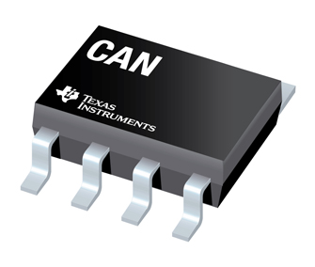

SN65HVD251 / SN55HVD251
5V High Speed CAN Transceiver
Features
Benefits
ISO 11898-2 Compliant
Signaling Rate Optimized for up to: 1Mbps
Common-Mode Range: -7 to +12V
Protection Features:
  ±36V Bus-Fault Protection
  ±14kV HBM ESD Protection
Specialized Modes:
  High-Speed Mode via R_{S} pin
  Slope Control Mode via R_{S} pin
  Standby Mode with bus monitoring
  SN65HVD251 Option:
    Temperature range: -40° to +125°C
  Package: SOIC-8 (D) and PDIP-8 (P)
SN55HVD251 Option:
  Extended Temperature Range: -55° to +125°C
  Small Package: SON-8 (DRJ) (4mm x 4mm)
  Compliant with CAN physical layer standard
  High reliability in harsh environments
  Excellent for low power applications while still monitoring the bus
  Small package option available (>40% PCB savings)
  Extended Temperature Range option available
  Footprint Replacement to PCA82C250 / 251
SNx5HVD251
TXD
GND
V_{CC}
RXD
R_{S}
CANH
CANL
V_{REF}
Applications
Industrial
Transportation
Construction
Computing and Telecom
V_{CC}/2

Slide 31
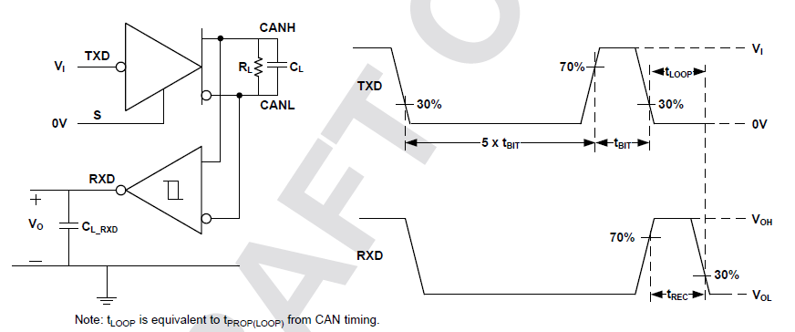
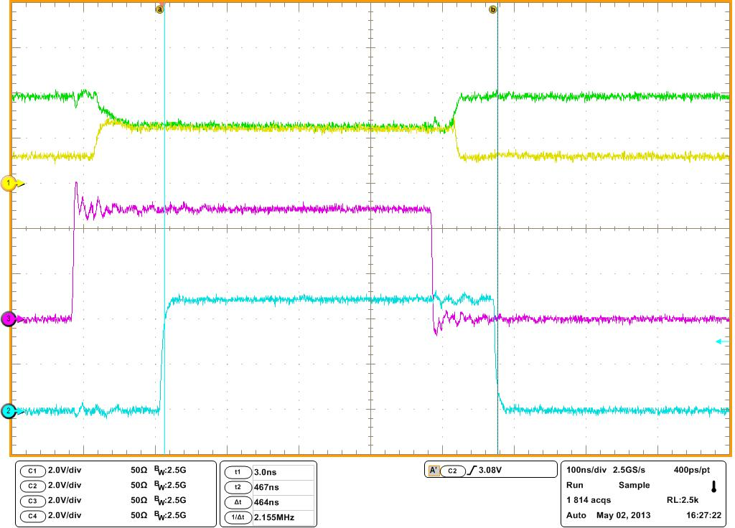
HVD26x: Specified for CAN FD Loop Delay Symmetry (t_{REC})
Draft Standard: Test Circuit and Spec
CAN FD Proposed Limits @ 2Mbps:
550ns > t_{REC} > 400ns
Bit time = 500ns
Tested with 5 dominant bit times then 1 recessive bit time
SN65HVD26x: specified to meet these requirements of CAN FD 2Mbps

Slide 32
SN65HVDA540/541
CAN XCVRs with Remote Bus Wake-Up
Features
Benefits
ISO 11898-2 and -5 Compliant
Ultra-Low Power Standby Mode
  Remote wake-up available (541)
  Only V_{IO} Supply Needed in STB Mode (541)
V_{IO} Supply: 3 to 5.33V
Ideal Passive – High impedance I/Os when unpowered
  Common-Mode Range: ±12V
Protection Features:
  -27V to +40V Bus-Fault Protection
  ±12kV HBM ESD Protection
  Under-voltage Protection on both V_{CC} and V_{IO}
  Thermal shutdown protection
  TXD dominant state time-out
Package: SOIC-8 (D) (5mm x 6mm)
Wide V_{CC} Range (4.68V → 5.33V)
Only single supply needed for low power mode (541)
  Wide I/O Voltage Level Adapting from 3.0V to 5.33V (541)
  Industry Standard Packaging: Pin to pin compatible
HVDA540
TXD
GND
V_{CC}
RXD
STB
CANH
CANL
V_{IO}
DTO
Applications
Industrial
Transportation
Construction
Computing and Telecom
M
U
X
*
* Wake Up Receiver

Slide 33
SN65HVD1040/1050
5V CAN Transceivers: EMC Optimized, Ultra-low Power Bus Wake-up
Features
Benefits
ISO 11898-2 (1050) and -2&-5 (1040) Compliant
High Electromagnetic Compatibility (EMC) Performance
SPLIT / V_{REF} Pin for stabilizing common-mode voltage
Common-Mode Range: ±12V
Protection Features:
  -27V to +40V Bus-Fault Protection
  ±12kV HBM ESD and ±6kV IEC ESD Protection
  TXD Dominant Time-out Protection
Specialized Modes:
  SN65HVD1050: Silent Mode (Listen only) for bus diagnostics
  SN65HVD1040: Ultra-low power standby with bus wake-up
Digital I/O: Digital Inputs 3V compatible (TXD, S)
  Temperature range: -40° to +125°C
Package: SOIC-8 (D) (5mm x 6mm) (1040 & 1050)
  Compliant with CAN physical layer standard
  High reliability in harsh environments
  Low interference with other devices
  Protection against hardware and software bus blocking faults
  Footprint Replacement to PCA82C250 / 251, TJA1050/1051/1057/1040/1042/1044
SN65HVD1050
SN65HVD1040
TXD
GND
V_{CC}
RXD
S
CANH
CANL
V_{REF}
TXD
GND
V_{CC}
RXD
STB
CANH
CANL
SPLIT
DTO
DTO
Applications
  Industrial
  Transportation
  Construction
  Computing and Telecom
M
U
X
WU
V_{CC}/2
V_{CC}/2

Slide 34
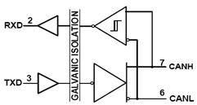
ISO1050
Industry’s First Isolated CAN Transceiver
Features
Benefits
Meets or Exceeds ISO 11898-2 Standard
5V Supply Voltage
Common-Mode Range: ±12V
Protection Features:
  -27 to +40V Bus-Fault Protection
  ±4kV HBM ESD Protection
Silicon Integrated SiO₂ Insulation
  4kV_{PK} / 2.5kV_{RMS} – DUB
  7kV_{PK} / 5kV_{RMS} – DW
Fast Loop Time (150ns) (Typical)
Packages:
  SOP-8 (10.5mm x 9.5mm)
  SOIC-16 (10.6mm x 10.5mm)
Compliant with CAN standard physical layer
Reduce Components and Board Space - 30%
Isolated CAN with short loop time allowing higher data rates in network, even with isolation
Meets DeviceNet and CAN timing requirements
High Speed Isolation allows longer buses – 34%
Proven Reliability of SiO2 Insulation, Stable over
Time, Temperature & Moisture
  Life Span > 25 years @ 105oC
Part # | Isolation | Temp (C) | Package
ISO1050DUB | 4kV_{PK} / 2.5kV_{RMS} | -55 to 105 | SOP-8
ISO1050DW | 7kV_{PK} / 5kV_{RMS} | -55 to 105 | SOIC-16
Applications
Medical – ISO1050DW
Motor Control
Industrial Automation
DeviceNetTM Data Buses
SAE J1939 Standard Data Bus Interface
ISO 11783 Standard Data Bus Interface
NMEA 2000 Standard Data Bus Interface
Compatible with 75+ TI Processers with CAN controllers : C2000, TMS470 ARM, LM3Sxxxx ARM3 Cortex - M3, OMAP3505/3517

Slide 35
Galvanic Isolated Typical Application
Optimized Isolated CAN system
Easy system integration
Optimized isolated CAN transceiver:
  Meets ISO11898-2 including galvanic isolation
  Isolated CAN with fast loop time (<210ns, ISO1050) offsets loop delay from isolation layer allow high data rate isolated CAN networks.
High efficiency transformer driver to power CAN transceiver (or reverse if power from bus side) to minimize power losses

Slide 36
3.3V CAN Value

Slide 37
Customers are moving to 3V today
3V microcontrollers (MCUs) availability and use in industrial markets are growing at a rate higher than 5V (figure 1)
3V CAN transceivers are capitalizing on this growth (figure 2) due to the fact that they simplify the design and reduce the BOM and associated costs
figure 1
figure 2

Slide 38
Pinout / Layout Compatibility
3.3V CAN offers same modes of operation, pinouts, and features as 5V CAN
  Eliminates requirement for VIO (level shifting) pin
TXD
RS/STB/S
TXD
RS/STB/S
GND
3.3V
CANH
GND
5V
CANH
V_{CC}
CANL
V_{CC}
CANL
RXD
VREF/NC/
SHDN/FAULT
RXD
VREF/NC/
VIO/FAULT
Same Pins!
R_{S} = Slope Control /
Mode Select
S = Silent Mode
STB = Standby Mode
V_{REF} = V_{CC}/2 Output
FAULT = Fault Output
NC = No Connect
Same Modes!
Silent Mode
Standby Mode w/ Bus Wake
Slope Control Mode
Shutdown Mode
Sleep Mode
Same Features!
Fault Protection
IEC ESD Protection
CAN FD Optimization
Fast Loop Delay
Under-voltage Protection
Thermal Shutdown Protection
TXD/RXD Dominant Timeout

Slide 39
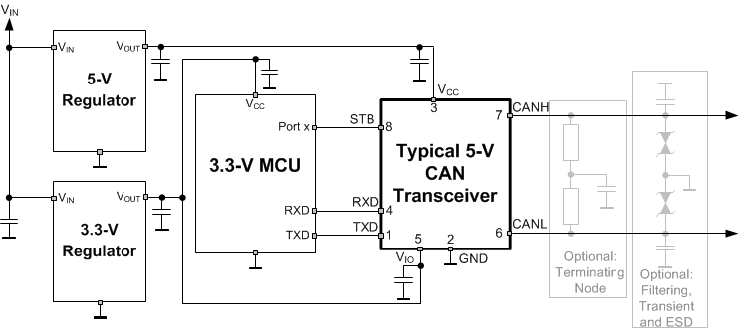
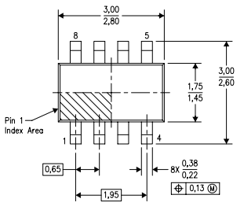
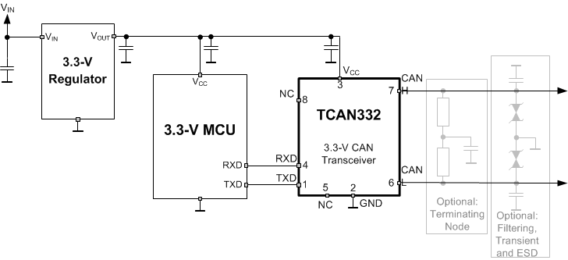
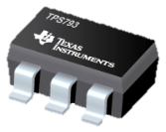
3.3V CAN reduces BOM, space, and cost
Available in a small 3mm x 3mm, 8-pin SOT package
Can save 70% (22mm²) when compared to standard 5V SOIC package
5V Regulator available in a
2.90mm x 1.60mm 6-pin,
SOT package
Can save another 4.64mm2 by utilizing 3.3V CAN transceiver
5V Regulator:
TPS79301
Eliminates the device, placement, and test
costs of a 5V regulator
Reduces PCB space by up to 75%
Reduces BOM ~$0.24!
Save over 26mm² of PCB space
Notes:
For more information on the TI TPS79301…
See Datasheet:
http://www.ti.com/lit/ds/symlink/tps793.pdf

Slide 40
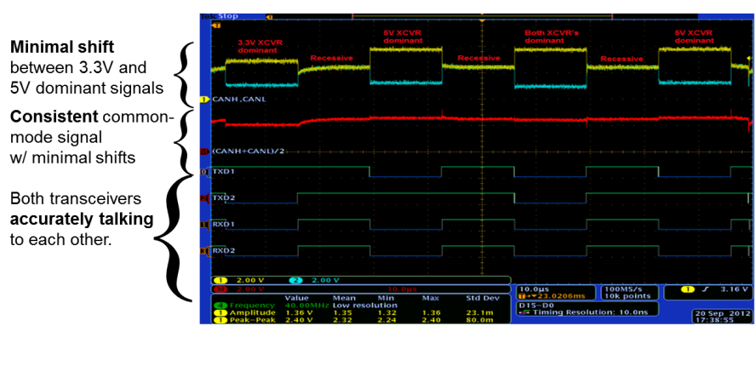
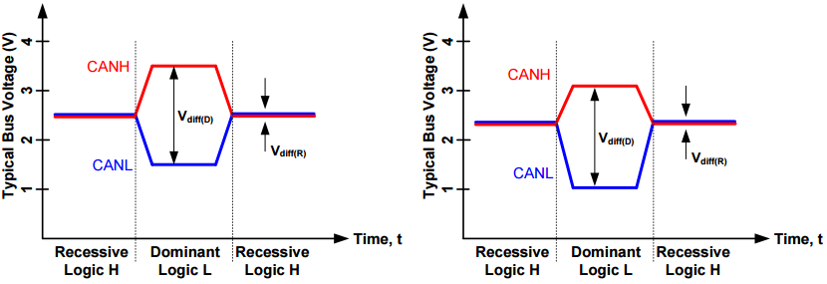
3.3V & 5V CAN Interoperability
3.3V CAN transceivers are fully interoperable with 5V CAN transceivers
  Same cable length, speed, or number of nodes as 5V CAN
Biased at similar voltage levels!
Meets CAN dominant differential minimum of 1.5V
Meets CAN recessive differential requirement of -120mV to +12mV
5V CAN
3.3V CAN
Typical CAN bus levels for 5V & 3.3V CAN transceivers
SN65HVD255 (TXD1/RXD1) and SN65HVD234 (TXD2/RXD2) on same bus
Meets ISO11898-2 & ISO11898-5 Common-Mode Requirement
Notes:
Designed with stronger output stages for similar driving performance as 5V CAN.
ISO11898-2 specifies the driver differential output with a 60 Ω load (two 120 Ω termination resistors in parallel) and the differential output must be greater than 1.5 V. 3.3V CAN devices are specified to meet the 1.5 V requirement with a 60 Ω load, and additionally specified with a differential output voltage minimum of 1.2 V across a common mode range of –2 V to 7 V via a 167 Ω coupling network
Application Note and PDF on Mixed Networks:
https://e2e.ti.com/support/interface/industrial_interface/f/142/t/230101

Slide 41
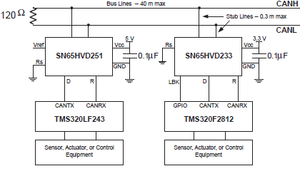
3.3V CAN reduces power consumption
Reduce transceiver power by >33% when compared to 5V CAN solutions
Lower voltage and lower current, in most cases
Feature |  | HVD255 | HVD234
Supply Voltage (V) |  | 5 | 3.3
Opposite States | Recessive ICC (mA) | 18.6 | 7.2
 | Dominant ICC (mA) | 61.8 | 38.6
SN65HVD255
SN65HVD234
5V & 3.3V CAN Transceivers Operating on Two-Node Bus
3.3V CAN solution results in
more efficient power consumption!
Notes:
For a 60Ω load to have 1.5V – 25mA has to go through it. Therefore, a 3.3V transceiver that drives 25mA uses 82.5mW of additional power, and a 5V transceiver uses 125mW of additional power. This means that from a driver perspective, less power (66% less) is dissipated in a 3.3V CAN driver, than a 5V CAN driver.

Slide 42
References
Type | Title / Link
Analog Wire Blog | Put ABHI blog link here
Application note | Overview of 3.3V CAN Transceivers
Application note | Introduction to the Controller Area Network (CAN)
Datasheet | TCAN33x 3.3-V CAN Trancsceivers with CAN FD
Reference Design | Non-Isolated Bi-Directional converter
Planet Analog Blog | Industrial Market Transitions to 3.3V CAN Transceivers
Training | Additional resources
www.ti.com/can

Slide 43
CAN Flexible Data Rate (FD)

Slide 44
What is CAN FD?
CAN with Flexible Data Rate (CAN FD) is a proposed enhancement to the CAN protocol (ISO11898-1).
Proposal from Bosch, outlined in Specification 1.0.
Has impact to the physical layer (transceivers) as data rates for the protocol are specified up to 20Mbps, which is 20x higher than the current CAN standard and transceivers.
Two key differences between CAN and CAN FD Protocol:
  Data Rate (Bit Time): CAN FD frames have the option to have separate data rates (bit times) for the arbitration portions and the data portions. Arbitration portions match CAN, however data has the option to jump to a second (higher) data rate.
  Data Field Length: CAN FD frames allow for data fields up to 64 bytes, 8x the 8 bytes allowed in CAN.

Slide 45
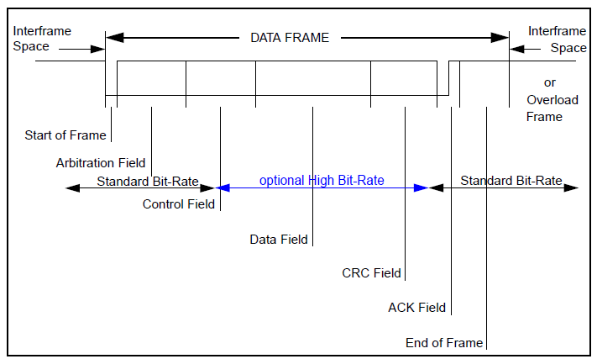
CAN with Flexible Data-Rate (“CAN FD”)
Submitted to ISO for working group consideration to become an addition to 11898-1 as of October 2012
Provides several updates to the CAN protocol and enhances the capability of CAN based communication:
  Bit rates in excess of 1mbps specified
  Data byte field expanded to support up to 64 bytes vs CAN’s 8 bytes, CRC updated to cover this expanded data byte field
  Arbitration and ACK phases unchanged, run at standard CAN bit rates
Source: Bosch, White Paper, Version 1.1, “CAN with Flexible Data-Rate”

Slide 46
Why do we need CAN FD?
Increased usable bandwidth
  CAN served the automotive and industrial markets well for 2 decades, however in certain applications bandwidth is running out. The option to increase data rate in the same network is very helpful.
  The 8 byte limitation in CAN frames is constraining for certain applications and adds overhead of multiple messages to get the necessary data across the network.
Lower Cost and Complexity
  CAN is a low cost, robust network system
  CAN FD adds low incremental cost to gain bandwidth
  CAN FD adds low incremental complexity to the network vs major changes such as FlexRay or Ethernet.
Fast Flash Programming
  CAN FD will open the pipe for end of line flash programming of modules and ECUs cutting manufacturing cost.

Slide 47
What Components are Impacted by FD?
CAN Controller (uP):
  Hardware changes may be limited to the CAN controller in the uP assuming a data rate above 1Mbps is never used
  CAN controller in the uP or protocol engine must be updated to the new CAN FD standard.
  Will be backward compatible to CAN, however original CAN controllers are not “forward” compatible to CAN FD.
  Highlights of changes in CAN controller
    Arbitration Field: determine and understand new use of reserved bits from CAN, new bit rate switch bit (2nd data rate) and longer DLC for up to 64 byte data fields.
    Mailboxes must support up to 64 byte data fields
    CRC (Cyclical Redundancy Check) polynomials are updated for CAN FD.
Physical Layer (PHY or Transceiver):
  Original CAN transceivers, cabling, connectors, protection circuitry meeting the CAN requirements for 1Mbps may all be used for CAN FD at up to 1Mbps. Just like CAN, CAN FD will scale down in data rates based on long cabling and high node count or loading.
  >1Mpbs CAN FD data rates may require changes
    Transceivers will require new and additional electrical timing requirements to guarantee proper operation above 1Mbps. 2Mbps bit timing and electrical specifications for transceivers are in working groups and draft status now.
    Cabling, connectors, protection circuitry: may require improvements to support higher data rates. Transmission line properties and parasitic impedance becomes much more critical at higher data rates. CAN in Automation has a working group for System Recommendations for CAN FD.

Slide 48
More Information on CAN FD
Bosch CAN FD 1.0 Spec: http://www.bosch-semiconductors.de/media/pdf_1/canliteratur/can_fd_spec.pdf
Bosch 13th International CAN Conference (iCC) 2012 Paper on CAN FD: http://www.bosch-semiconductors.de/media/pdf_1/canliteratur/icc13_paper_Hartwich.pdf
TI Analog Wire: The need for speed - Turbo Charged CAN: http://e2e.ti.com/blogs_/b/analogwire/archive/2013/07/30/the-need-for-speed-turbo-charged-can.aspx
TI 14th International CAN Conference (iCC) 2013 Paper on “Solutions of CAN and CAN FD in a mixed network topology” – waiting on CAN in Automation to upload papers to website.

