Slide 1
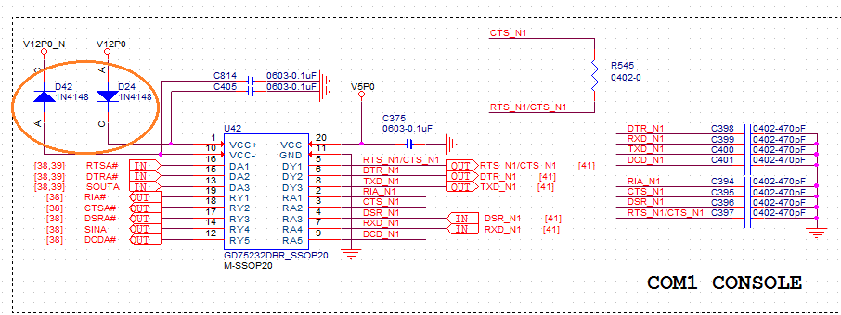
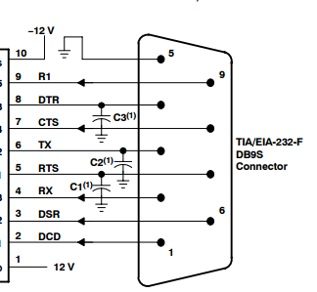
From ATX power
Need D42, D24 or not
Before GD75232DBR
After SN75185DBR
Com port RS-232 cable hook up to other device already

Slide 2
Left => SN75185DBR
Right =>GD75232DBR
CH1 +3.3V(ATX POWER)
CH2 DTR(PIN15)
CH3 VCC+(PIN1)
CH4 VCC-(PIN10)
Cause system fail to power-on

Slide 3
Issue
Whether the diode is needed or not? (D24, D42), could be replaced by 0 ohm?
What reason will cause DTR signal delay about 2ms

