Slide 1
LDO Thermal Performance
Kyle Van Renterghem
Applications Manager

Slide 2
Topics
JEDEC Standard
Using θja
Guidelines For Maximum Thermal Relief

Slide 3
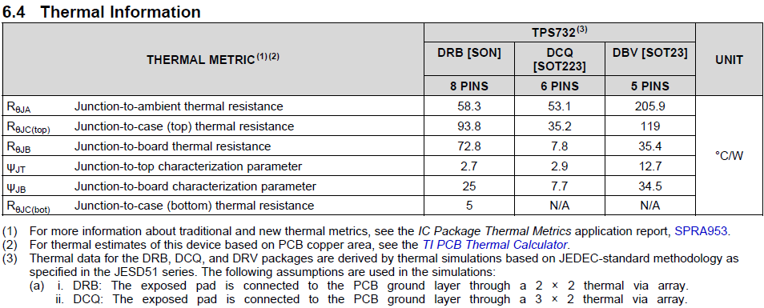
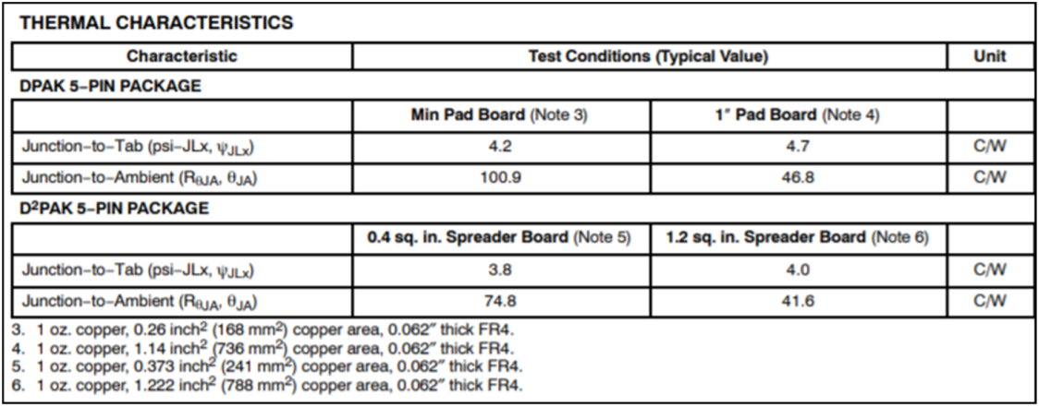
JEDEC Thermals
    Because an IC’s thermal dissipation is subject to many variables we use the JEDEC standard (JESD51) for all thermal modeling.
    The JEDEC standard is used so that devices can be easily compared on a similar basis.
      if a competitor is not reporting the JEDEC standard the customer should consider why they don’t want to be directly compared to other devices.
    Common thermal metrics: θ_{JA}, θ_{JB}, θ_{JC(top)}, θ_{JC(bot)}
TI Datasheet
Competitor Datasheet
28mm x 28mm area on the top side dedicated to only thermal dissipation?
Notes:
The junction-to-ambient thermal resistance, θ_{JA}, is the most commonly reported thermal metric and is often misused.
θ_{JA} is a measure of the thermal performance of an IC mounted on a PCB. TI uses a standard board so that the thermal performance of one device can be compared to another device.
However, comparisons are only possible when both devices use the same test setup to measure θ_{JA},
The industry standard is JEDEC’s JESD51-x series of documents.
Some competitors do not use the JEDEC conditions and the deviations from the standards are not documented.
These test variations can have a dramatic effect on the measured values of θ_{JA}.
So, unless test conditions are reported with the θ_{JA} value, they should be considered suspect.

Slide 4
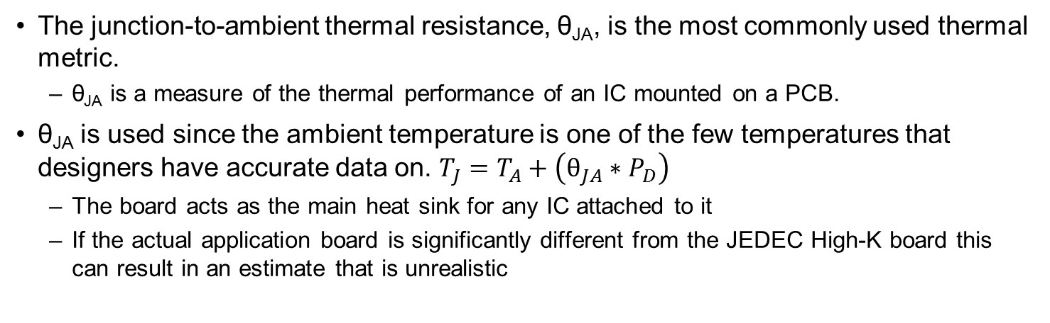
θ_{JA}: Understanding Usage and Limitations
The junction-to-ambient thermal resistance, θ_{JA}, is the most commonly used thermal metric.
  θ_{JA} is a measure of the thermal performance of an IC mounted on a PCB.
θ_{JA} is used since the ambient temperature is one of the few temperatures that designers have accurate data on. $T_{J}=T_{A}+\left(θ_{JA}∗P_{D}\right)$
  The board acts as the main heat sink for any IC attached to it
  If the actual application board is significantly different from the JEDEC High-K board this can result in an estimate that is unrealistic
Factors Affecting θja | Strength of Influence (rule of thumb) | Relation to θja
PCB design | Very Strong | The more metal connected to the IC the lower θja due to larger thermal mass
Chip or pad size | Strong | The larger the chip and thermal pad the lower θja due to heat spreading
Altitude | Medum | The lower the altitude the lower θja due to increased cooling efficiency of air
External ambient temperature | Weak | The higher the ambient temp the lower θja due to increased radiative heat transfer
Power dissipation | Very Weak | The higher the junction temp the lower θja due to increased heat transfer

Slide 5
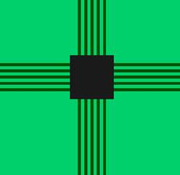
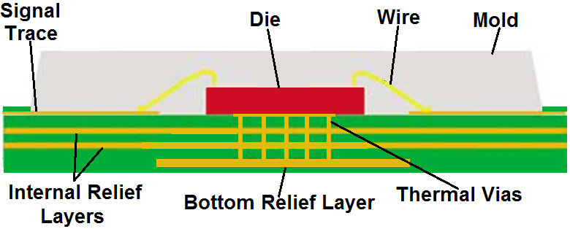
JEDEC High-K Board
    TI LDO thermal metrics are modeled using the JEDEC High-K Board (2s2p)
    The JEDEC High-K board has:
      Two internal planes which have ~5500mm² of 1oz copper (1 GND & 1 PWR plane)
      Bottom layer (opposite the IC) thermal relief layer which has ~1100mm² of 2oz copper
      One internal GND plane and bottom GND plane are connected to the thermal pad using as many thermal vias as can be fit within the power pad dimensions.
      The top layer only has traces running straight to the pins.
    The JEDEC high-k board is good but not 100% optimized for maximum thermal dissipation
TEST BOARD DESIGN | JEDEC HIGH-K 2s2p | JEDEC LOW-K 1s0p
Trace thickness | 0.0028 in
Trace length | 0.98 in
PCB thickness | 0.062 in
PCB width | 4 in
PCB length | 4.5 in
Power/ground plane thickness | 0.0014in (2 planes) | No internal copper planes

Slide 6
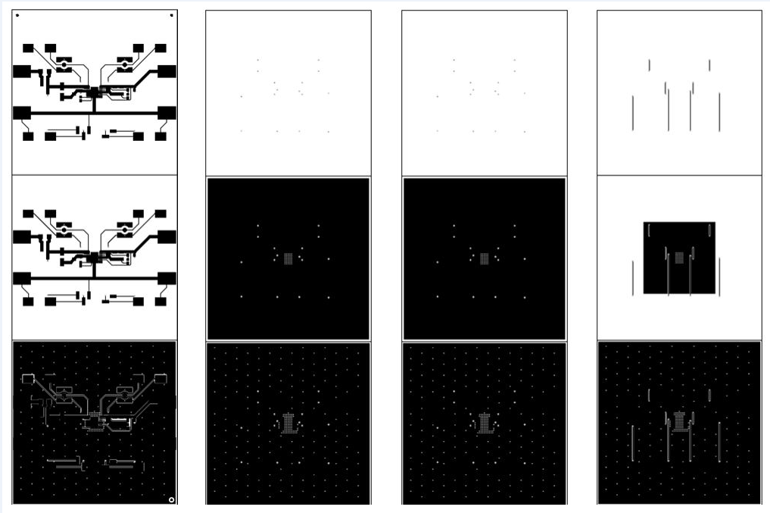
Guidelines For Maximum Thermal Relief
Have as much metal as possible in the areas around the device (on both the same layer and the layers below the IC)
  2oz copper is better than 1oz copper simply because there is extra metal
  The more thermal vias the better spreading the heat between the different layers
An array of thermal vias maximizes the amount of heat which can be transferred from the LDO to the internal and bottom layers.
  With a large enough thermal via array the internal layers can dissipate heat almost as well as the top layer which is often crowded with other components.
  Vias should be as small as possible to decrease the amount of open space in the via hole (this maximizes the amount of metal)
  Ideally these thermal vias are all within the power pad landing pattern, but if the power pad is too small then placing extra vias as close as possible to the power pad is still helpful
If the board is large, there is a lot of metal, and the thermal vias are maximized then it is possible to reduce the θja by 25%-50%.
2s2p
JEDEC
1s0p
Notes:
➔ Have as much metal as possible in the areas around the device (both on the same layer and the layers below it)
- 2oz copper is better than 1oz copper simply because there is extra metal which will absorb heat given off by the LDO
- Even internal layers which are not connected to the power pad but are close to the device (in the x and y direction) will help dissipate heat, and the more thermal vias the better this effect.
➔ A 9 x 9 array of thermal vias maximizes the amount of heat which can be transferred from the LDO to the internal layers (as well as the layer opposite the LDO)
- Ideally these thermal vias are all within the power pad landing pattern, but if the power pad is too small and/or the PCB fab process doesn’t have small enough feature sizes then placing extra vias as close as possible to the power pad is still helpful.
- The 9 x 9 array allows the internal layers to dissipate heat almost as well as the top layer which is often crowded with other components (this reduces the copper area that can be connected to the power pad).
➔ If the board is large, there is a lot of metal, and the thermal vias are maximized then it is possible to reduce the θja (junction to ambient thermal resistance) by approximately 25%.

Slide 7
Other Thermal Considerations
Nearby heat sources on the PCB can reduce the ability of the LDO to shed heat to the board
  This is because those other heat sources increase the local board temperature decreasing the temperature differential between the board to the LDO in question
Load pulses can still heat the die significantly if the duty cycle isn’t low
  A step increase in power dissipation will cause the die temp to stabilize on the order of hundreds of milliseconds to 1 second
    For ~1 second pulses the LDO should reach a similar internal temp as if the load was on constantly
  Pulses of tens of milliseconds don’t heat the die nearly as much
Forced convection and board level heatsinks can help significantly, though they are rarely a consideration for many applications which have to rely on passive cooling only
  The thermal models in our datasheets assume natural convection (no forced air).
  Some customer applications have a metal enclosure and it is punched so that the metal enclosure makes contact with ICs which are dissipating large amounts of power. This conduction of heat is much more affective than standard natural convection cooling.

Slide 8
2 methods for testing effective θ_{JA} of a PCB
For applications which can force ambient temp >165C
  Set a very light load on the output (ideally less 1mA or less)
  Increase the ambient temp until the device enters thermal shutdown (~165C). Note this temp as Tsd
  Decrease the ambient temperature at least until the devices turns back on (we usually use ~85C but in general lower is better). Note this temp as Ta.
  Increase the power dissipation until the LDO turns off. Note this temp as Pd
  You can now calculate θ_{JA} =(Tsd-Ta)/Pd
For applications with limited ability to change ambient temp
  Assume the Tsd is equal to value listed in the EC table of the datasheet.
    Sims indicate it can vary +-5C, but we’ve not seen that much variation with actual units on the bench
  Set the ambient temperature so that the device is on (we usually use ~85C but in general lower is better). Note this temp as Ta.
  Increase the power dissipation until the LDO turns off. Note this temp as Pd
  You can now calculate θ_{JA} =(Tsd-Ta)/Pd

