Slide 1
LVDS Alternative IC Review Results
Purpose
Review of replacement products following discontinuation(Obsolete) of DS90CF383MTD
Background
Review of 2 types of LVDS replacement ICs following discontinuation of DS90CF383MTD
+ SN65LVDS93AIDGGRQ1
+ SN65LVDS93BIDGGRQ1
Review method
Comparison review by replacing two types of alternative ICs in the set applied to DS90CF383MTD.
+ Test was conducted by replacing 3 samples each with the same sample.
+ After checking the final defect symptoms, reinstall the existing IC (DS90CF383MTD) and check whether the
set is defective.
Review result
When applying DS90CF383MTD (Obsolete), Multi-burst is displayed normally on the screen.
When applying two alternative products, the Multi-burst screen is displayed in yellow instead of black and white.
When expressing the entire image in R, G, B monochrome and confirming it in a segmented form of R, G, B divided into 9 parts, it appears in a normal representation.
Technical details
Data input : RGB[0:23] , CLK= 60MHz
2. Resolution : 1024 X 768
3. Review LCD and size : The same symptom was reproduced when reviewed on 3 vendor LCDs in 2 sizes, 8.4”
and 10.4”.

Slide 2
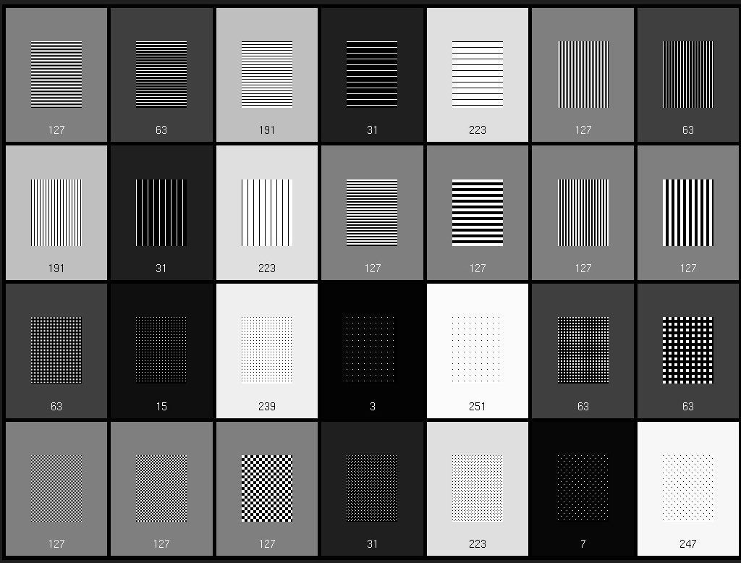
Normal Image (OK)

Slide 3
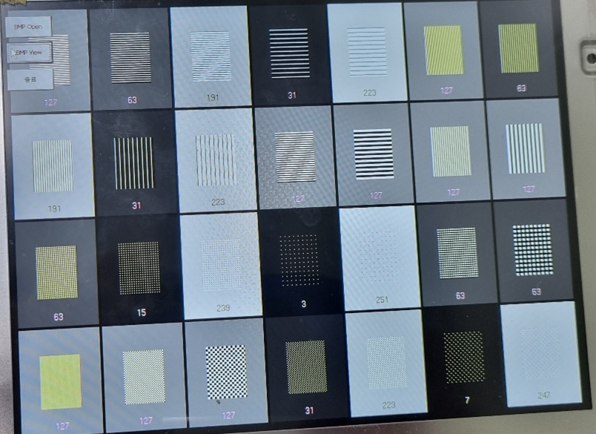
Abnormal image (error)_When applying a replacement product

Slide 4
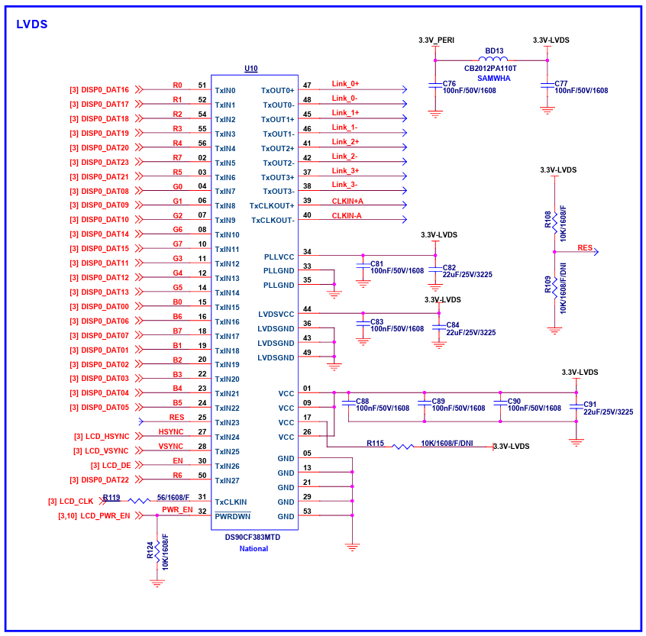
Schematics

