Slide 1
Layout Review (935)

Slide 2
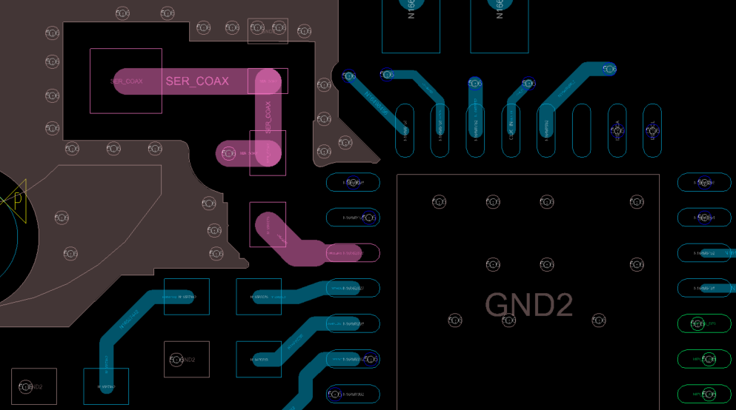
1) Tightly-Controlled Impedance Requirements
High-speed signal traces require tight impedance control
Make sure that the single-ended DOUT+/- traces on the 935 each have tightly controlled 50-Ohms (+/-10%) single-ended impedance
Single-ended impedance depends on a number of factors in your PCB, such as trace width, stack height, dielectric, etc…
The width of the DOUT+ trace seems inconsistent.
Can customer verify that the single-ended impedance of the DOUT+ trace and the DOUT- trace is strictly within 50-Ohms (+/-10%)?
DOUT+ (Pin 14)
DOUT- (Pin 13)

Slide 3
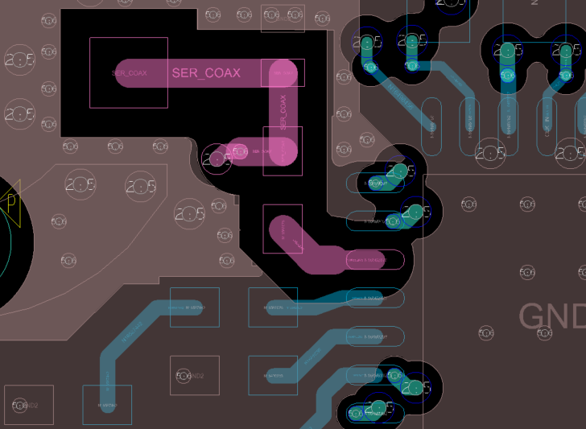
2) Reference GND Plane
High-speed signal traces (CSI-2 traces and DOUT+/- traces) need a continuous ground plane running underneath them in an adjacent layer.
It seems the high-speed DOUT+/- traces are not always routed over the ground plane in the next layer.
You need to make sure that the DOUT+/- traces are routed over a continuous, unbroken ground in the next layer in the PCB.
DOUT+ (Pin 14)
DOUT- (Pin 13)

Slide 4
3) Anti-Pads
Remove the ground plane underneath only the landing pads of components along the DOUT+/- traces, such as the AC coupling capacitors and the PoC component touching the DOUT+ trace
This minimizes the impedance mismatch caused by the width of the landing pads and also minimizes parasitic capacitance affecting the high-speed signal
Make sure to maintain the ground reference plane underneath the rest of the high-speed signal trace
Areas circled red are where the ground plane should be removed in the next layer.
DOUT+ (Pin 14)
DOUT- (Pin 13)

Slide 5
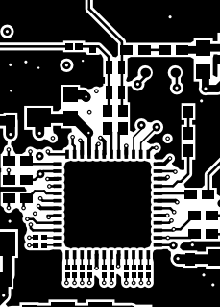
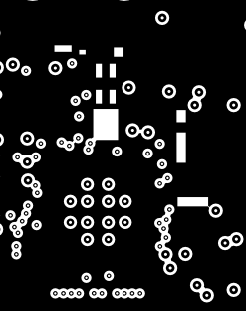
3a) Anti-Pad Example
Here is a visual anti-pad example from the UB954 EVM User’s Guide, which applies to the UB935 layout as well
The top layer is a signal layer that has the routing for the high-speed RIN+/- traces.
The second layer is a ground layer.
The ground layer provides a continuous ground reference plane underneath the RIN+/- traces.
There are AC coupling capacitors, a CMC, and a Ferrite Bead from a PoC network touching the RIN+/- traces on the top layer.
The ground plane underneath the landing pads of all of the components along the RIN+/- traces is removed, in order to minimize parasitic capacitance and impedance mismatch. The ground reference plane is still running underneath the rest of the PCB traces.
Layer 1
Layer 2

Slide 6
4) Connector Landing Pattern
Recommend to use simulation to verify the effects of the connector landing pattern on the impedance
Connector can introduce impedance mismatch.
Follow the PCB footprint recommendations from the connector manufacturer to maintain a consistent 50-Ohm (+/- 10%) single-ended impedance through the connector
DOUT+ (Pin 14)
DOUT- (Pin 13)

Slide 7
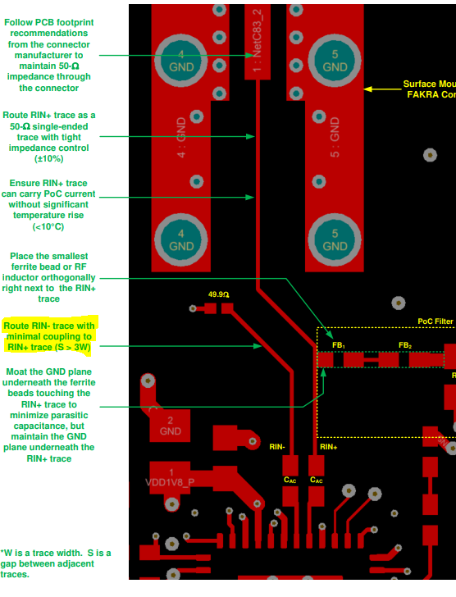
5) Loosely-Coupled DOUT+/- Traces
The DOUT- trace should be loosely-coupled to the DOUT+ trace and routed along the DOUT+ trace, all the way up to the connector
Spacing between DOUT+/- traces should be at least 3 times the trace width, to minimize crosstalk
This type of routing helps prevent noise from coupling onto the high-speed signal on the RIN+ trace and improves EMI/EMC test results
The DOUT- trace should be routed along the DOUT+ trace (S>3W) and the 50-Ohms resistor should be terminated to ground near the connector.
Example of recommended routing is in the right picture.
50-Ohms
RIN+
RIN-

Slide 8
6) CSI-2
Make sure to double-check that all of the CSI-2 layout guidelines defined in the device datasheet are followed, as well as maintain a continuous ground plane under the traces
See the next slides for more details.

Slide 9
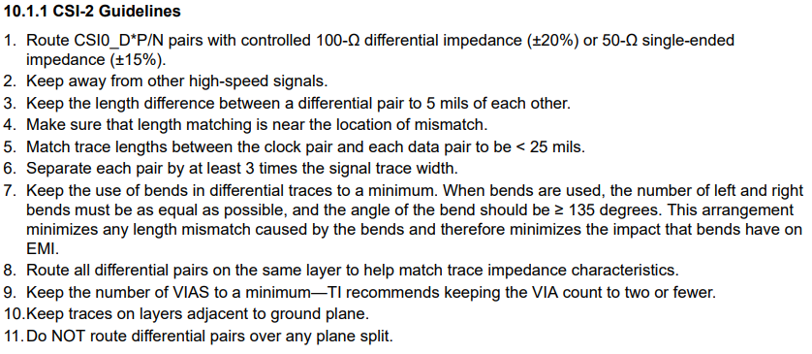
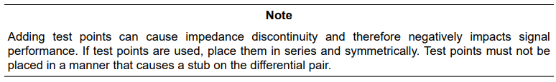
6a) CSI-2 Layout Guidelines

Slide 10
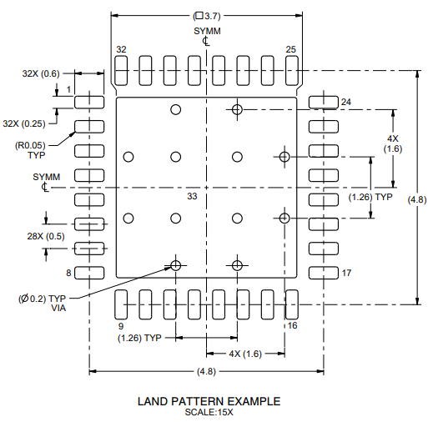
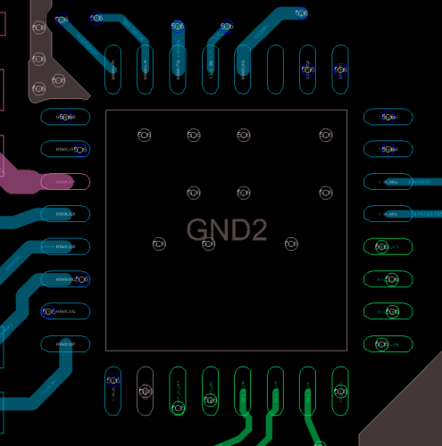
7) DAP Landing Pattern
There is a recommended land pattern for the UB935 in the device datasheets, with recommended ground vias through the board for thermal relief, ground connections, and recommended clearances around the DAP
Recommend to use or reference this land pattern for customer design
Ground vias in customer land pattern are not evenly distributed, which could lead to thermal issues. We recommend to use a design based on our recommended land pattern.
Customers will need to verify that there are no thermal issues, when using their chosen landing pattern design on their own board.
Also keep in mind that the ground vias leading to the DAP make the only ground connection between the UB35 device and the PCB board’s ground plane, which means all switching current will travel along these ground vias.
Any PCB trace routed near these ground vias may have noise coupled onto them. Make sure to keep high-speed signal traces and other sensitive traces away from the ground vias underneath the DAP.

