Slide 1
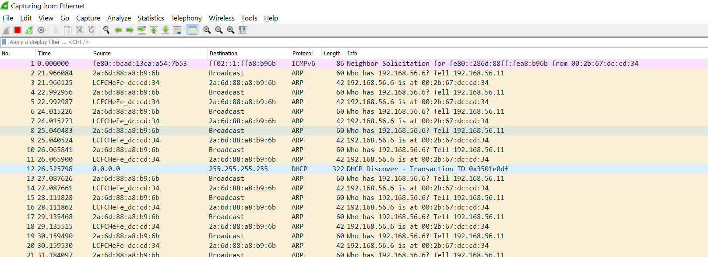
Lunewave DSP
T1 PHY
(dp83tg720)
Slave
IP: 192.168.56.11
TI DP83TG720EVM-MC
(tg720 set to Master)
Host PC with common GbE NIC
IP: 192.168.56.6
T1 Cable
CAT6 Cable
Current symptom is Pinging either from T1 PHY to Host PC, or from PC to T1 PHY is not successful.
The T1 PHY can transmit packets out okay. Seems it could never receive packets.

