Slide 1
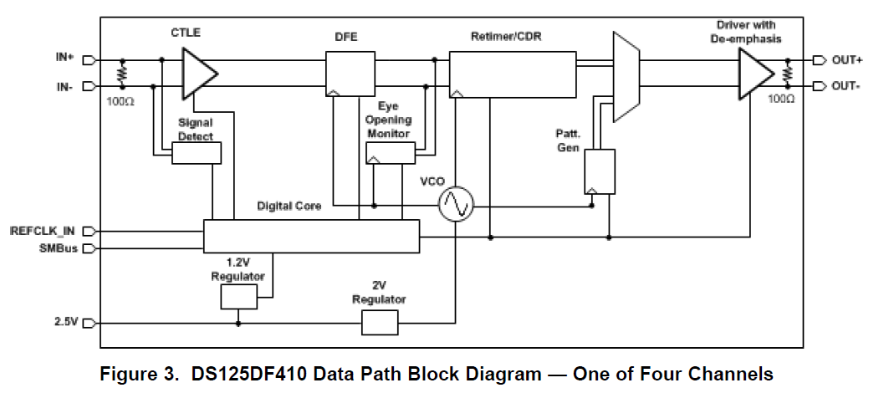
Is MUX which you said this part?

