Slide 1
5V
INA220
Main board side
Power side
5V
3.3V
3.3V
5V
INA220
2.2K
5V
INA220
Master
VrefA VrefB
I2CA I2CB
Vref1 Vref2
I2C1 I2C2
5V
INA220
LSF0102DCTR
PCA9306
3.3V
5V
HDC1080
Use 1.5m cable to connect
10K
Light sensor

Slide 2
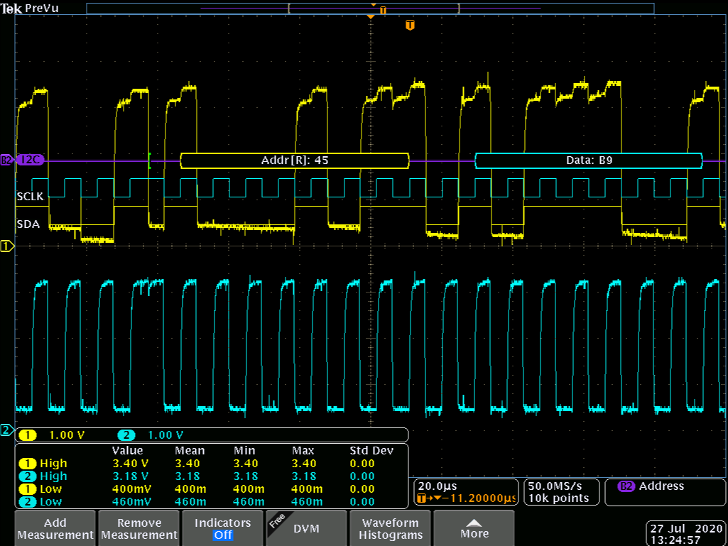
Measured the I2C of INA220
when no pull high
All sensor can be got the data,
but the high voltage is approach 3.3V

Slide 3
5V
INA220
Main board side
Power side
5V
3.3V
3.3V
5V
INA220
2.2K
10K
5V
INA220
Master
VrefA VrefB
I2CA I2CB
Vref1 Vref2
I2C1 I2C2
5V
INA220
LSF0102DCTR
PCA9306
3.3V
5V
HDC1080
Use 1.5m cable to connect
10K
Light sensor

Slide 4
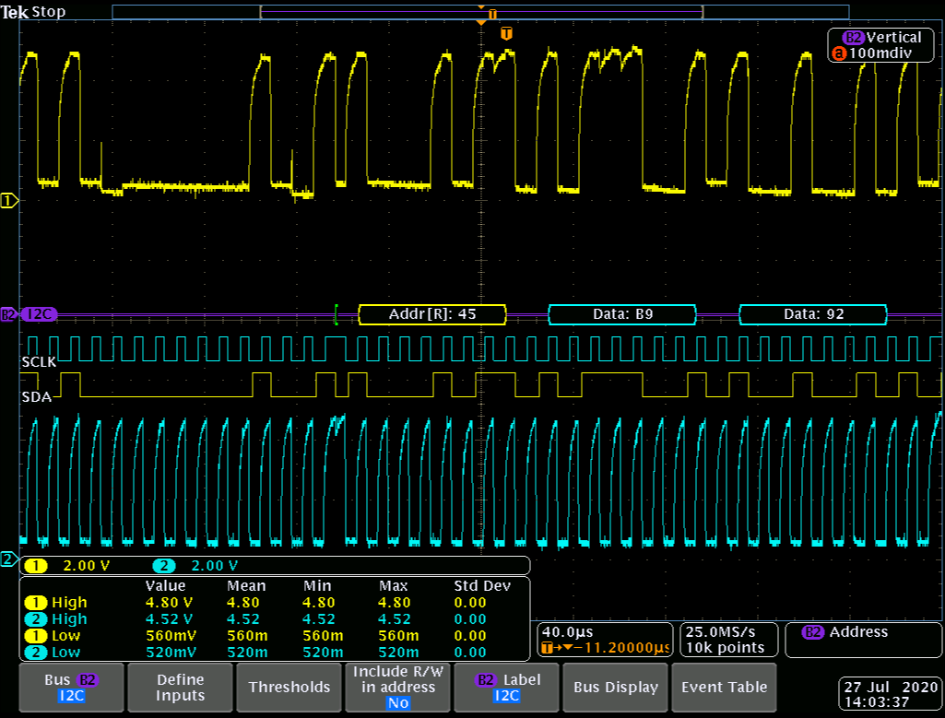
Measured the I2C of INA220
when pull high 10K
All sensor can be got the data

Slide 5
5V
INA220
Main board side
Power side
5V
3.3V
3.3V
5V
INA220
2.2K
8.2K
5V
INA220
Master
VrefA VrefB
I2CA I2CB
Vref1 Vref2
I2C1 I2C2
5V
INA220
LSF0102DCTR
PCA9306
3.3V
5V
HDC1080
Use 1.5m cable to connect
10K
Light sensor

Slide 6
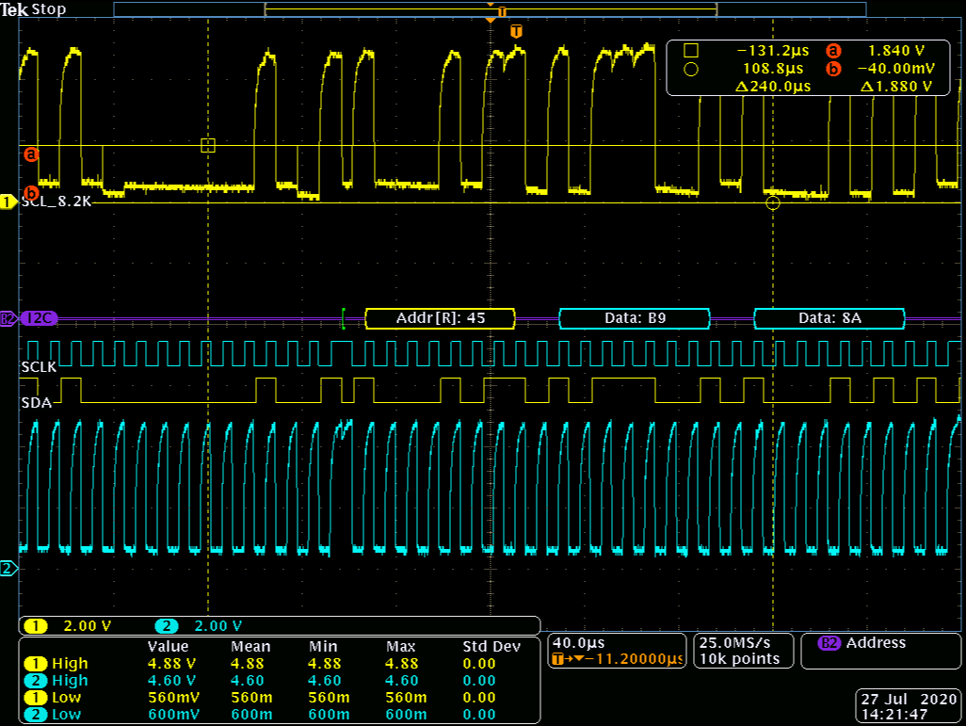
Measured the I2C of INA220
when pull high 8.2K
Some data can be lost

