Slide 1
Power board side
5V
INA220
Main board side
5V
1.8V
3.3V
3.3V
5V
INA220
2.2K
10K
5V
INA220
Master
VrefA VrefB
I2CA I2CB
Vref1 Vref2
I2C1 I2C2
5V
INA220
LSF0102DCTR
PCA9306
3.3V
5V
HDC1080
Use 1.5m cable to connect
10K or 100K
Light sensor

Slide 2
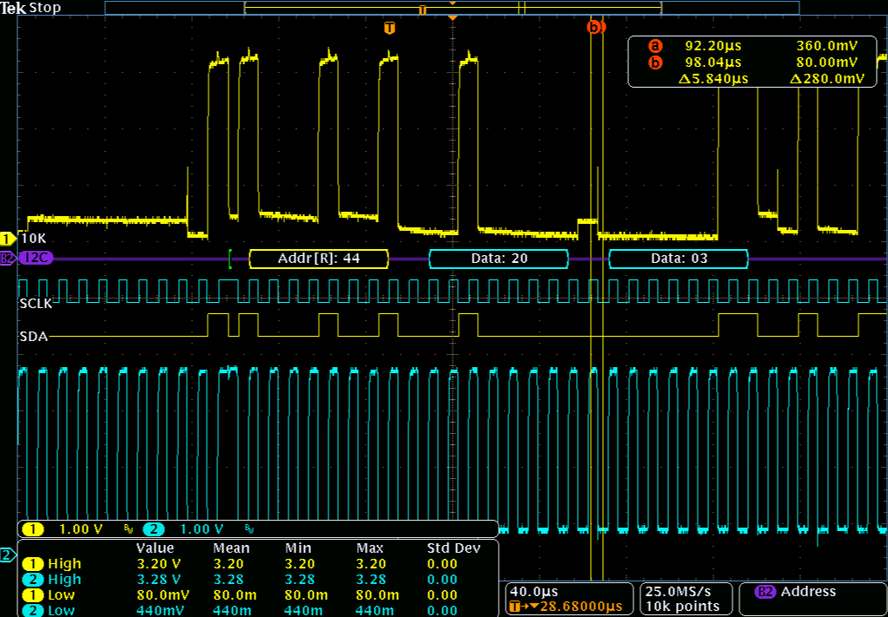
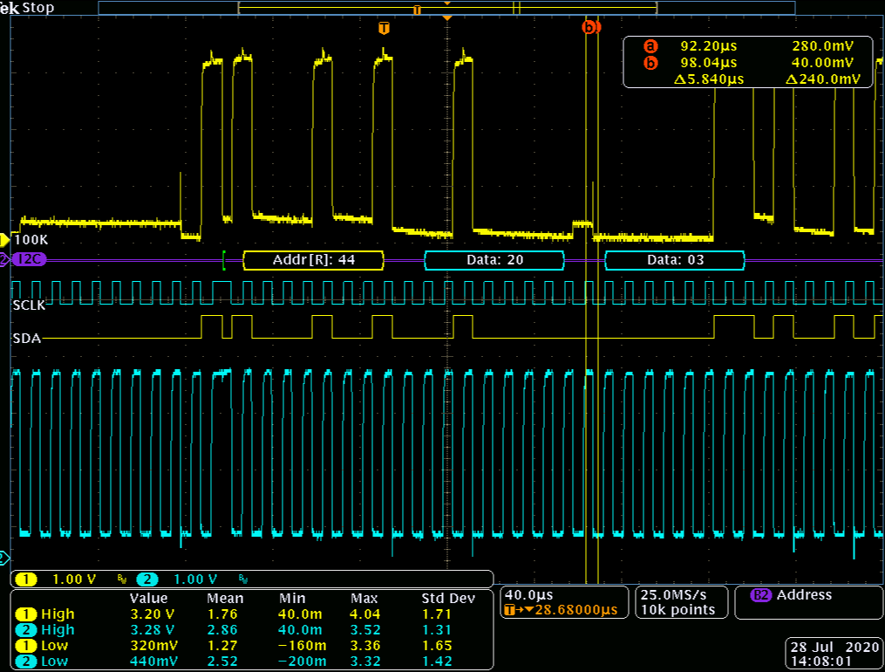
We tried to adjust pulled high resistor(10K&100K) at ALS I2C.It looked like no difference
Pulled high 10K at ALS I2C bus
Pulled high 100K at ALS I2C bus

Slide 3
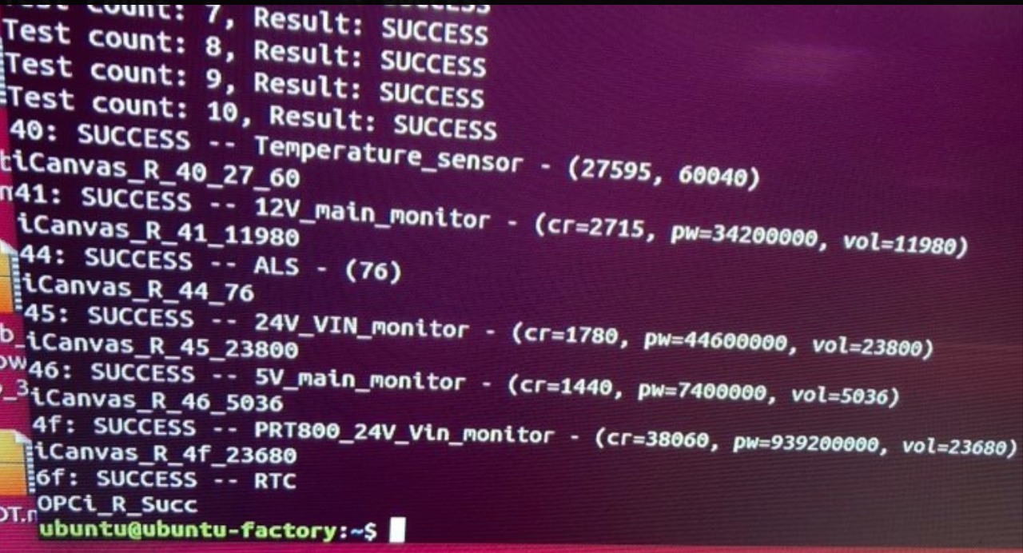
All sensor can be got data as the following figure

Slide 4
Power board side
5V
INA220
Main board side
5V
1.8V
3.3V
3.3V
5V
INA220
2.2K
6.8K
5V
INA220
Master
VrefA VrefB
I2CA I2CB
Vref1 Vref2
I2C1 I2C2
5V
INA220
LSF0102DCTR
PCA9306
3.3V
5V
HDC1080
Use 1.5m cable to connect
10K or 100K
Light sensor

Slide 5
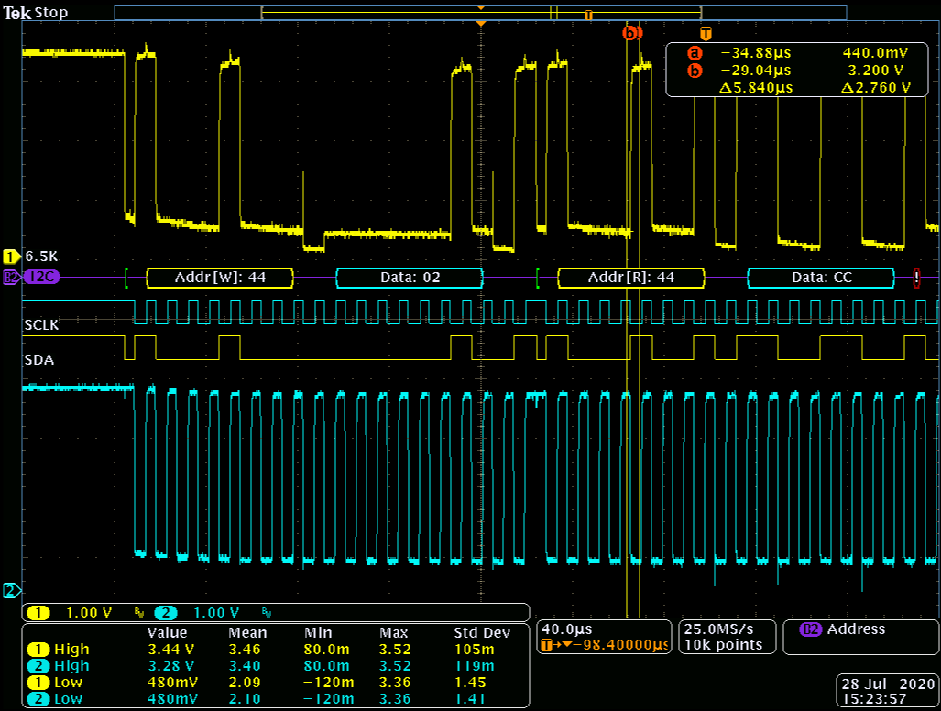
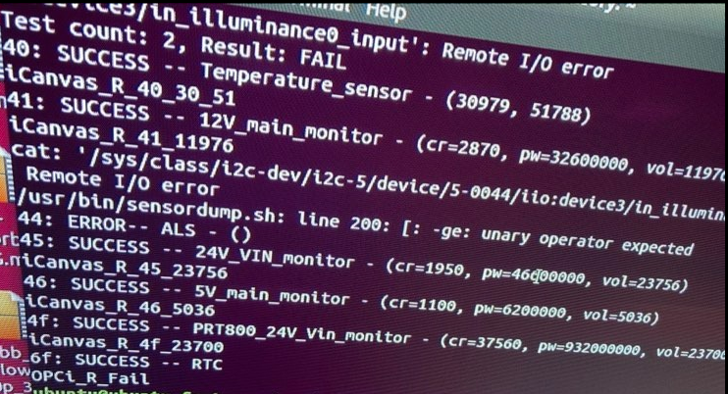
We tried to adjust pulled high resistor(6.8K) at INA220 I2C bus. Sometimes the data be lost for ALS.
Pulled high 6.2K at INA220 I2C bus
ALS data lost

Slide 6
Because the I2C of INA220 is not met I2C spec. We try to adjust pull high resistor to change the raising time.
But when the pull high(2.2K) at INA220 I2C bus, all I2C address can not capture. We try to disconnect the ALS cable and it’s
also not got other sensor address
Power board side
5V
INA220
Main board side
5V
1.8V
3.3V
3.3V
5V
INA220
2.2K
2.2K
5V
INA220
Master
VrefA VrefB
I2CA I2CB
Vref1 Vref2
I2C1 I2C2
5V
INA220
LSF0102DCTR
PCA9306
3.3V
5V
HDC1080
Use 1.5m cable to connect
10K
Light sensor

Slide 7
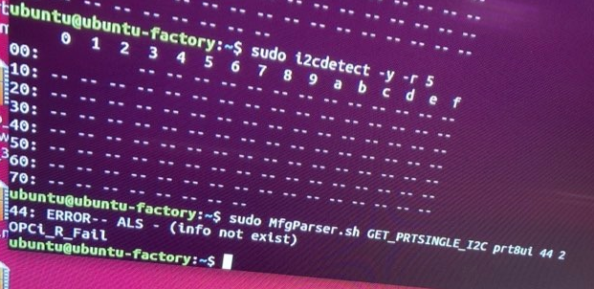
If we pulled high(2.2K) at INA220 I2C bus or disconnected ALS , all sensors can not be captured address.
When we loaded this address, the SDA will be pulled low.

