Slide 1
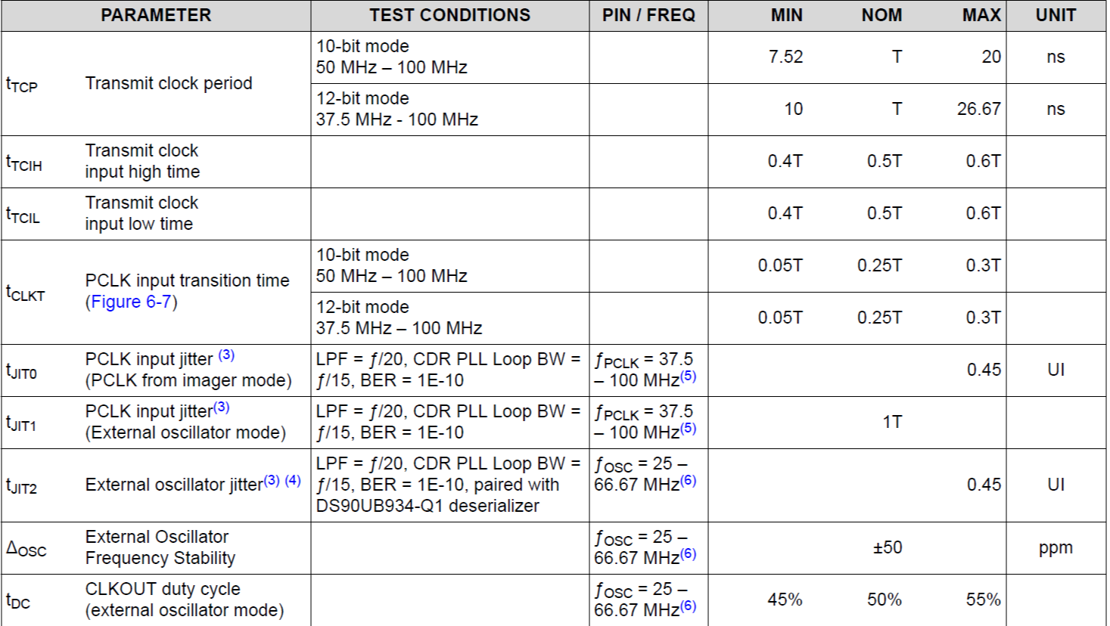
What does the clock jitter allowed look like?
T = 10ns
PCLK input (External oscillator mode)

