Slide 1
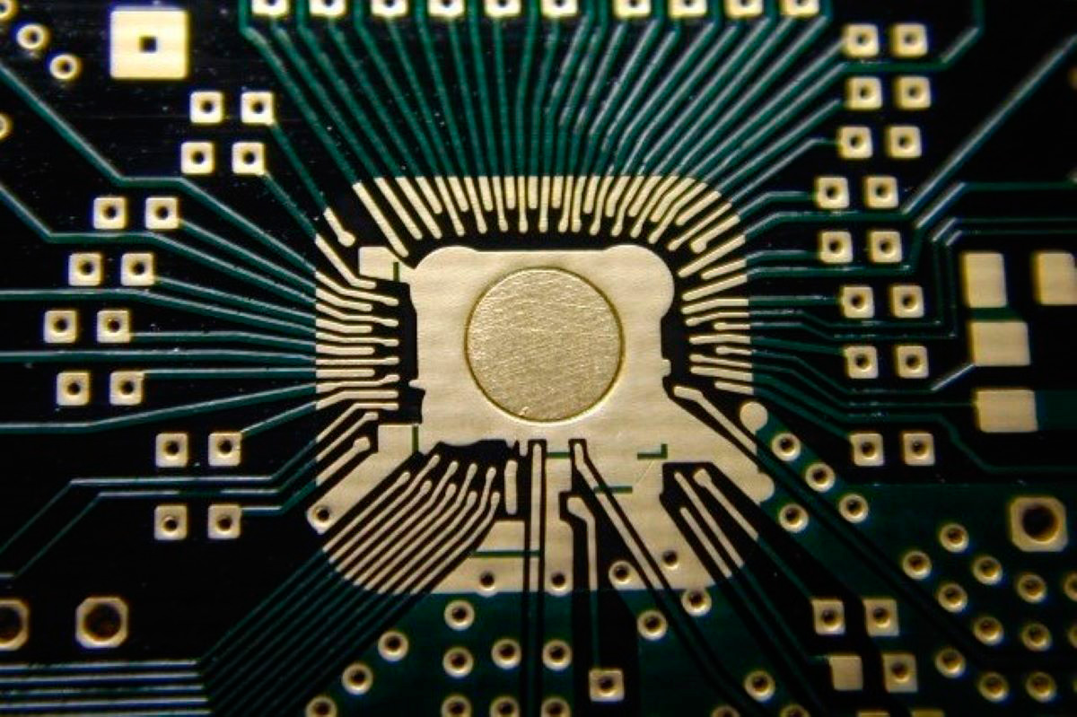
CCAR CA00168760
ProPart # - P-MF01-0170
Texas Instruments
AM26LV32EIPWR
Chris Hodder

Slide 2
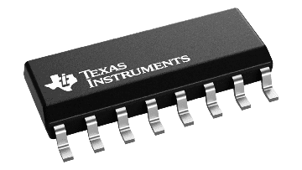
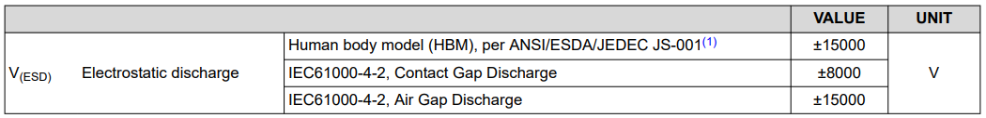
P-MF01-0170 – Package
Manufacturer – Texas Instruments
Part Number – AM26LV32EIPWR
Package – 16pin TSSOP (PW) (5 mm x 6.4 mm)
Component Grade – Commercial
ESD:-
Storage Temperature Range – -65 to +150°C
Shipping – 2k T&R
MSL 1 – Unlimited
Part Marking:- SB32

Slide 3
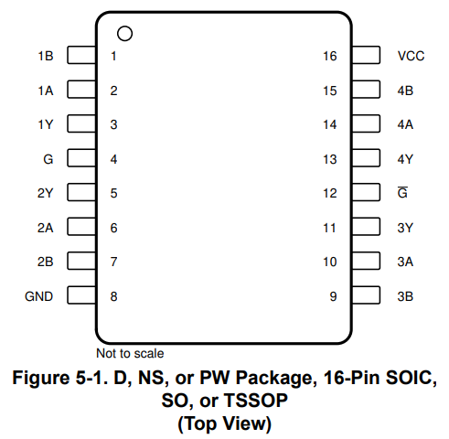
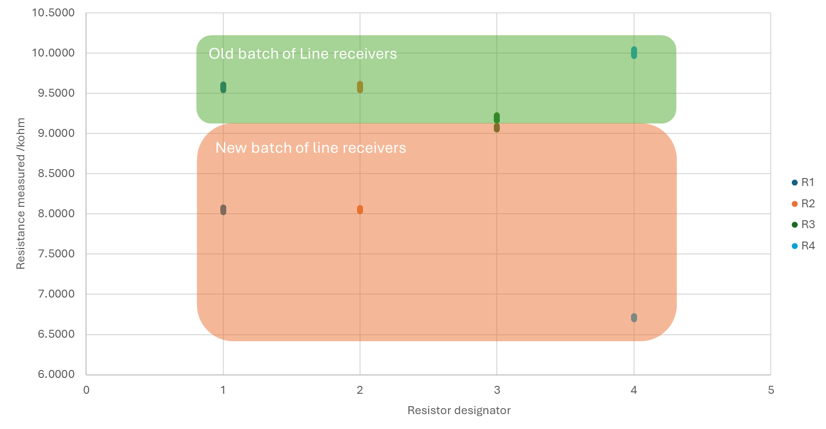
Problem Statement
Test failures between PU03652051 (Arrow) & PU03700914 (Arrow)
Subsequent deliveries from Digikey & Texas Instruments have the same issue
Measured across pins 1 & 2 on a good board (PU03652051) were getting 470KΩ
On a bad board (PU03700914) measured 40KΩ
Resistance between old & new devices on the flying probe

Slide 4
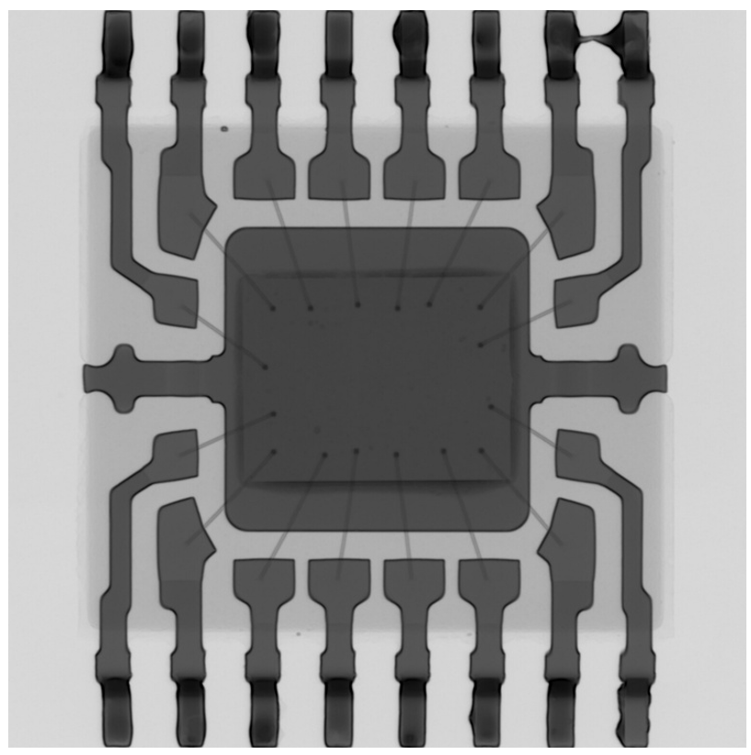
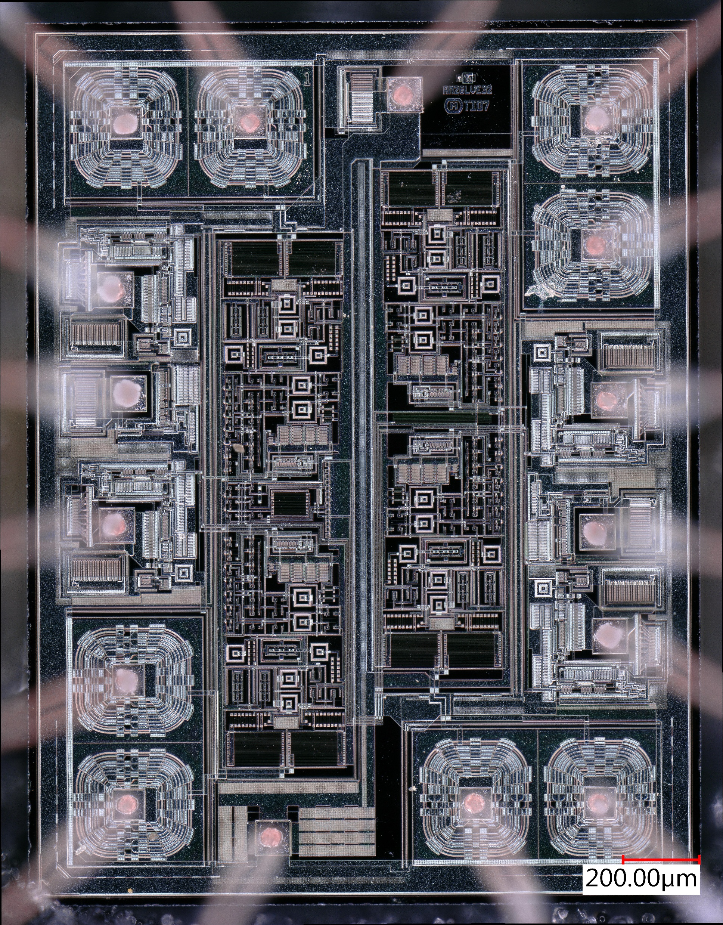
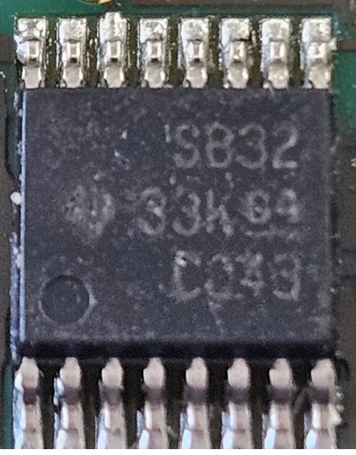
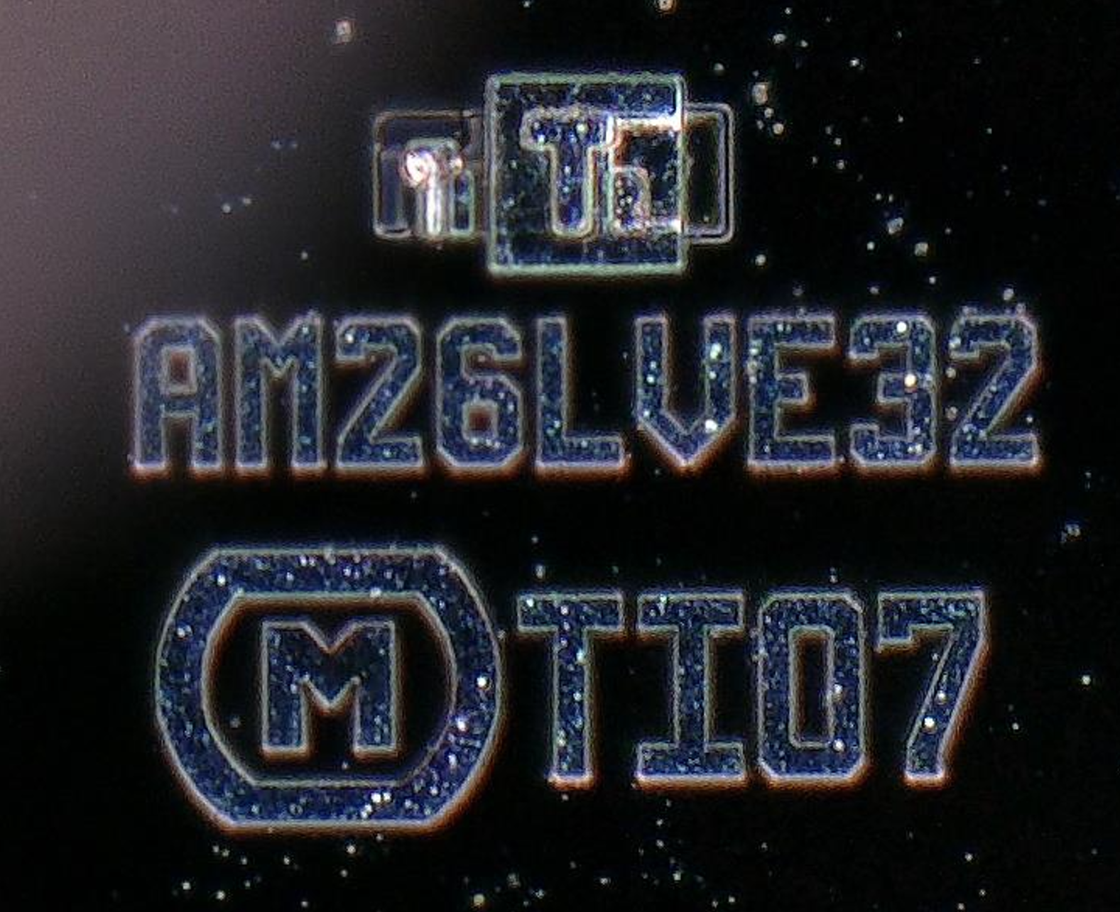
P-MF01-0170 – Orders
Renishaw PO# – PU03652051 (2k)
Supplier – Arrow
Batch Number – 31T3252150ML3
Datecode – 12/2023
Topside Markings

Slide 5
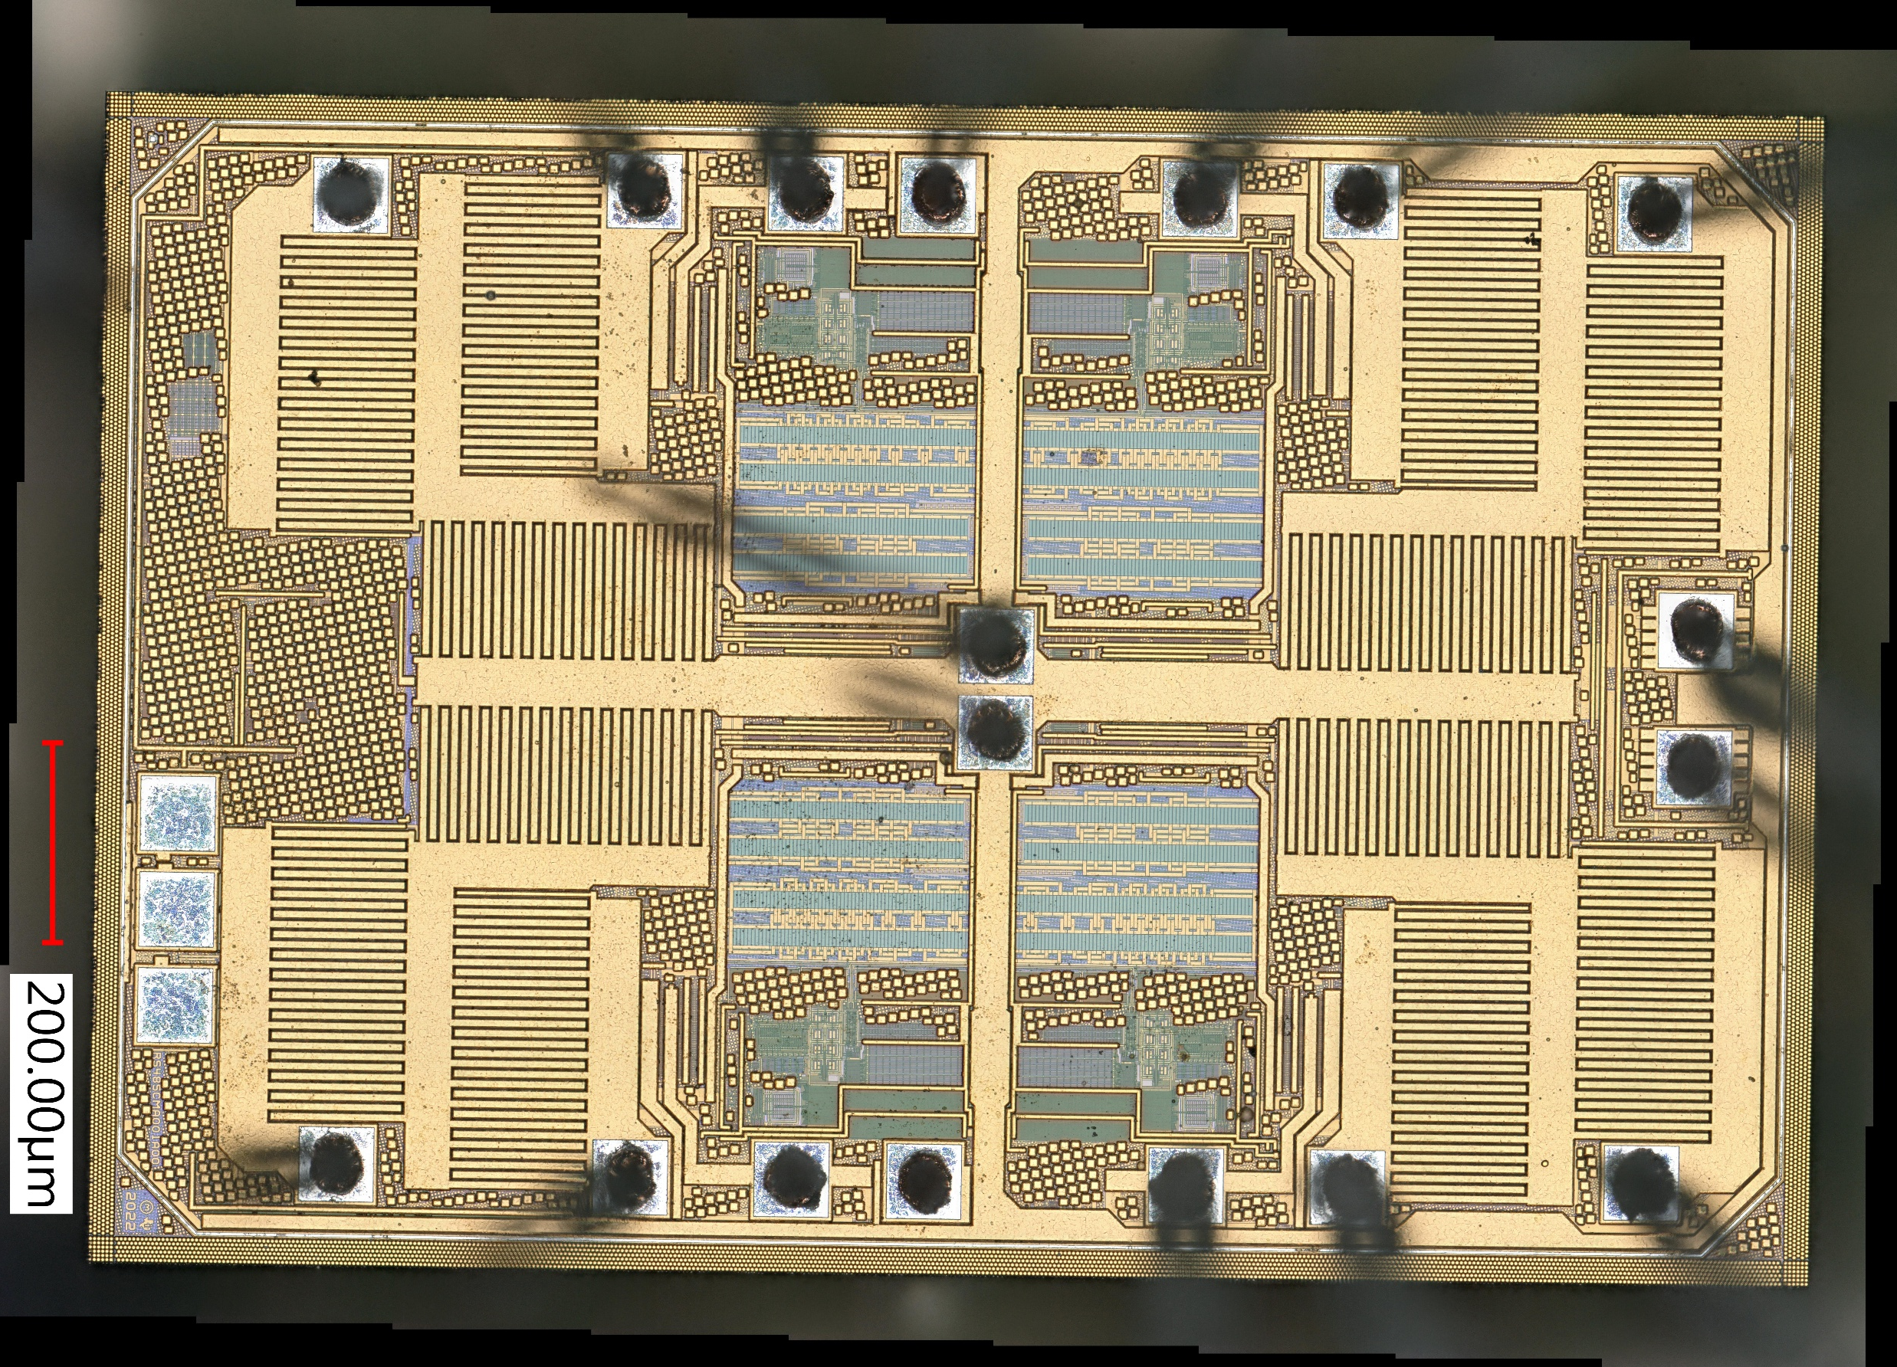
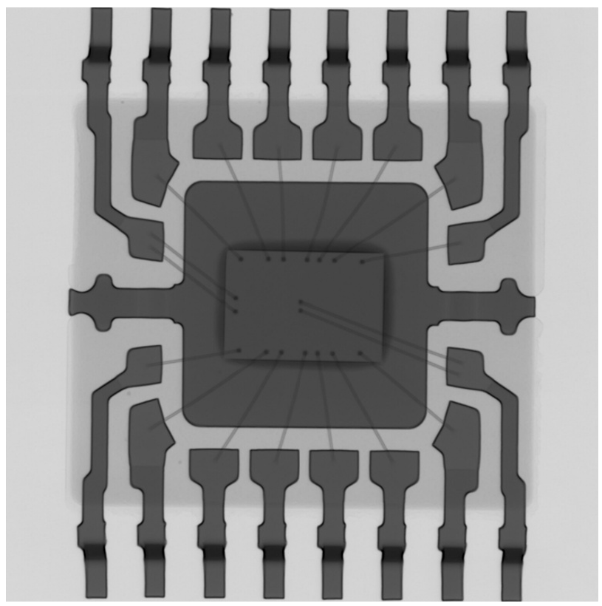
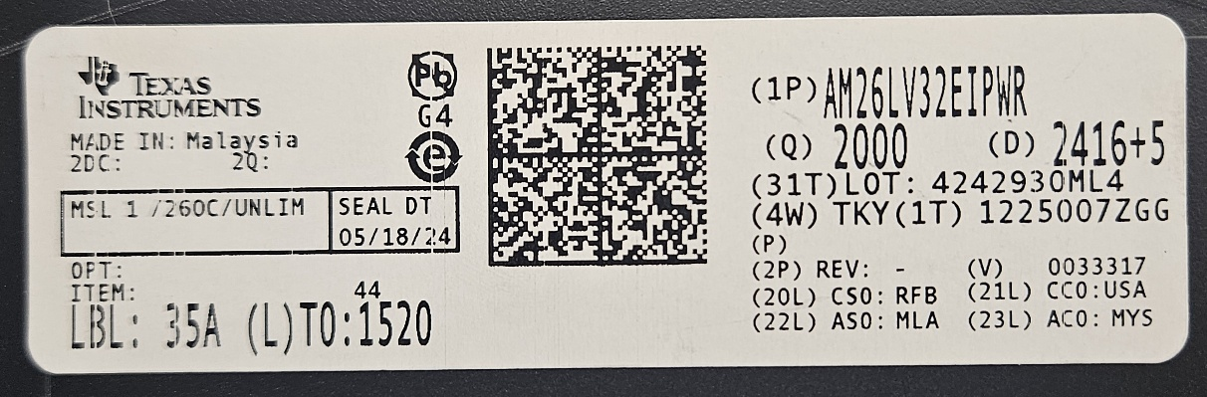
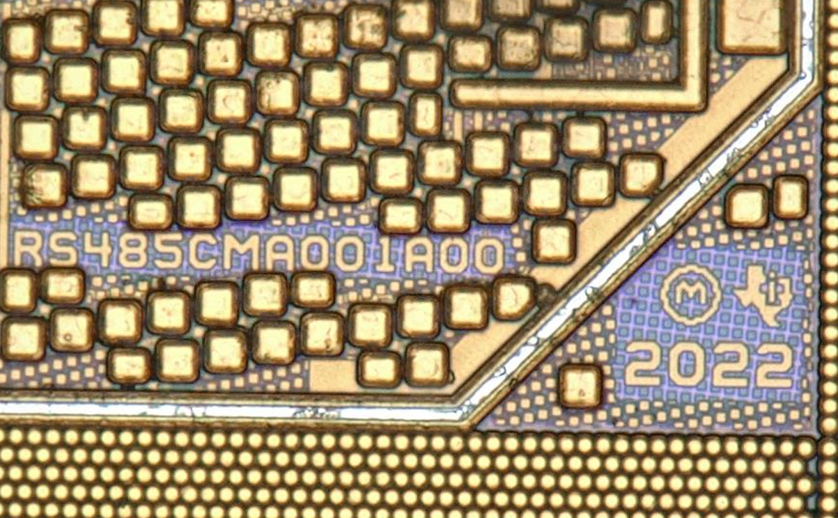
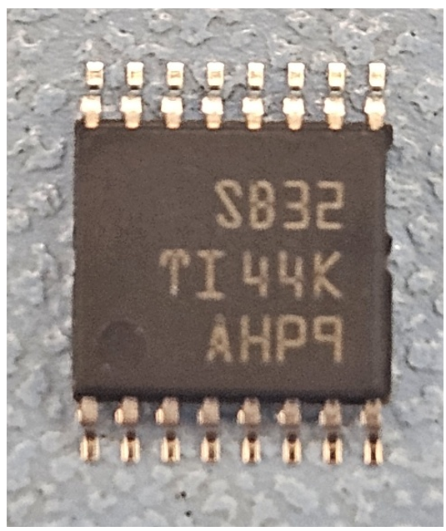
P-MF01-0170 – Orders
Renishaw PO# – PU03700914 (2k)
Supplier – Arrow
CSO – RFB - Code for TI Richardson, USA Wafer Fab
ASO – MLA - Code for TI Kuala Lumpur, Malaysia A/T Site
CCO – USA – United States America
ACO – MYS – Malaysia
Topside Markings

Slide 6
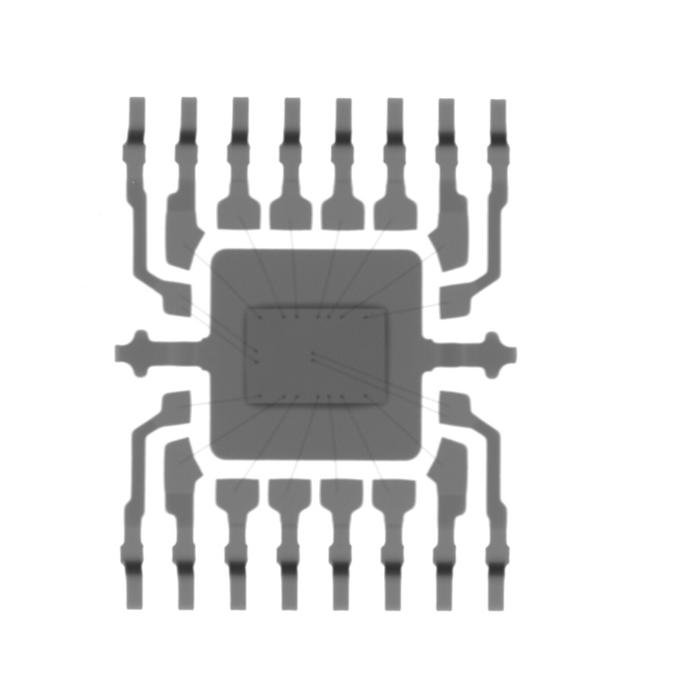
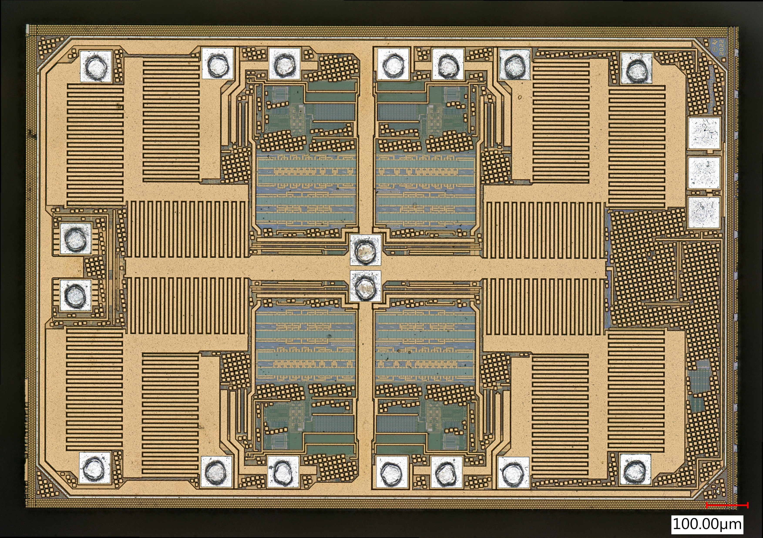
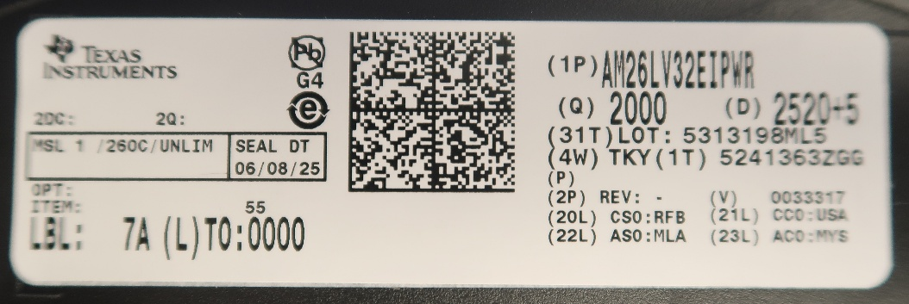
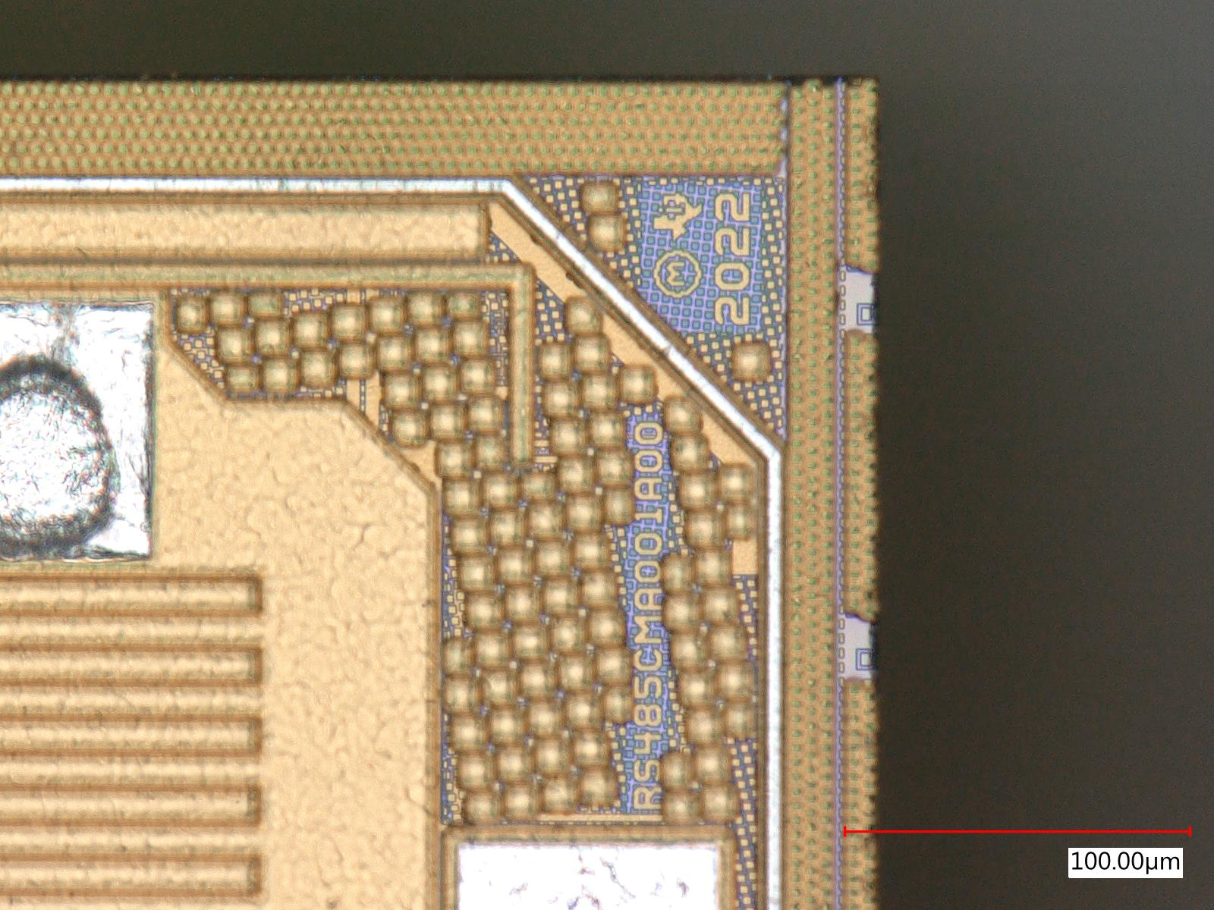
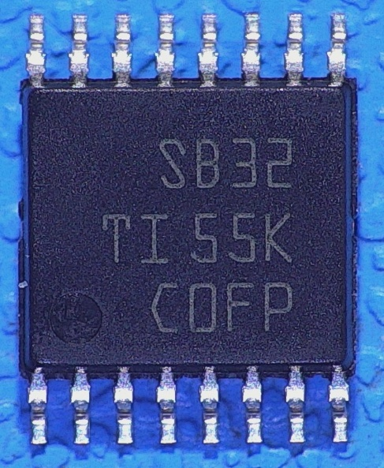
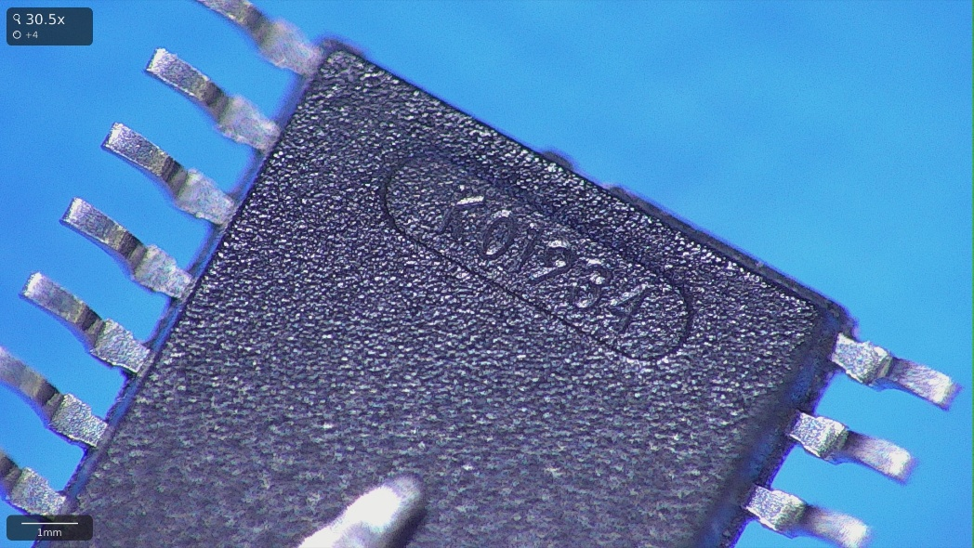
P-MF01-0170 – Orders
Renishaw PO# – PU03778710 (2k)
Supplier – Digikey
CSO – RFB - Code for TI Richardson, USA Wafer Fab
ASO – MLA - Code for TI Kuala Lumpur, Malaysia A/T Site
CCO – USA – United States America
ACO – MYS – Malaysia
Topside Markings/ Bottomside molding

Slide 7
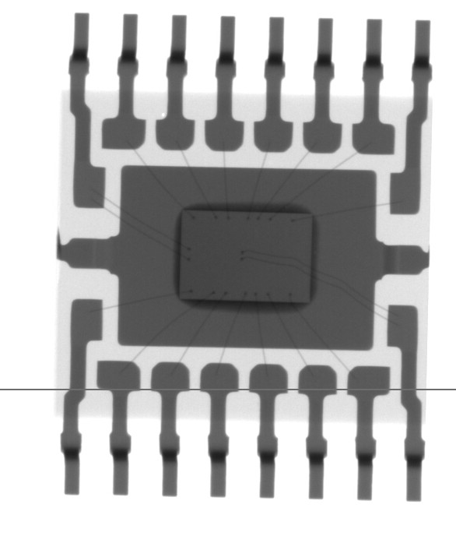
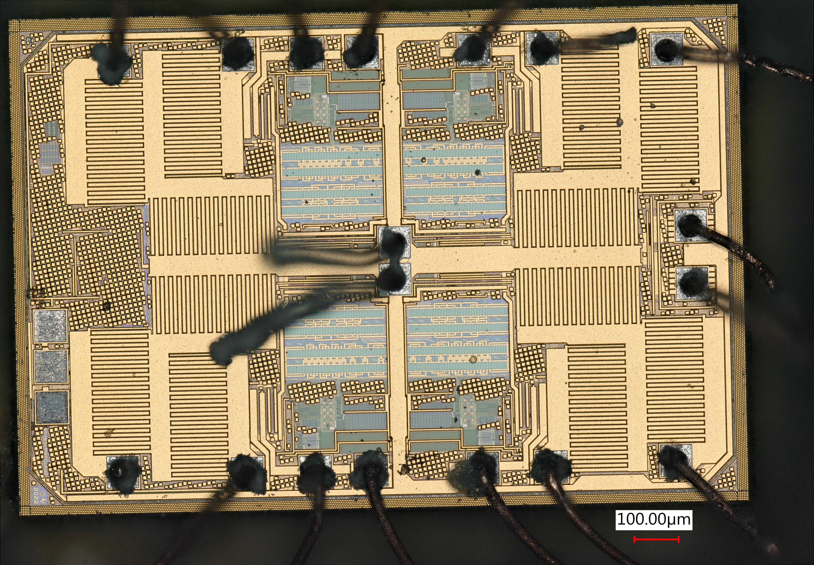
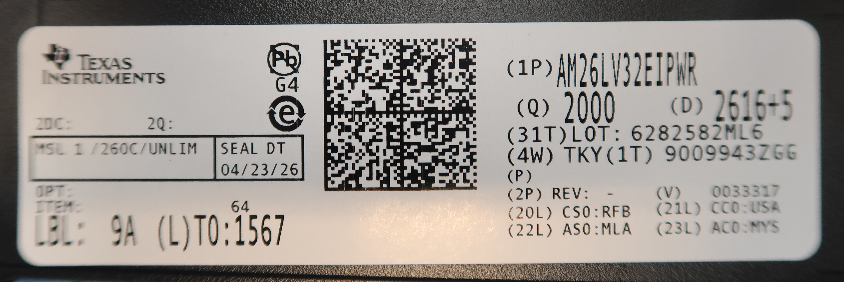
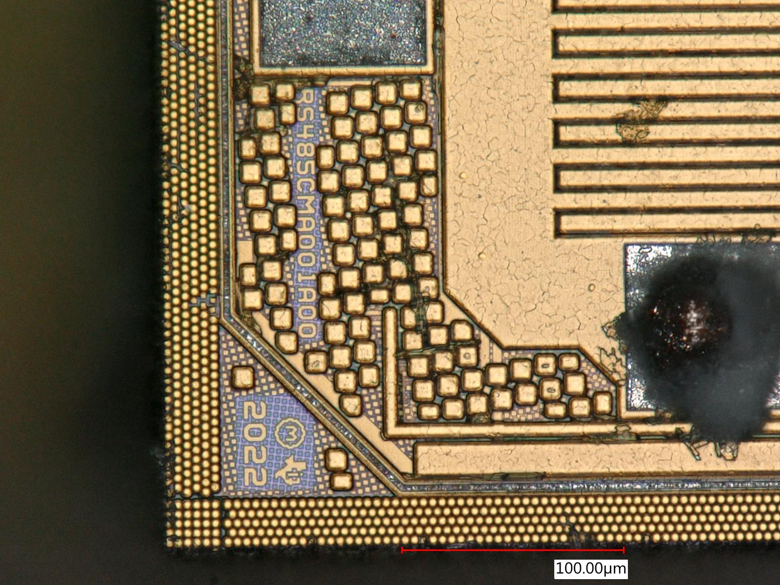
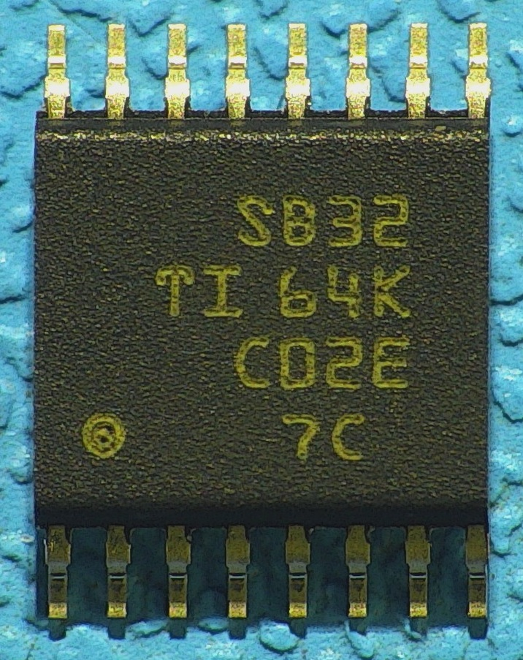
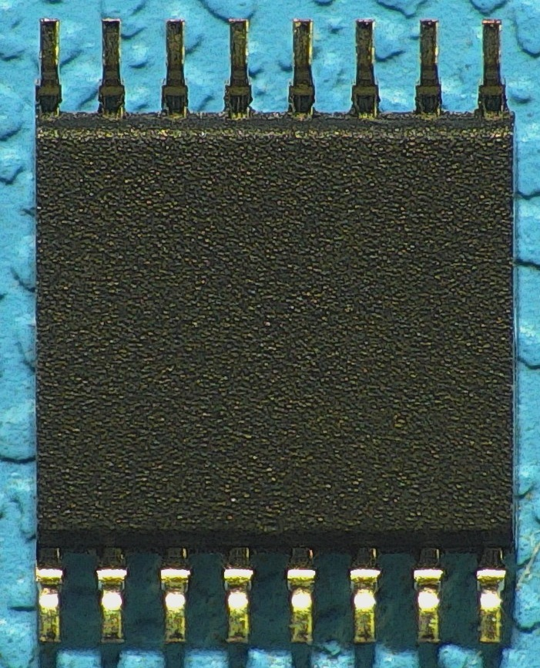
P-MF01-0170 – Orders
Renishaw PO# – PU03764212
Supplier – Texas Instruments (Direct)
CSO – RFB - Code for TI Richardson, USA Wafer Fab
ASO – MLA - Code for TI Kuala Lumpur, Malaysia A/T Site
CCO – USA – United States America
ACO – MYS – Malaysia
Topside Markings/ Bottomside molding

Slide 8
Observations
Differences in die after decapsulation being carried out, between good & failed devices
Good die has references to correct part number, other dies has no reference to part number
An additional internal bond-wire on later devices
Different resistance values observed between old & new devices on flying probe

