Slide 1
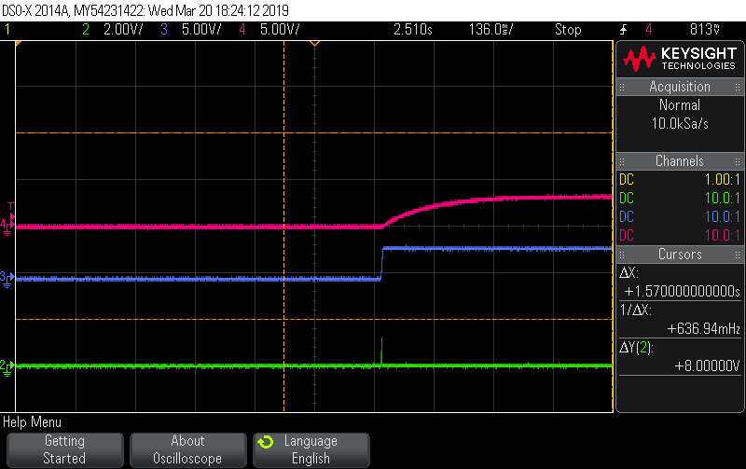
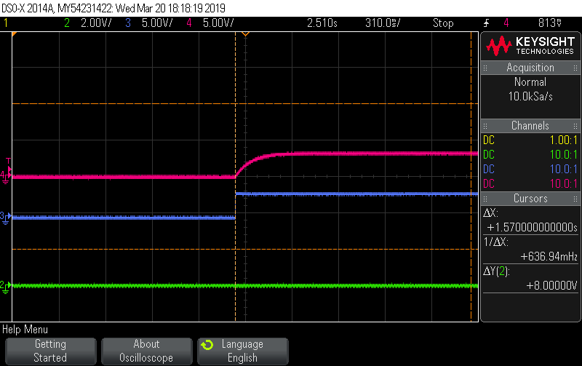
Good one
PDB
OEN/VCC
Lock
PDB
OEN/VCC
Abnormal one
Lock

