Slide 1
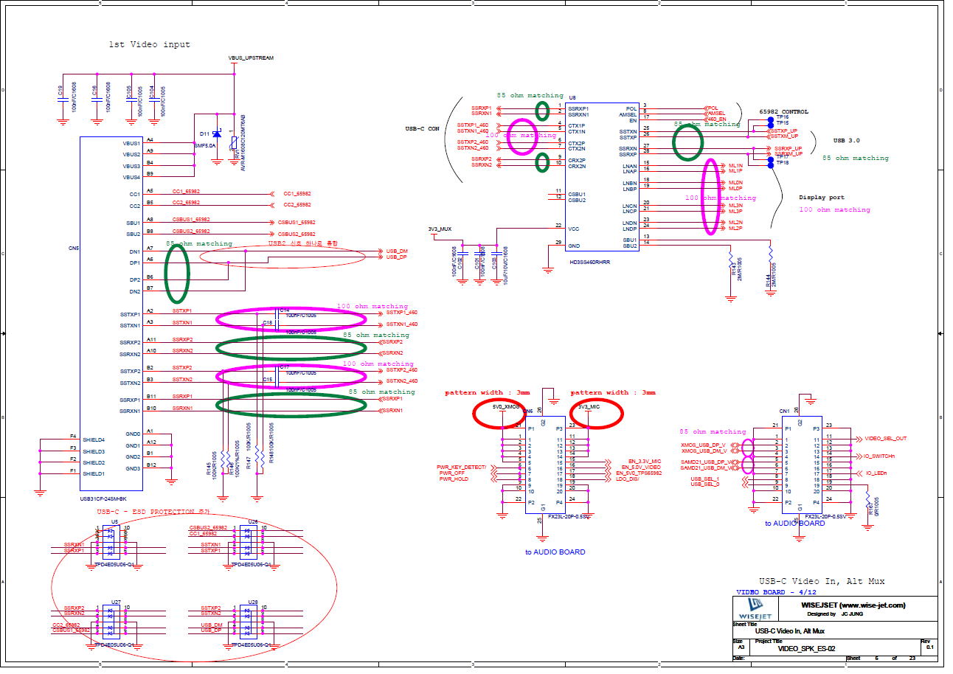
USB TYPE C RECEPTACLE & 1:2 SWITCH

Slide 2
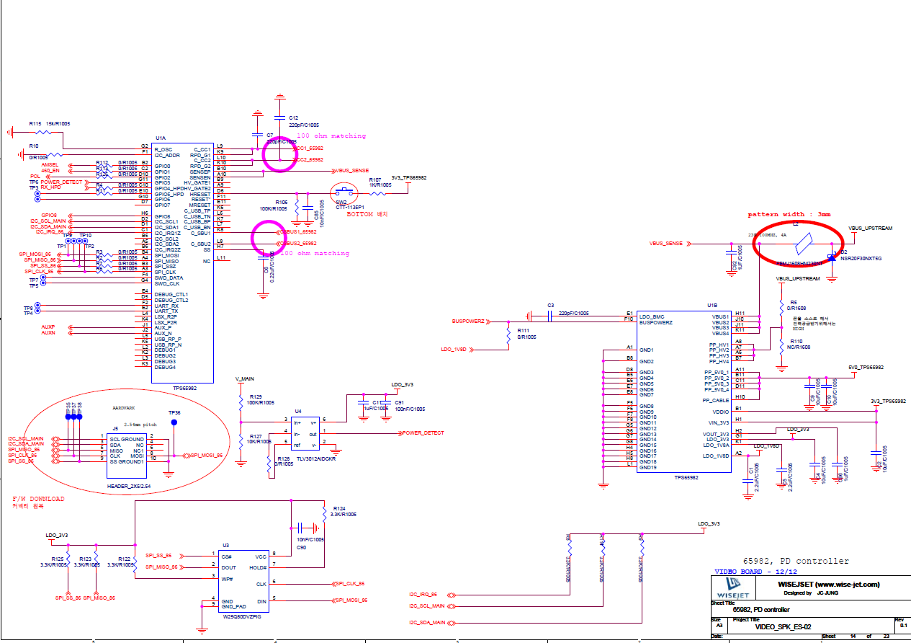
TPS65982

