Slide 1
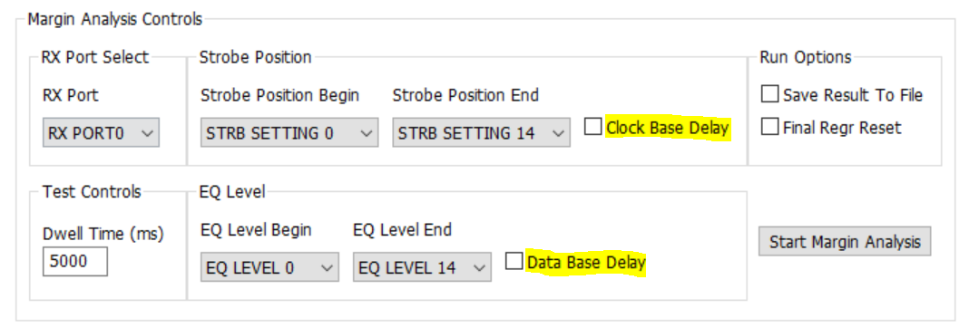
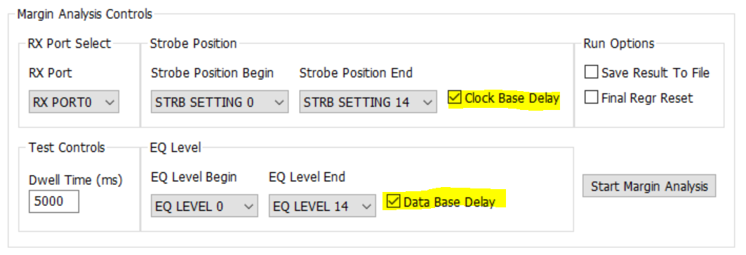
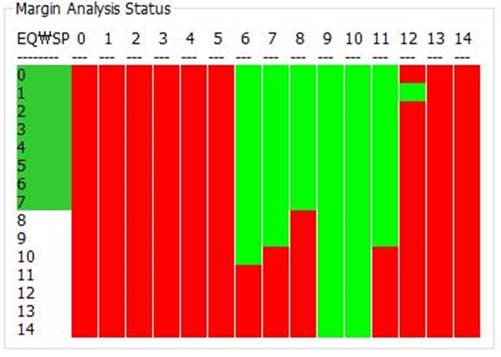
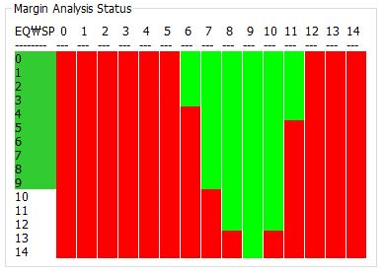
a) Setup : All of environment is same, difference thing is whether disable of Delay box or not.
b) DS90UB954-Q1 Register is set default for Delay. Selected 6extra buffer delay.
VS
< Result.1 >
<Result.2>
Q1. Which I can trust data ? Result.1 or Result.2 and Please explain reasons that you recommend.
Q2. Do you mind recommending AEQ area for trust data ? And Please explain reasons that you recommend
Q3. Do you mind recommending Dwell time ?
Q4. As I know strobe position is sampling position and I don’t know EQ meaning. Could you explain what is EQ ?

