Slide 1

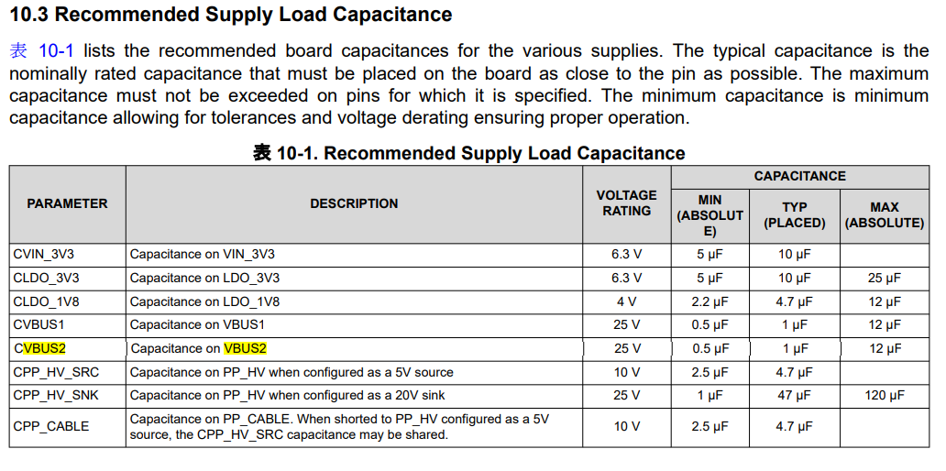
C1004
10uF(2012)⇒NoMount

