Slide 1
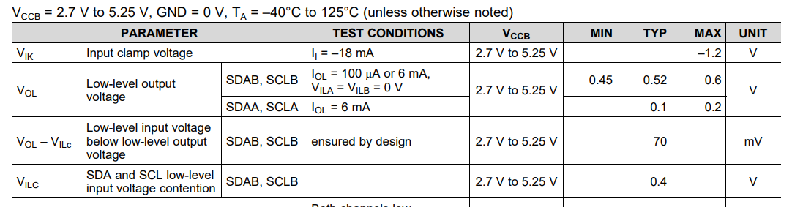
Please
Sudjest us
these voltages.

Slide 2
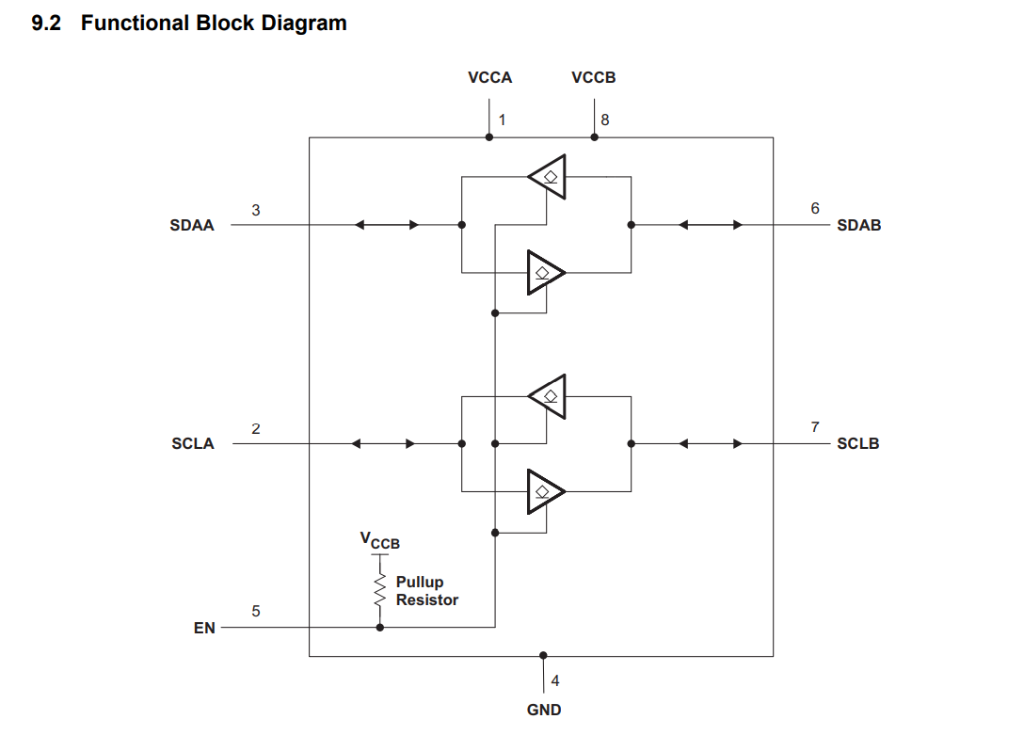
We understood this specification as follows. Are these understandings correct?
・TCA9517 convert the B-side input Voltage to buffered Low-voltage(≒0.5V), when connected device
outputs Low-voltage to the B-side.
・In this case, the output voltage of B-side is offset 70mV(typ) higher than output voltage of connected
device.
For Examples.
VILC=0.4Vtyp VOL-VILC=70mVtyp → VOL=0.47Vtyp
MasterDevice Vout=0.1V → TCA9517: VoutA<0.2V VoutB=0.45V
MasterDevice Vout=0.4V → TCA9517: VoutA<0.2V VoutB=0.45V~0.6V
MasterDevice Vout=0.5V → TCA9517: VoutA<0.2V VoutB=0.57Vtyp~0.6V
0.2Vout_max
0.1Vinput
0.2Vout_max
0.4Vinput
convert to 0.45V~0.6V
Convert to0.47V~0.6V
0.45V~0.6V
+70mVtyp

Slide 3
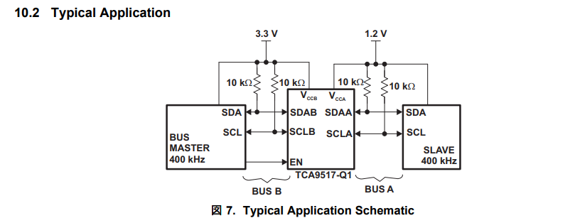
Are there any restrictions on the connection between the master and slave devices with the A/B of the TCA9517?
Typical Aplication (datasheet P.12)
Our Circuit Block diagram
2.2kΩ
2.2kΩ
2.2kΩ
2.2kΩ
Slave
SDA
SCL
Slave
SDA
SCL

