Slide 1
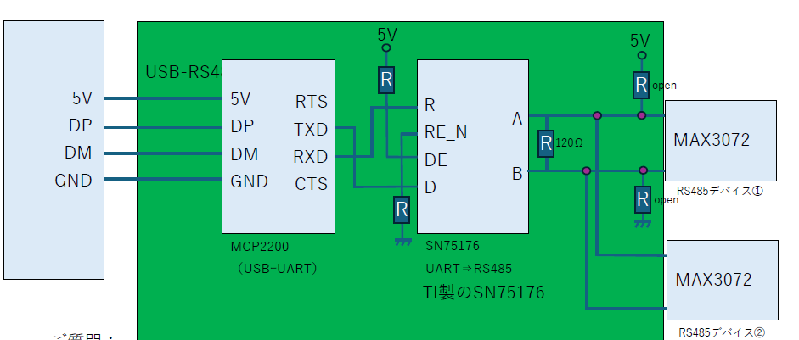
System Block diagram

Slide 2
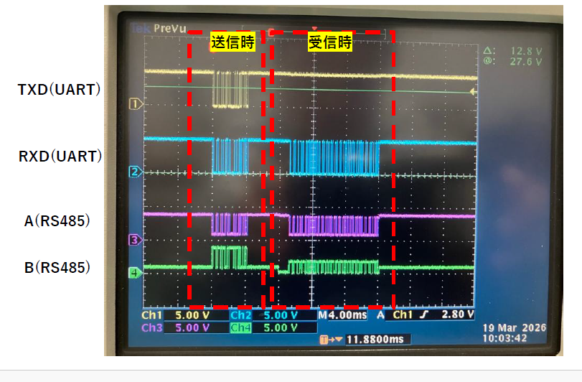
TX
RX

Slide 3
Compare Bus signal level
Cable length：70mm(Flexible Flat Cable)
Data rate：1.92kbps
termination：120Ω
Remove termination
A(RS485)
B(RS485)
Large level shift

