Slide 1
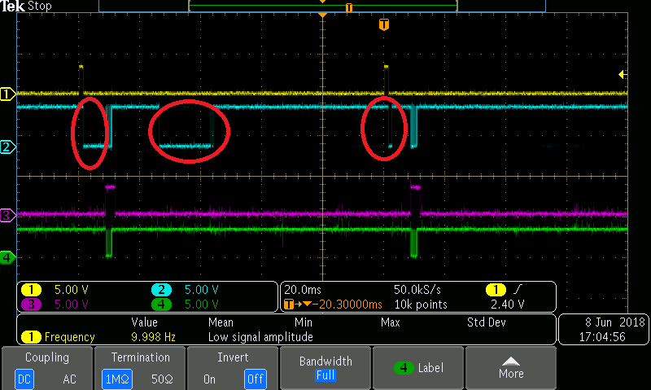
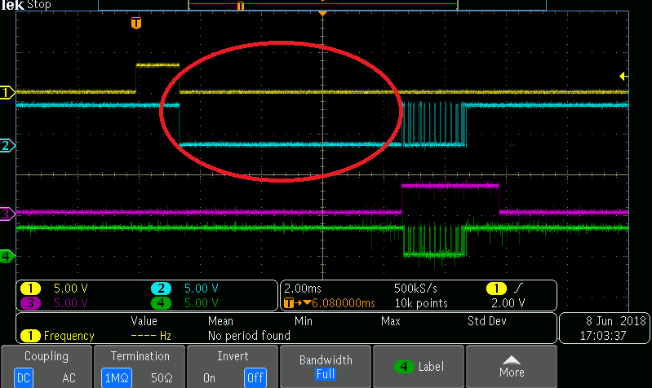
Base Systems 1 Receive Mode
Base System-2 Transmission Mode
SN75176B
SN65HVD1473DR
TX
A
RX
1
A
B
3
RS485
Trans.
RS485
Trans.
Controller 2
Controller 1
DE/REn
Z
DE/REn
2
B
Y
4
RX
TX
Issues present at Receiving end of the Base System 1. Transmitted data is not received exactly at the receiver end.

Slide 2
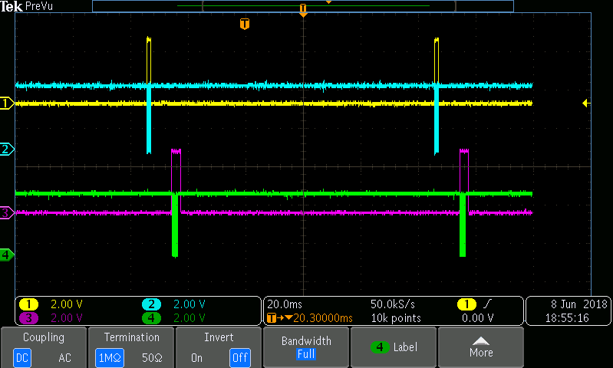
Base Systems 1 Transmission Mode
Base System 2 Receive Mode
2
SN75176B
SN65HVD1473DR
4
TX
A
RX
1
B
3
RS485
Trans.
RS485
Trans.
HMI
Processor
PLC Controller
DE/REn
Z
DE/REn
Y
RX
TX
Transmitted data from the Base 1 is received properly at the base receiver end.

