Slide 1
PD_P3V3 (C140) or PD_LDO_3V3(C141) output is unstable (ring)

Slide 2
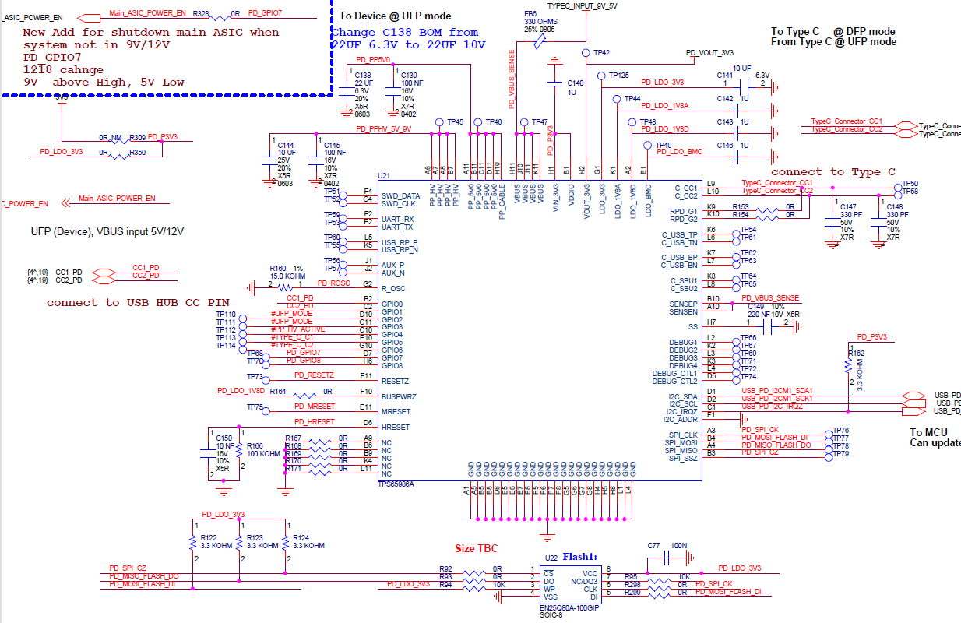
Symptom: PD_P3V3 (C140) or PD_LDO_3V3(C141) output is unstable (ring) when did the Adapter DC cable or USB cable plug in-out test.(The failure symptom is random)
Failure sample: 1 of 200pcs after life test finished.

Slide 3
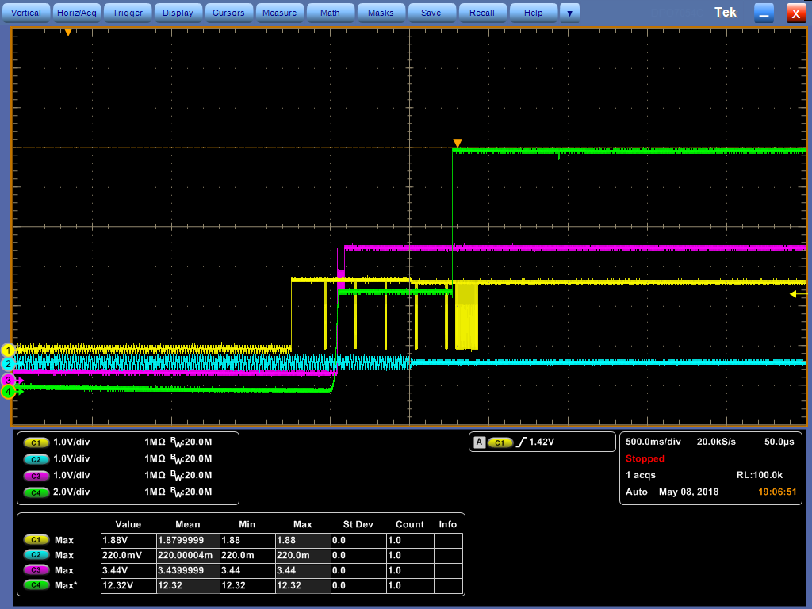
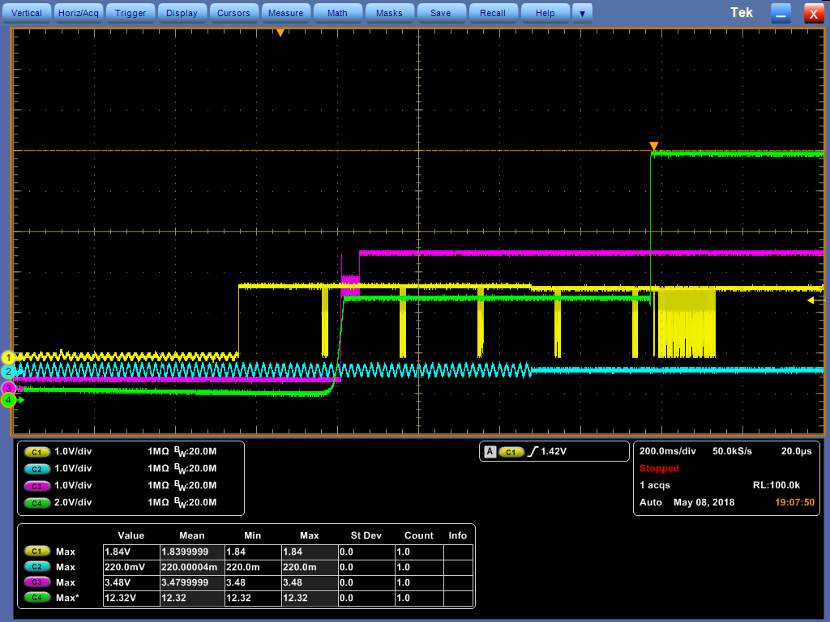
Power on waveform
CH1:CC1; CH2:CC2; CH3:VIN_3V3; CH4:VBUS
CH1:CC1; CH2:CC2; CH3:VIN_3V3; CH4:VBUS

Slide 4
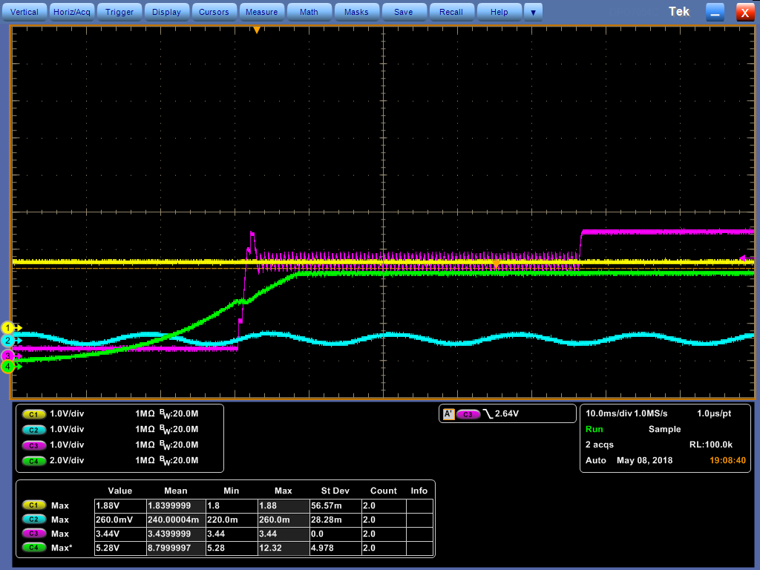
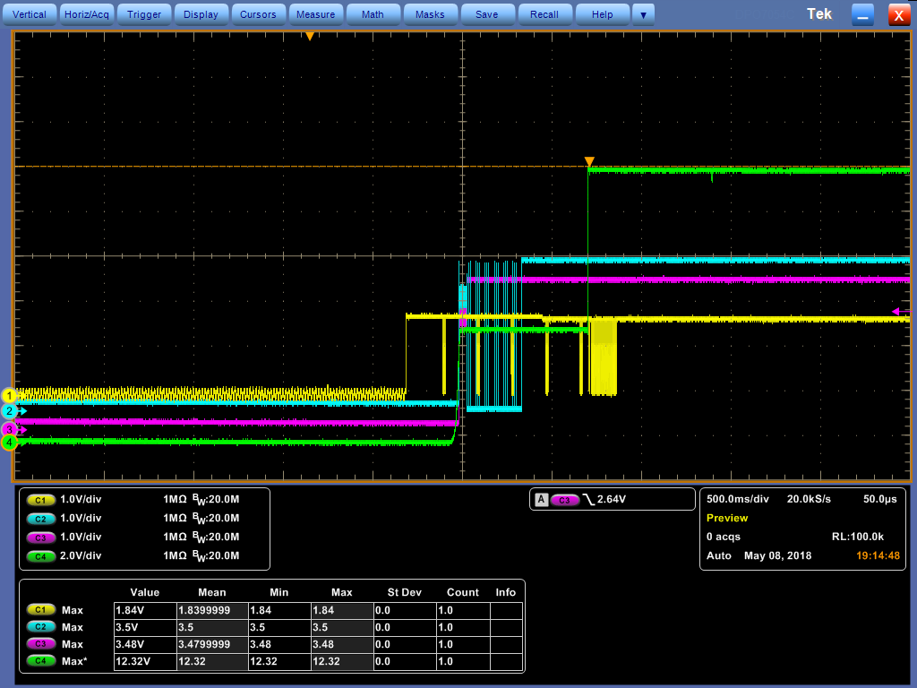
Power on waveform
CH1:CC1; CH2:CC2; CH3:VIN_3V3; CH4:VBUS
CH1:CC1; CH2:SPI_SSZ; CH3:VIN_3V3; CH4:VBUS

Slide 5
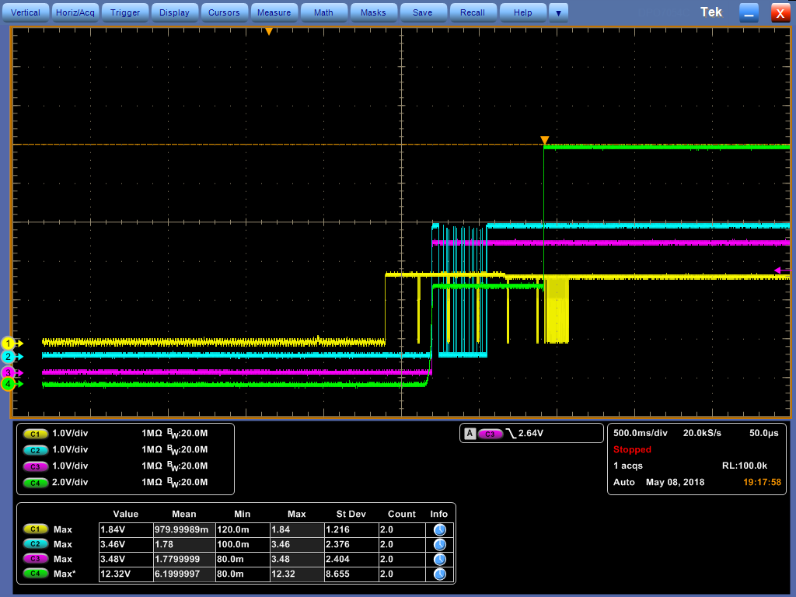
Power on waveform after remove R350
CH1:CC1; CH2:SPI_SSZ; CH3:VIN_3V3; CH4:VBUS

