Slide 1
S19 PD FW Setting
By Foxconn
20190616

Slide 2
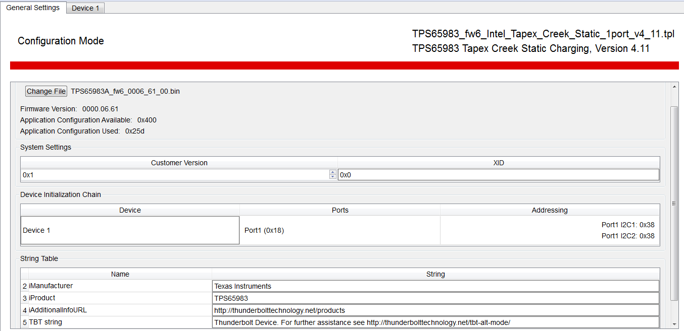
General Settings

Slide 3
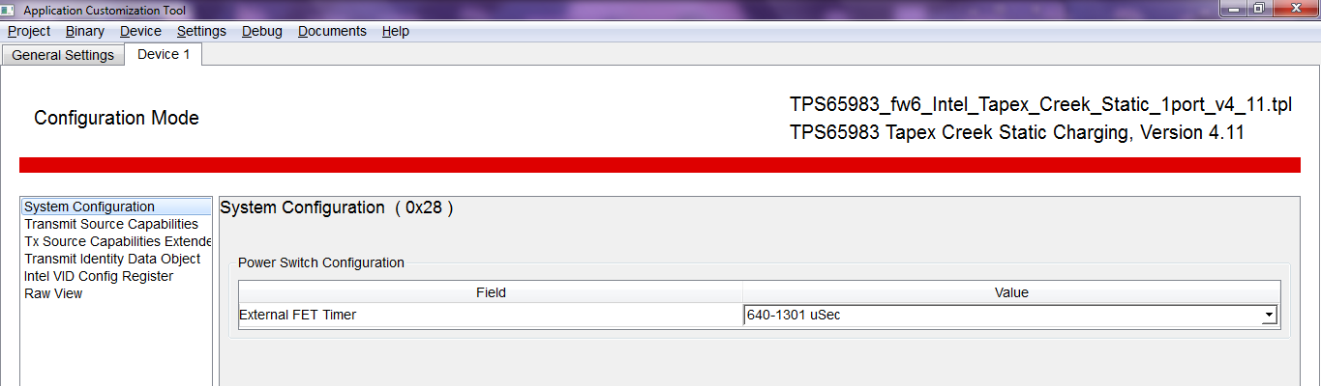
System Configuration

Slide 4
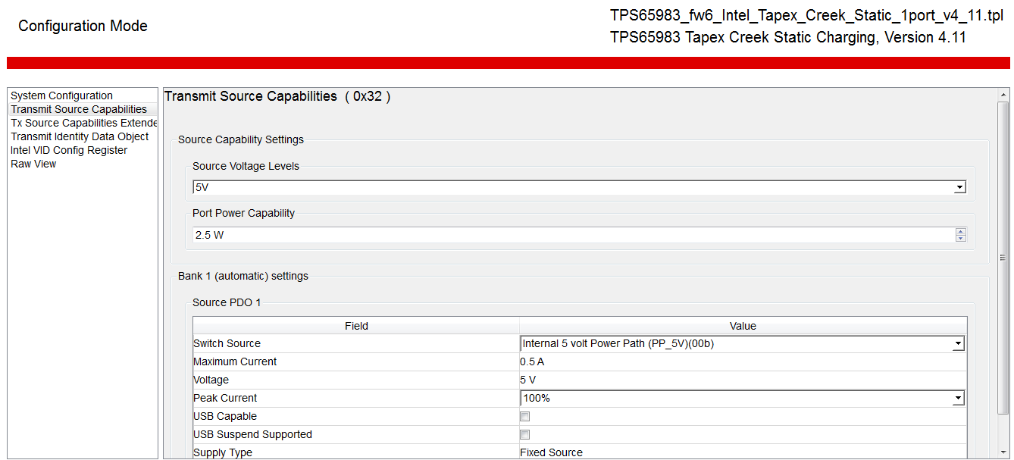
Transmit Source Capabilities

Slide 5
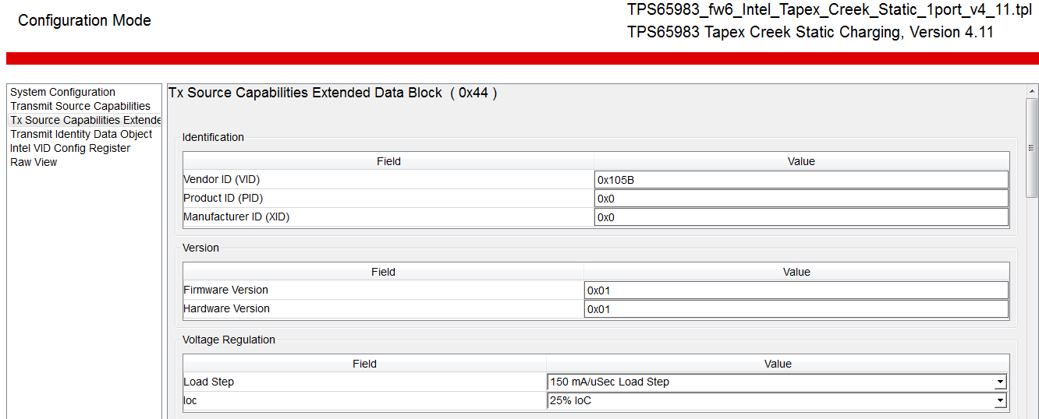
Tx Source Capabilities Extended - 1

Slide 6
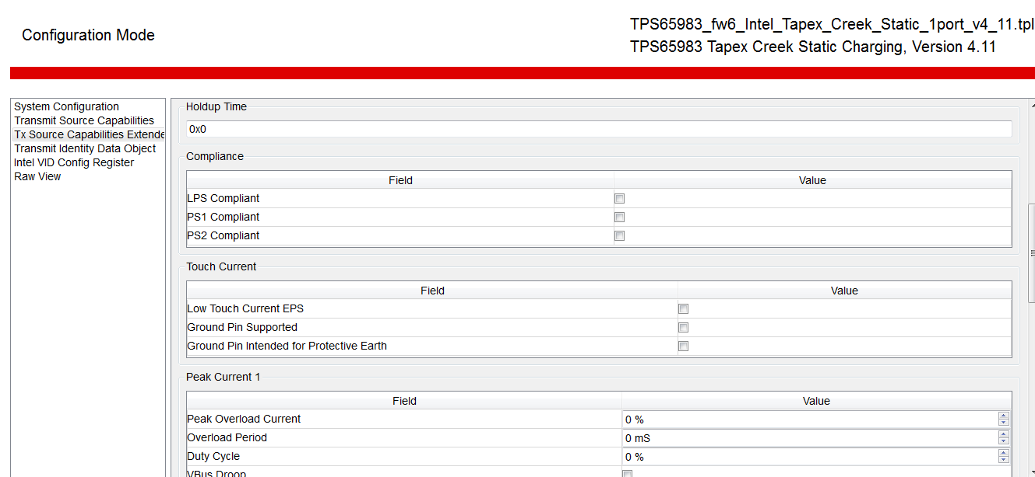
Tx Source Capabilities Extended - 2

Slide 7
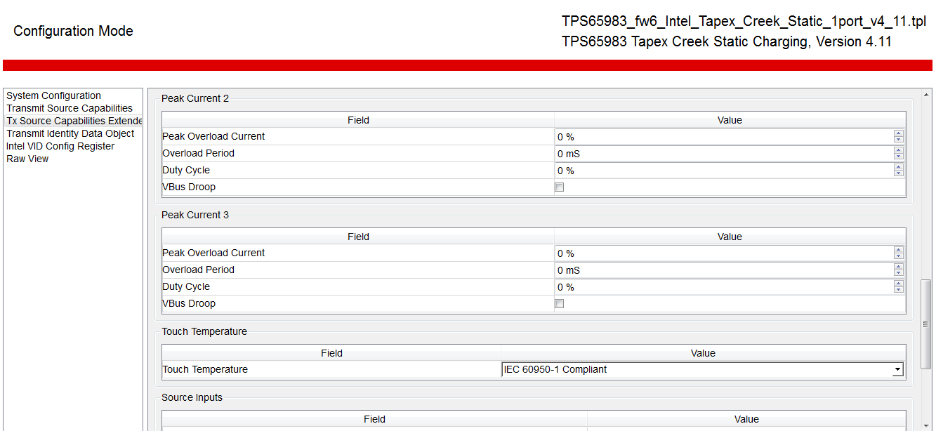
Tx Source Capabilities Extended - 3

Slide 8
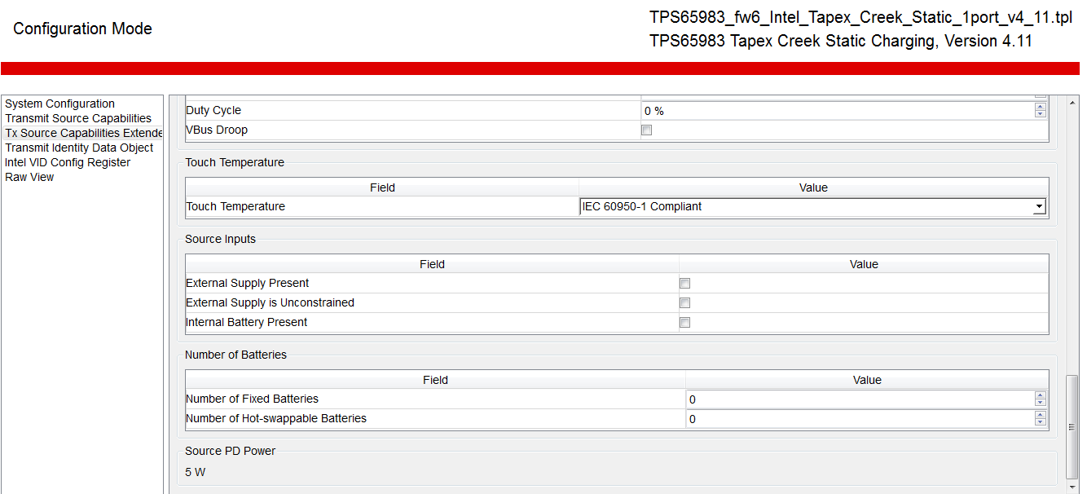
Tx Source Capabilities Extended - 4

Slide 9
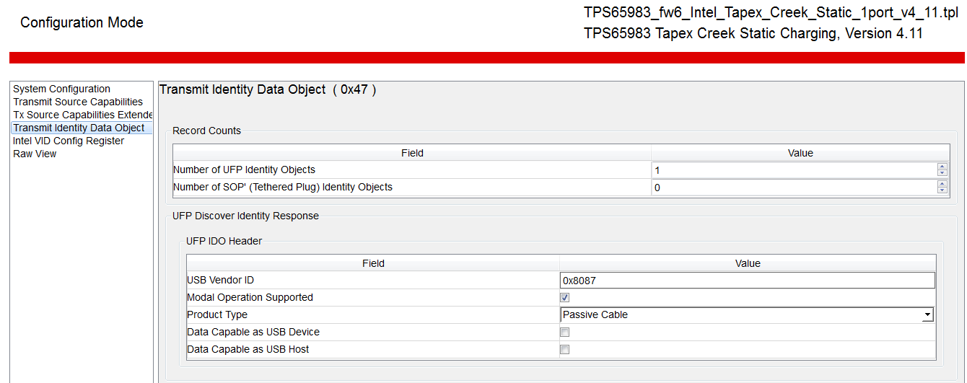
Transmit Identify Data Object

Slide 10
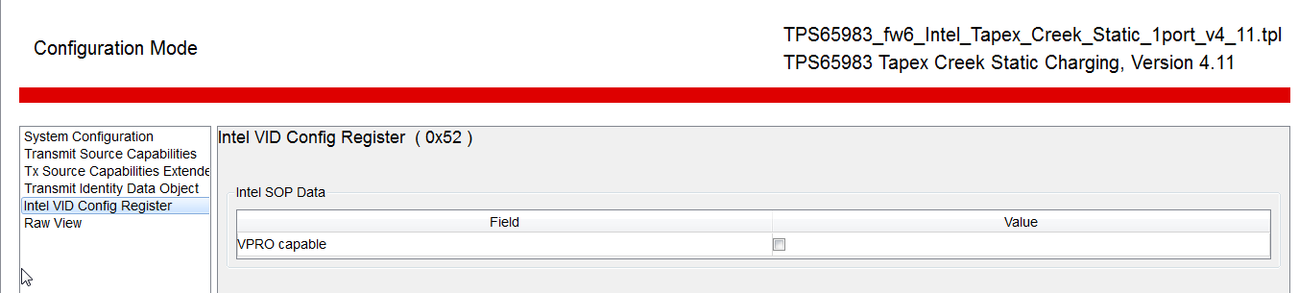
Intel VID Config Register

Slide 11
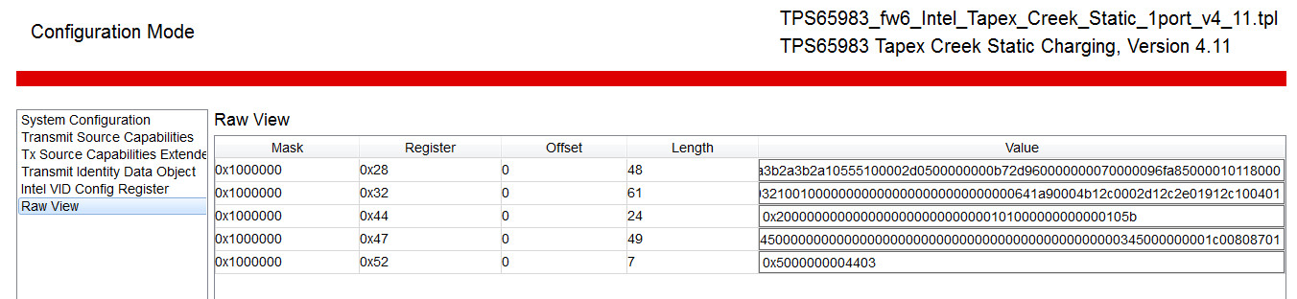
Raw View

