Slide 1
Schematic review
8/16/2023

Slide 2
Adding AC cap on USB3_SSRX_0P/N 100nf

Slide 3
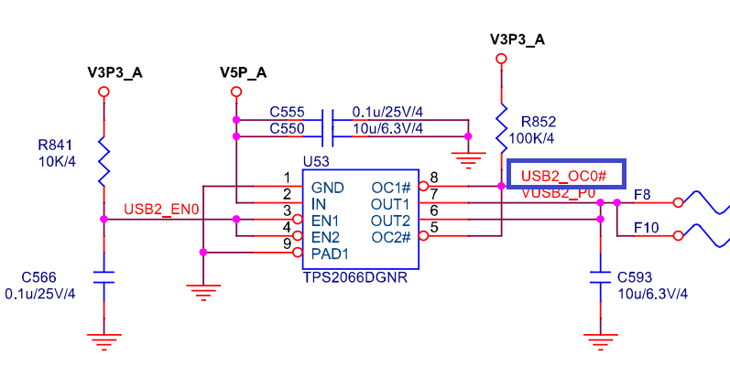
Where is USB2_OC0# is connected to?

Slide 4
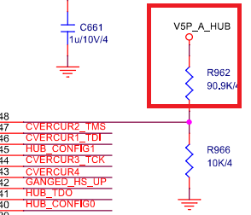
Where is Vs5_A_hub is connected to?

