Slide 1
Single-Wire CAN
Industrial Interface Applications
July 2015

Slide 2
Test Set-up: Differential Pair, R_{T} = 60 Ω
Node 1
~2m twisted pair cabling
Node 2

Slide 3
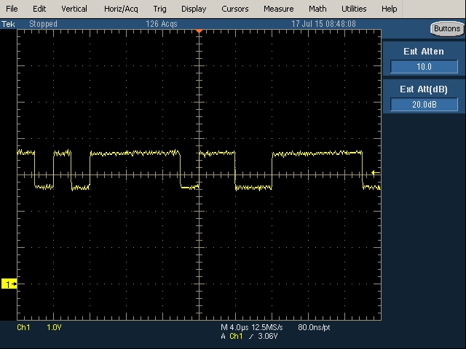
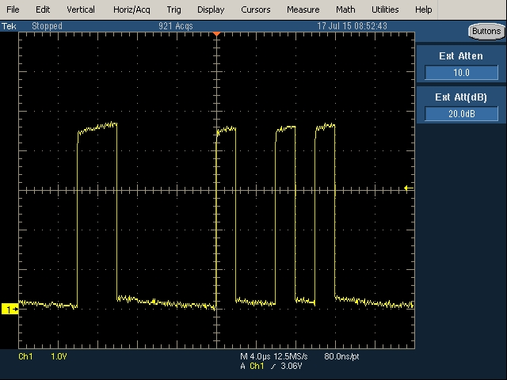
Results
CANH
RXD @ Node 2

Slide 4
Test Set-up: CANH only, CANL grounded, R_{T} = 60 Ω
Node 1
~2m twisted pair cabling
Node 2

Slide 5
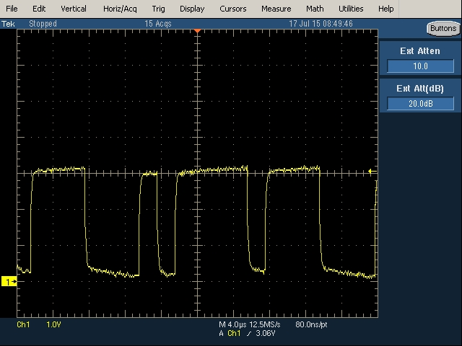
Results
CANH
RXD @ Node 2

