Slide 1
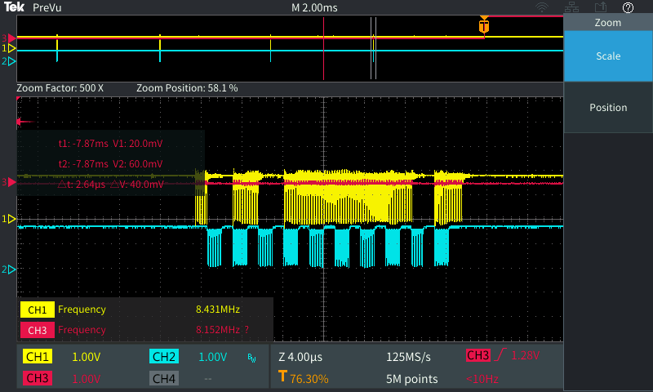
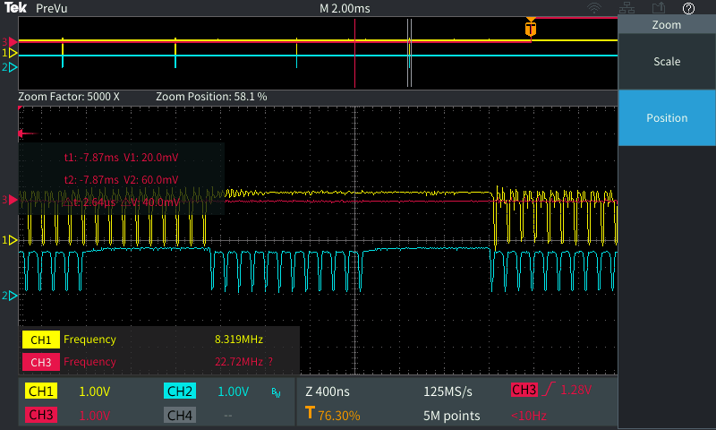
Background
Defect
  team found system failed to display correct DIMM inventory data in BMC web. DIMM 1-8 are always loss.
  Glitchy waveform was found during time frame of BMC trying to communicate with group of DIMM 1-8.
Glitch happened on I2C low

Slide 2
Topology is different between MB pass2 & pass3
Commonality block revised to move I3C level shifter (TCA39416) out of block to save cost
MB is brand new topology because TCA39416 is moved to before mux. Location of TCA39416 is different from verified pass 2 design.
3.8” – 6.5”
Pass 2 Topology
DIMM
DIMM
DIMM
MUX
DIMM
DIMM
TCA39416
DIMM
13”
DIMM
TCA39416
MUX
0.3”
DIMM
BMC
2.9”
1.1”
10.9”
DIMM 1-8
1.8”
TCA39416
0.12”
2” – 5.5”
MUX
DIMM
CONN
DIMM
DIMM
DIMM
DIMM
DIMM
DIMM
DIMM
DIMM 9-16
Pass 3 Topology
3.8” – 6.5”
DIMM
DIMM
DIMM
DIMM
13.5”
DIMM
MUX
DIMM
TCA39416
MUX
DIMM
BMC
2.9”
1.1”
11”
TCA39416
0.2”
DIMM
DIMM 1-8
CONN
1.85”
MUX
2” – 5.5”
DIMM
DIMM
DIMM
DIMM
DIMM
TCA39416 been moved out of commonality block
DIMM
DIMM
1.0V domain
1.8V domain
DIMM
DIMM 9-16
1.8”

Slide 3
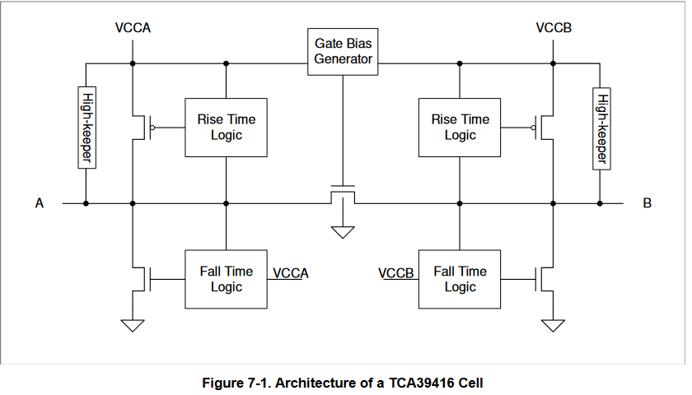
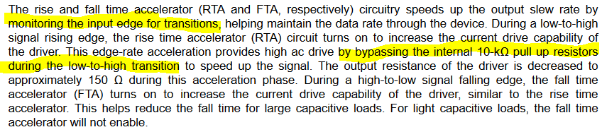
Accelerating circuit inside TCA39416 causes glitch
Reflection may trigger accelerating from TCA39416. That causes unexpected glitch.
DIMM
VDS < VGS-VTH
Triode mode >> TCA39416 acts like damping (Rds-on) in analog topology.
BMC
VGS=1V
DIMM
VDS < 1V
Not an end point, may receive reflection!
DIMM

Slide 4
Electrical Perspective
VGS < Vth, FET inside TCA39416 cutoff
1.0V
1.8V
1.8V
1.0V
BMC
VGS=1.8V
VGS=0V
To muxing circuit
1. XCC logic high, keep high by pulled resistor
High
1.0V
1.8V
VDS ~ 0.8V
VDS > VGS-VTH
Saturation mode
1.0V
1.8V
1.8V
1.0V
BMC
VGS=1.8V
VGS=1V
To muxing circuit
2. XCC start pull signal to low
High to low
High to low
VDS = 1V
VDS < VGS-VTH
Triode mode >> TCA39416 acts like damping (Rds-on) in analog topology.
1.0V
1.8V
1.8V
1.0V
BMC
VGS=1.8V
VGS=1V
To muxing circuit
Reflection
3. XCC pull low to low, FET enter triode mode act like damping in middle of signal path. Reflection might happen
Low
Low
VDS << 1V (below VGS-Vth)
Not an end point, may receive reflection!
1.0V
1.8V
1.8V
1.0V
4. TCA39416 sensed reflection and treat it as low to high edge transition. Pull up resistor bypassing asserted. Pull voltage to high
BMC
VGS=1.8V
VGS=1V
To muxing circuit
Reflection
High to low
TCA39416 A side senses reflection as a low to high edge transition. B side pull up bypass asserted
Low
1.0V
1.8V
1.8V
1.0V
B side achieved logic high, pull up bypassing de-asserted. Voltage been pulled back to low by BMC
5. TCA39416 de-assert pull up bypassing after voltage reach to high. Voltage been pulled to low
BMC
VGS=1.8V
VGS=0V
To muxing circuit
Low
1.0V
1.8V
High to low
VDS = 1V

Slide 5
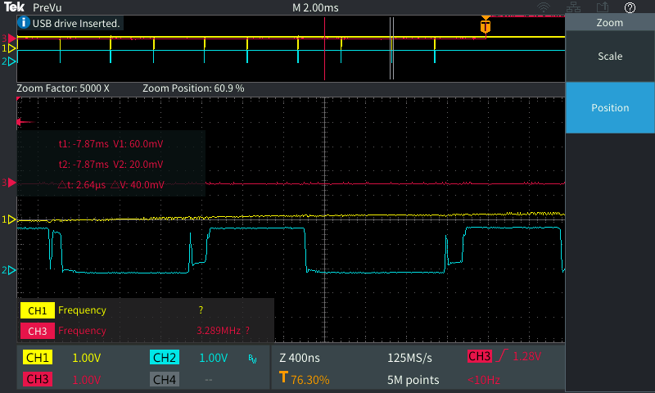
Cannot completely eliminate glitch with only tuning BOM items
Adjust damping resistors nearby DIMM
Remove extra pull up resistor
Adjust damping resistors on SCM
Adjust damping resistors nearby mux (branch of DIMM 1-8)
Bypass mux by jump wire
Adjust DIMM population condition (0 DIMM, 1 DIMM, full DIMM…)
Default (full glitch)
Best improve (still glitch)

Slide 6
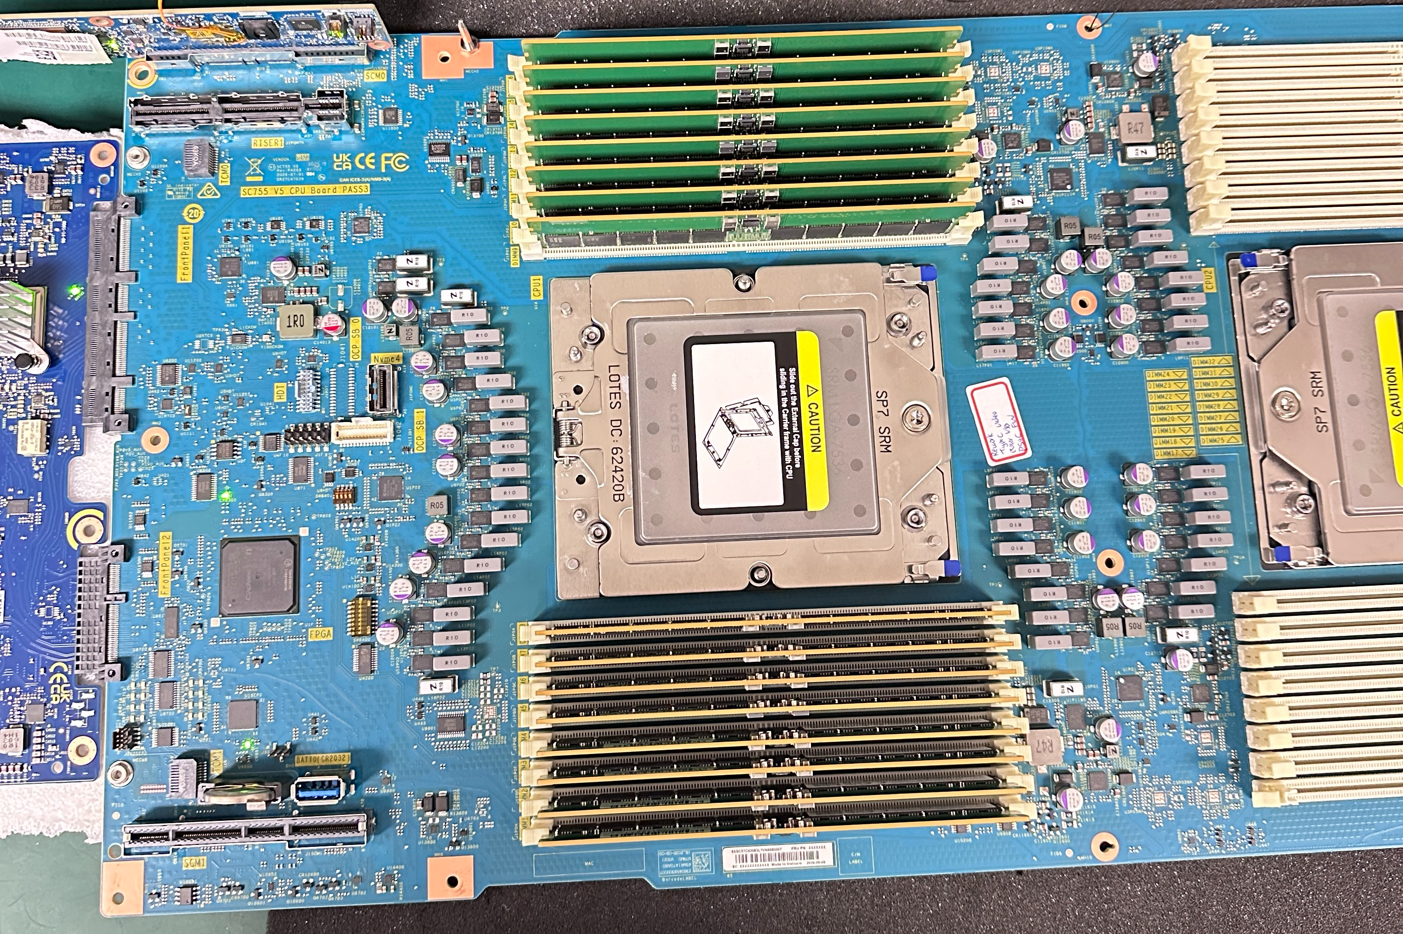
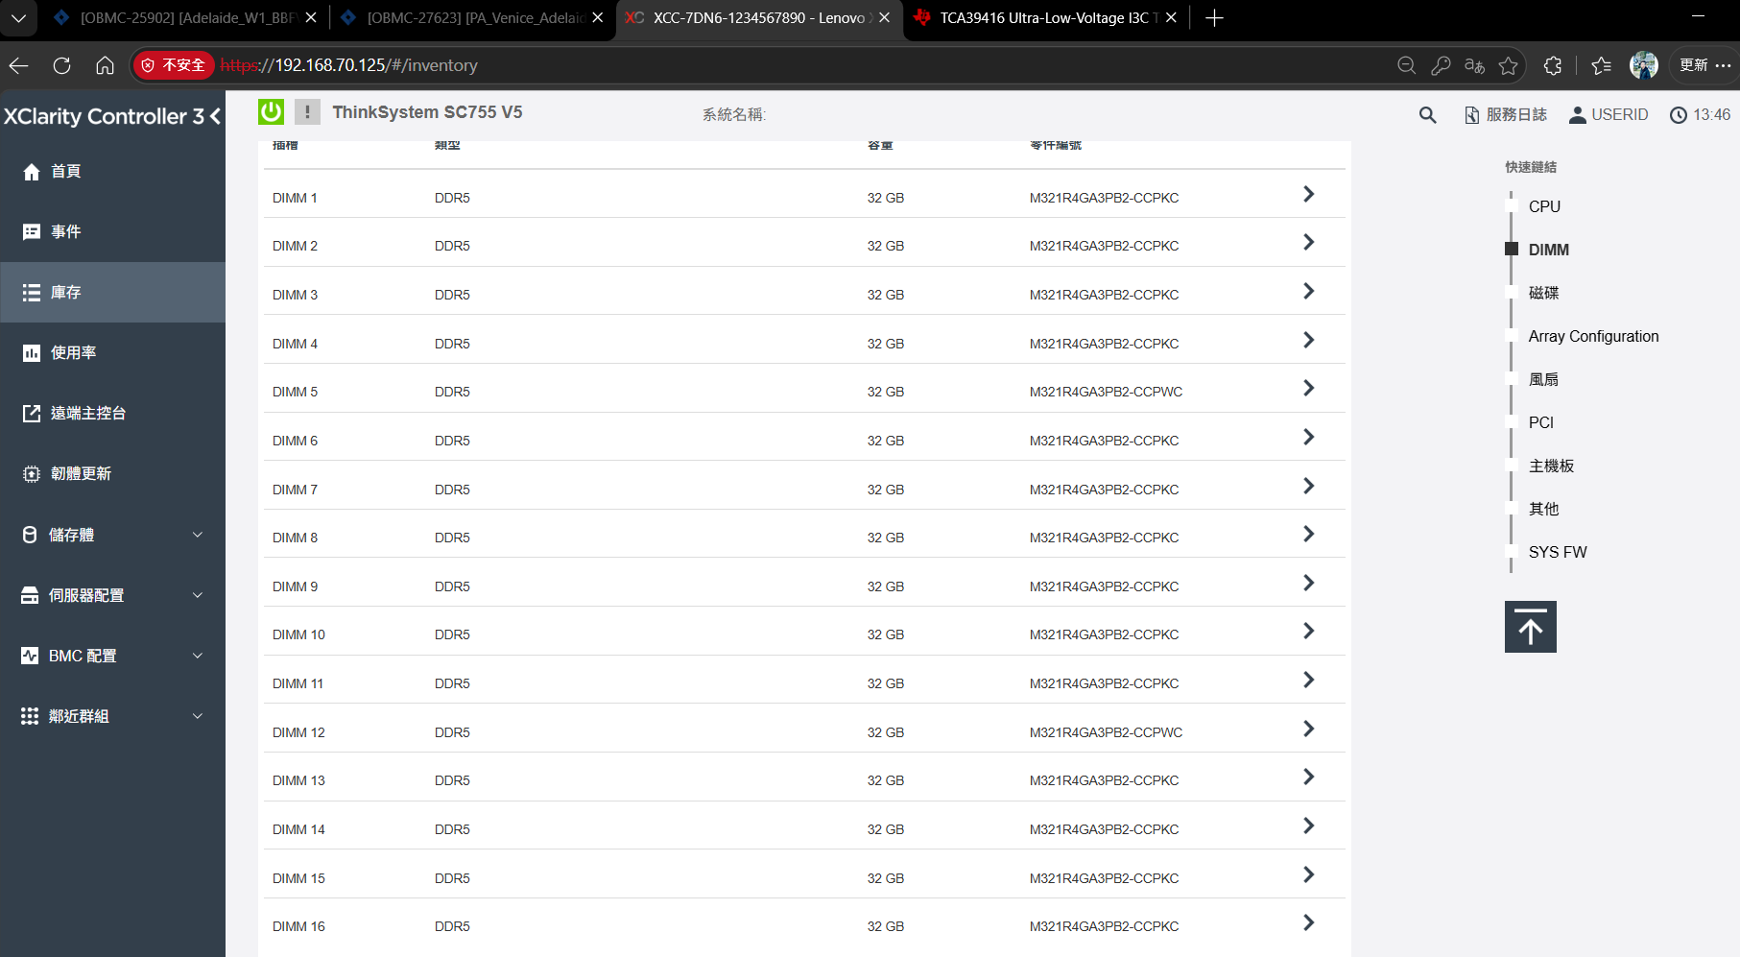
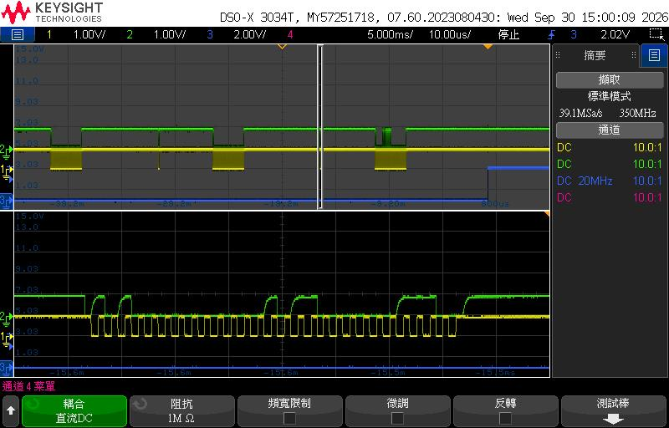
Bypass TCA39416
Both function-wise and signal-wise got fixed.
All DIMM display in XCC inventory
Signal is glitch-free

