Slide 1
TCAN1043 vs TCAN1043A
ASC-INT-TRX
September 9, 2021

Slide 2
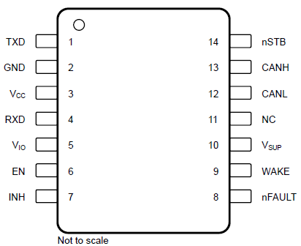
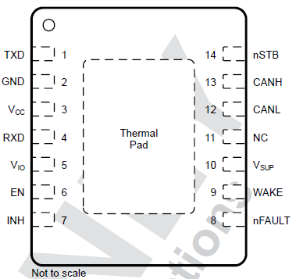
Migrating from TCAN1043 to TCAN1043A (Key Specs)
Parameter | TCAN1043(H) |  | TCAN1043A
CAN Data rate | CAN FD upto 2 or 5 Mbps |  | CAN FD upto 8 Mbps
CAN Bus Fault | ±58 V (±70 V) |  | ±58 V
RX Common mode | ±30 V , ±12 V in sleep |  | ±12 V
VSUP Abs Max | 58 V (70 V) |  | 45 V
VSUP Op Range | 4.5 – 45 V (60 V) |  | 4.5 – 40 V
VSUP UV | 3 V – 4.2 V |  | 3.5 – 4.25 V (Falling) 3.85 – 4.4 V (Rising)
Operating T_{J} | -55 to 150 °C |  | -40 to 150 °C
VIO Range | 2.8 – 5.5 V |  | 1.7V – 5.5 V
VIO UV | 1.3 V – 2.75 V |  | Falling: 1 V (min) Rising: 1.65 V (max)
INH Output | High Z when output disabled |  | 4MΩ pull-down on INH when disabled ( sleep mode )
Logic Pins Abs Max | 7 V |  | 6 V
I_{IH} at EN and nSTB | 10 µA |  | 115 µA (due to lower value of pull-down resistor)
Migrate to TCAN1043A-Q1 easily
Pin to Pin compatibility
Differences highlighted – all other parameters remain unchanged
Small SOT package (DYY) for space-saving applications
Pin-to-Pin Drop-in
VSON: 4.5 x 3 mm
SOIC: 8.65 x 3. 9 mm
SOT: 4.2 x 2 mm New

Slide 3
Migrating from TCAN1043 to TCAN1043A (Details)
Section | TCAN1043(H) | TCAN1043A
CAN Bus Biasing | Fixed Bus Biasing (2.5 V in Normal, GND in STB/Sleep) | Autonomous
Mode Behavior | CAN transmitter would transmit dominant until the TXDDTO timer expired | CAN driver disabled if TXD=0 when entering CAN Bias Active (TXDCLP)
 | UVIO, UVCC always run the 300ms Sleep timer (T_{UV}). VIO and VCC need to be above the UV thresholds within T_{UV} after powering up or after entering Standby mode from Sleep mode due to Wake event. | UVIO, UVCC 300ms Sleep timer (T_{UV}) is disabled until VIO/VCC are good. Allows for indefinite power up time. Sleep Wake Error (SWE) timer transitions the device into Sleep mode after 4 minutes (t_{INACTIVE}) if the device is stranded in Standby mode due to (a) VCC/VIO not powering up properly or (b) MCU fails to transition the device into Normal mode.
 | VCC Supervisor ON in Sleep mode – VCC > UVCC automatically transitions the device into normal or silent mode | VCC Supervisor Off in Sleep mode – Explicit toggling of nSTB from low-to-high required for transition into normal/silent mode (e.g. if the device enters sleep mode due to UVCC).
 |  | VIO < UVIO transitions the device from normal to Standby mode
 | NFAULT pin is driven high during sleep mode (if VIO is present) | NFAULT pin is high-Z in sleep mode (even if VIO is present)
Migrate to TCAN1043A-Q1 easily
Pin to Pin compatibility
Differenced highlighted – all other parameters remain unchanged
Small SOT package (DYY) for space-saving applications
SOIC: 9.9 x 3.91 mm
SOT: 4.2 x 2 mm
VSON: 4.5 x 3 mm
3

Slide 4
Thermal Table
THERMAL METRIC |  | TCAN1043x-Q1 |  | TCAN1043A-Q1 |  | UNIT
 |  | D (SOIC) | DMT (VSON) | D (SOIC) | DMT (VSON)
R_{θJA} | Junction-to-ambient thermal resistance | 78 | 33.1 | 87.1 | 39.7 | °C/W
R_{θJC(top)} | Junction-to-case (top) thermal resistance | 33.6 | 30.5 | 41.8 | 41.1 | °C/W
R_{θJB} | Junction-to-board thermal resistance | 34.7 | 10.8 | 43.7 | 15.9 | °C/W
Ψ_{JT} | Junction-to-top characterization parameter | 5.7 | 0.4 | 8.5 | 0.9 | °C/W
Ψ_{JB} | Junction-to-board characterization parameter | 34.3 | 10.7 | 43.3 | 15.9 | °C/W
R_{θJC(bot)} | Junction-to-case (bottom) thermal resistance | n/a | 1.3 | N/A | 6.6 | °C/W

