Slide 1
Abnormal voltage waveform on CANL pin with defective TCAN4550
Date: Apr. 10.2023

Slide 2
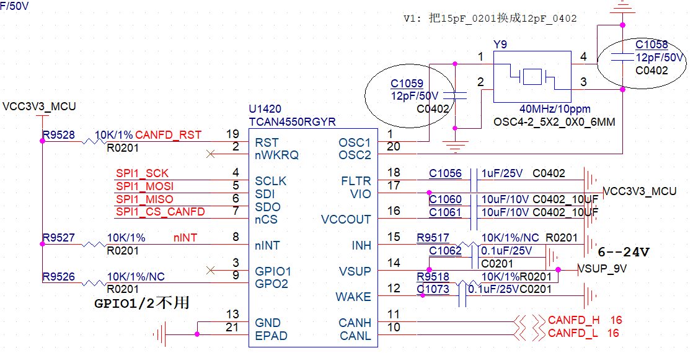
Schematic

Slide 3
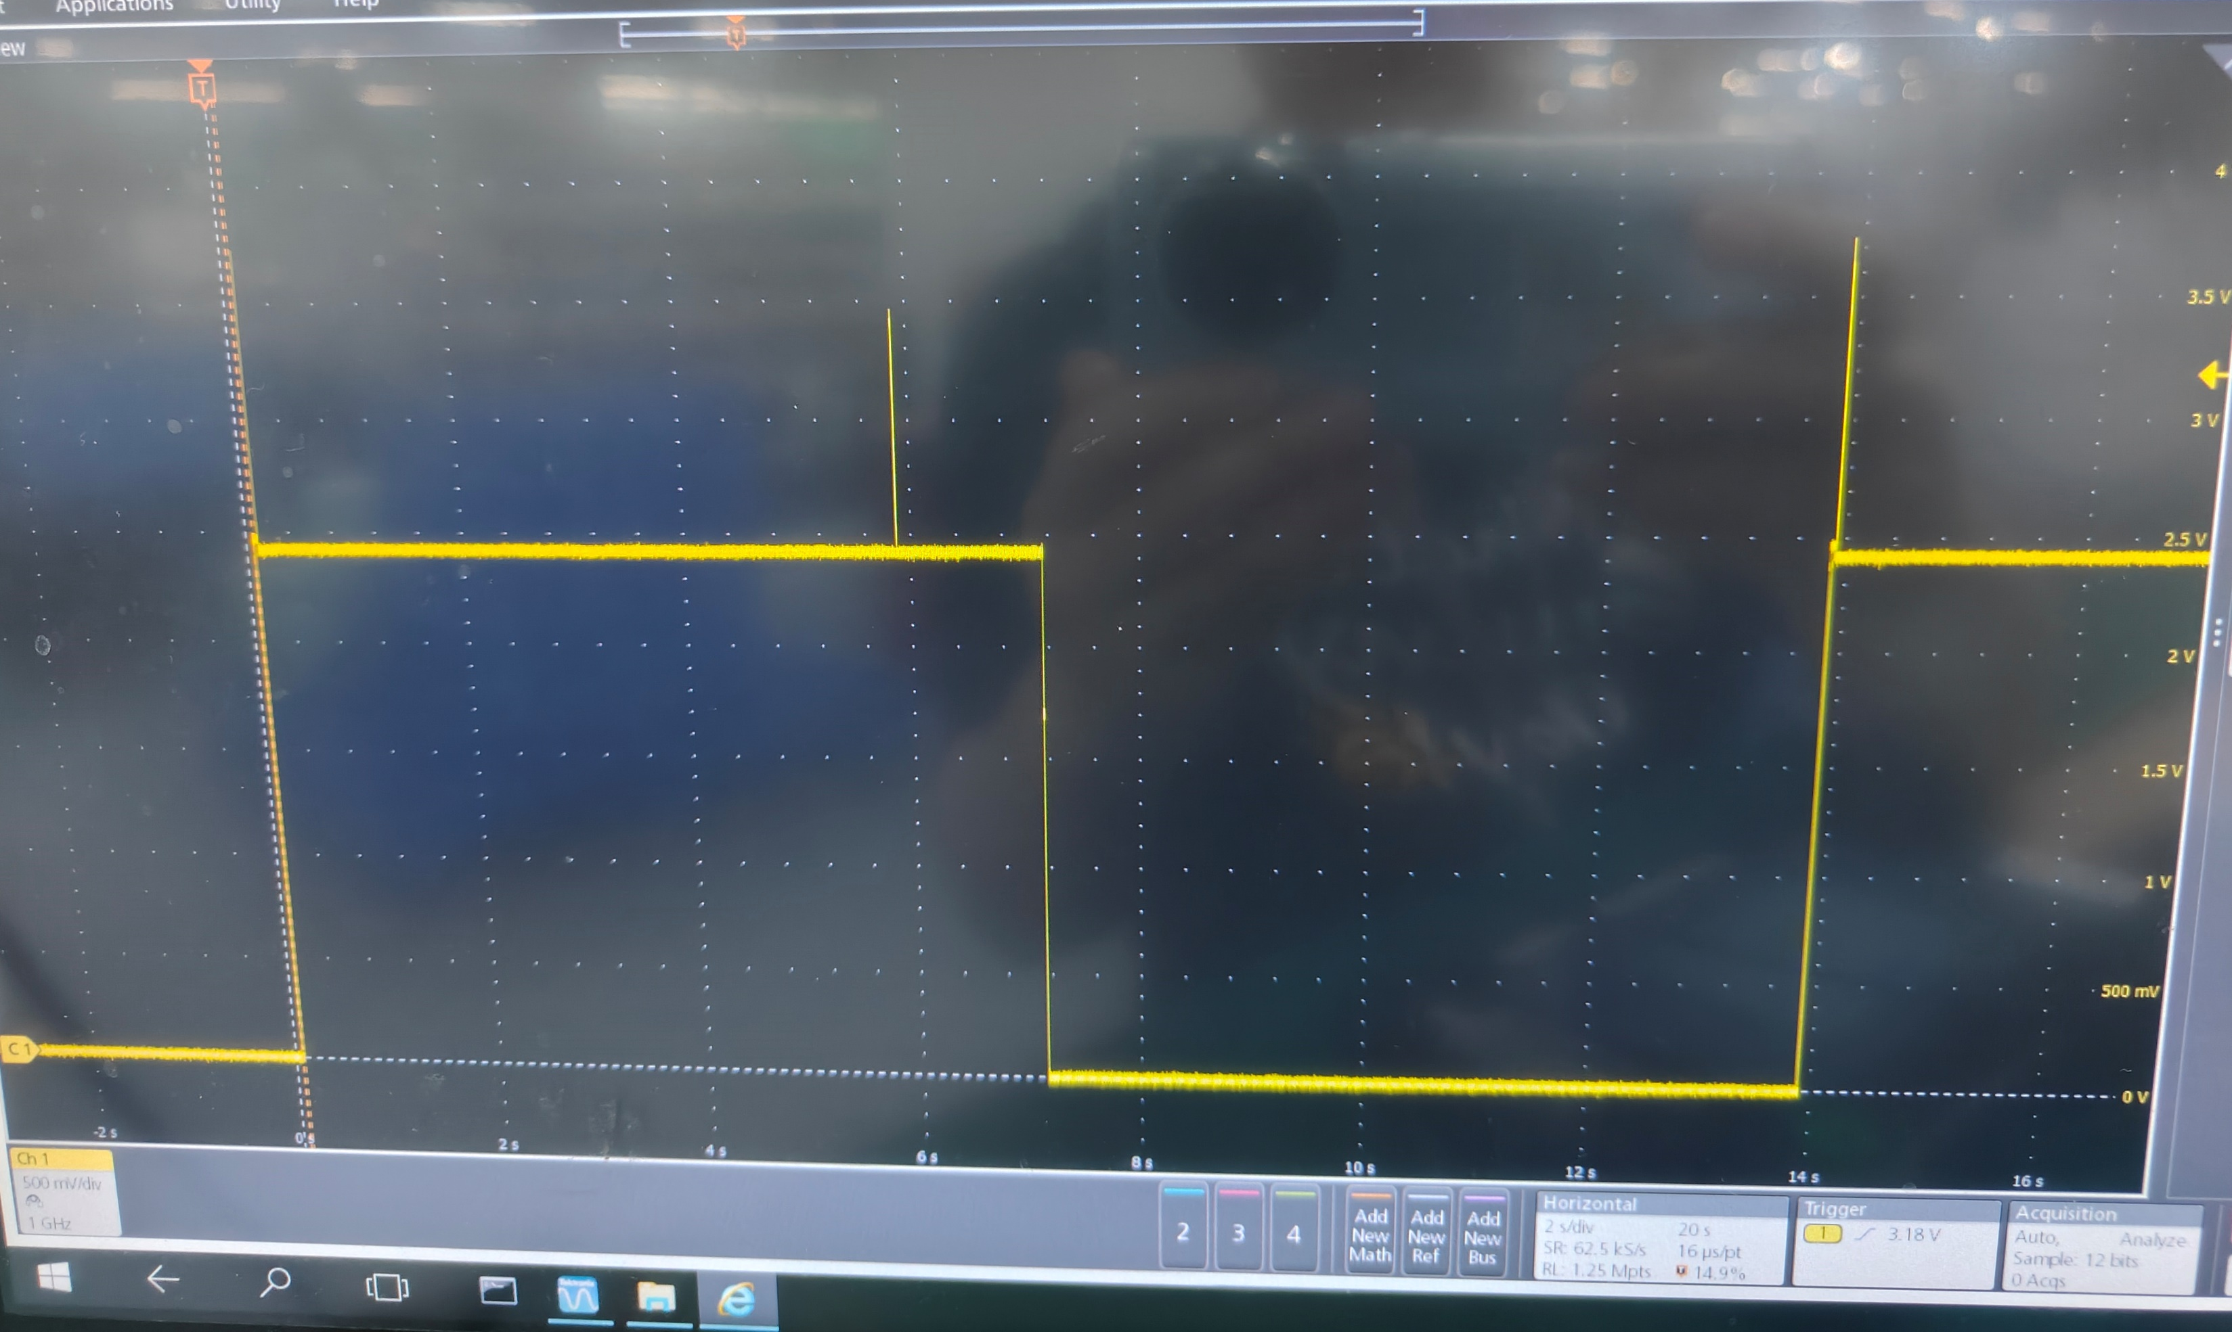
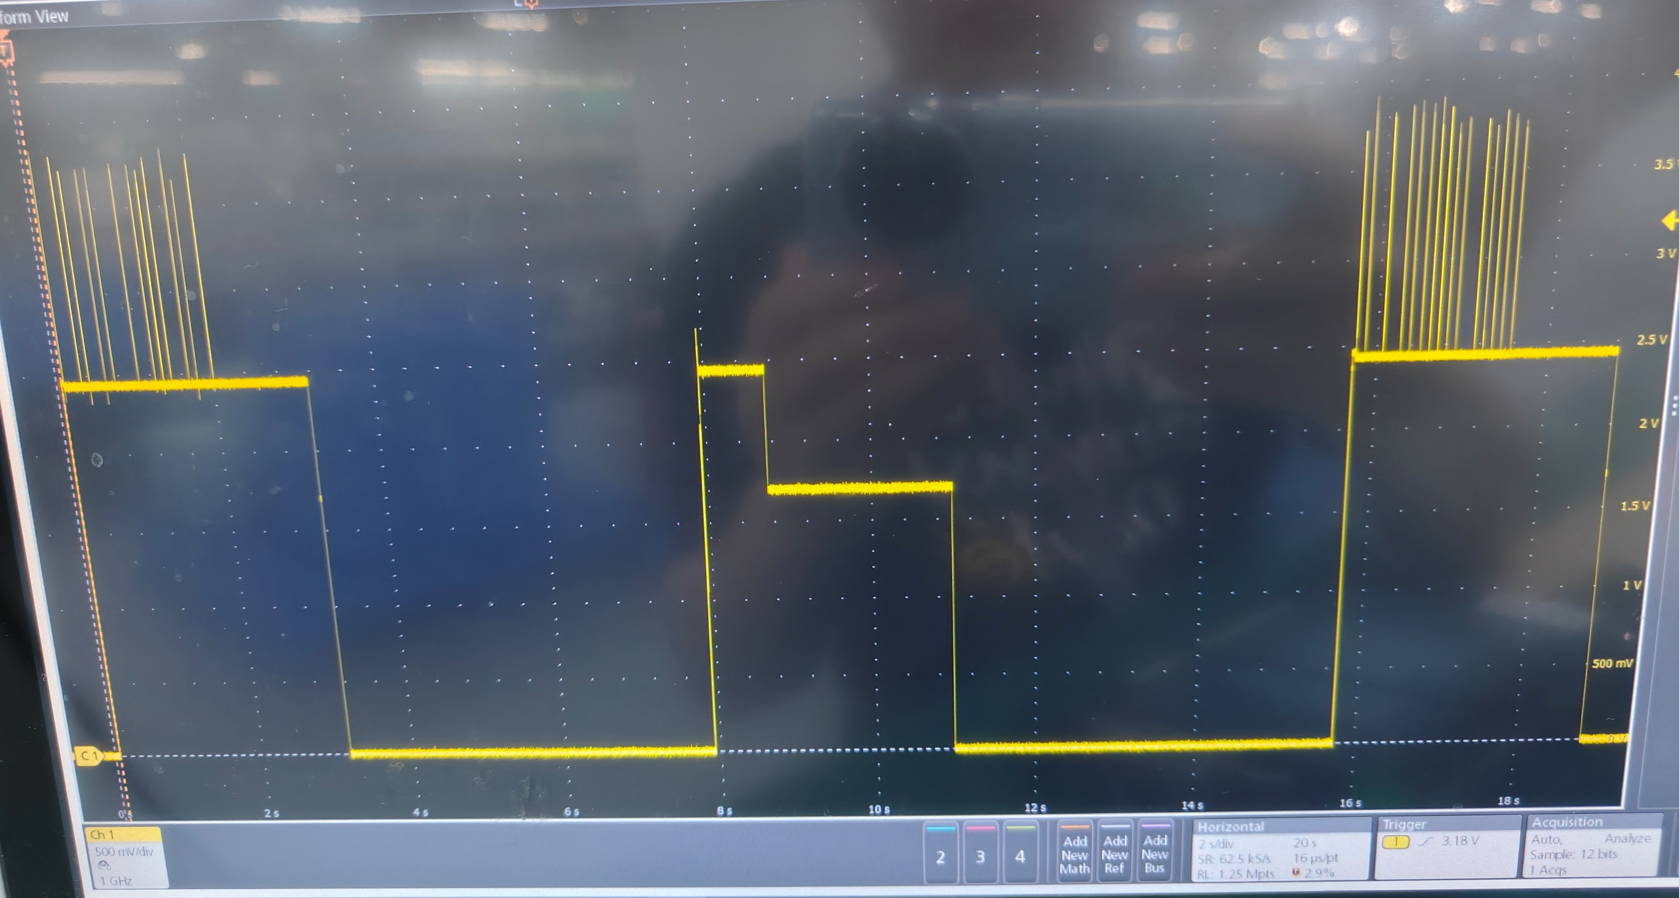
Waveforms on CANL pin
Fig1. Yellow: voltage waveform on CANL with good TCAN4550
500mv/div, 2S/div
Fig2. Yellow: voltage waveform on CANL with a defective TCAN4550
500mv/div, 2S/div
Question:
In Fig. 2, with a defective TCAN4550,The voltage level on CANL pin drops from 2.5V to 1.75V. Is it possible for some register setting of TCAN4550 to cause this phenomenon? Customer said that with the same system software, but I can’t confirm that the register setting for TCAN4550 ICs as no log file for TCAN4550 can be downloaded in customer system.
As the issue is followed with defective IC, we plan to apply for failure analysis if we can’t find out possible reason. do you agree our plan? If not, what waveforms of pins should I teste to dig out possible reason?

