Slide 1
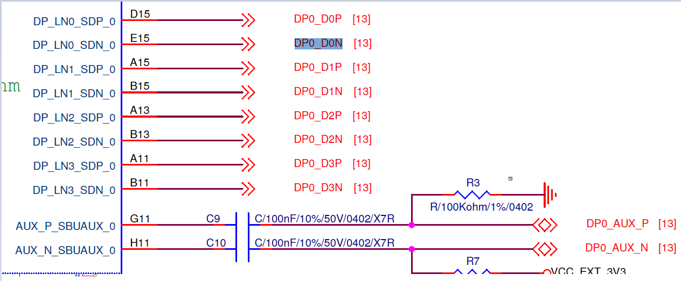
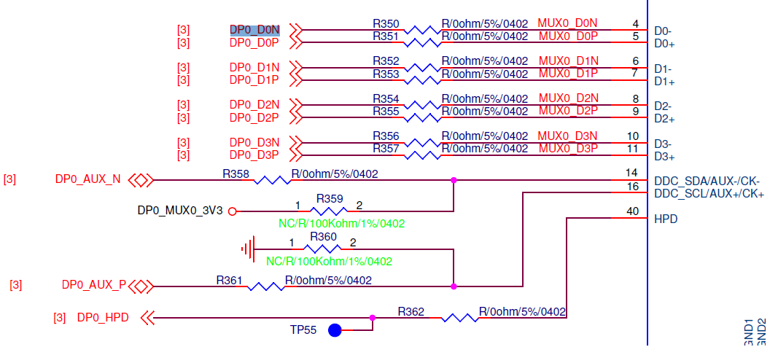
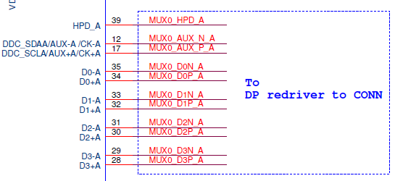
Application
SOC
Switch
TDP142RGFRQ1
DP connector
serializer
SOC interface
Switch

Slide 2
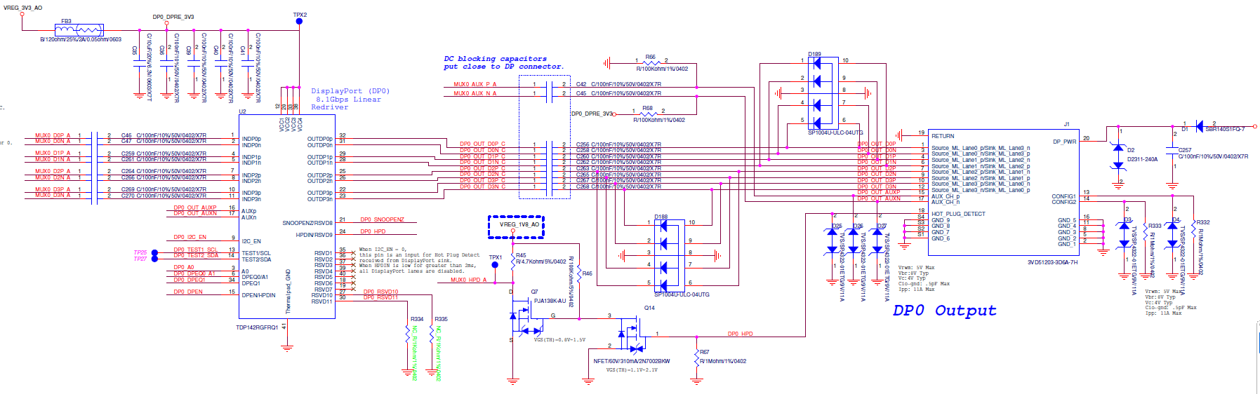
TDP142RGFRQ1=>DP connector

