Slide 1
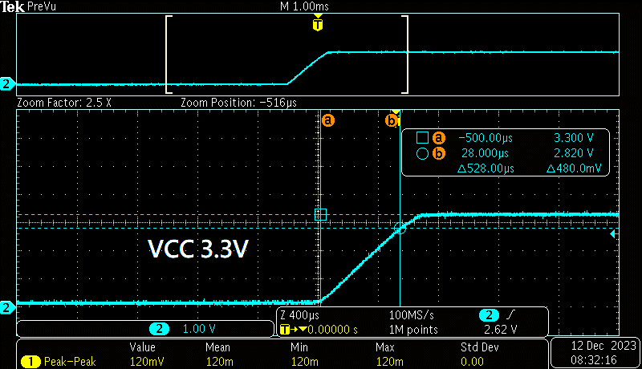
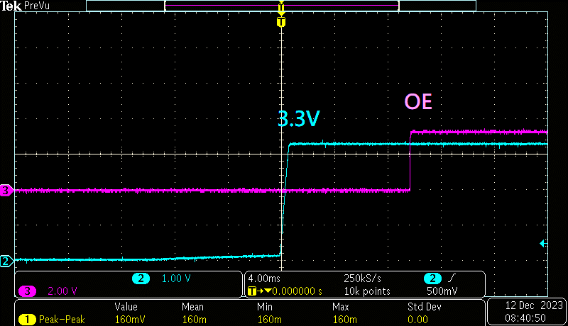
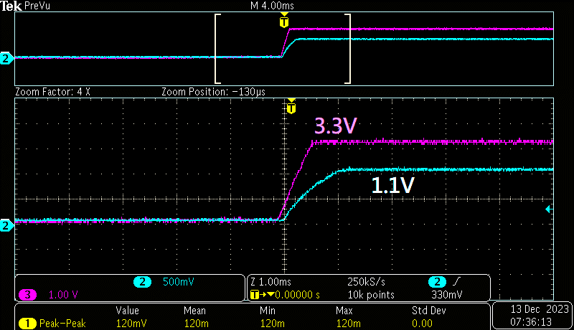
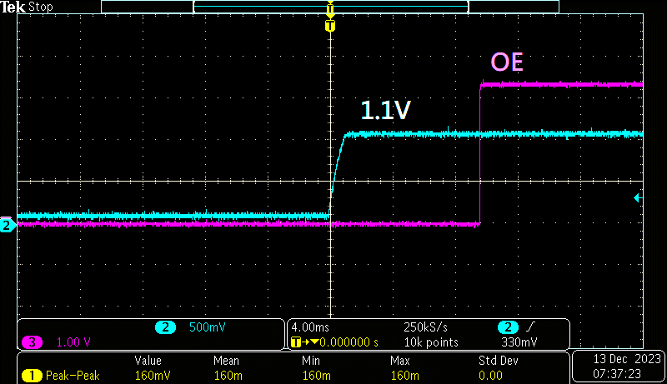
Ramp up time | Sequence before fine tune | Sequence after fine tune
VCC > 0.2ms | VDD before VCC ~10 mS | VCC before VDD
VDD>0.2ms | VCC before OE ~10 mS

