Slide 1
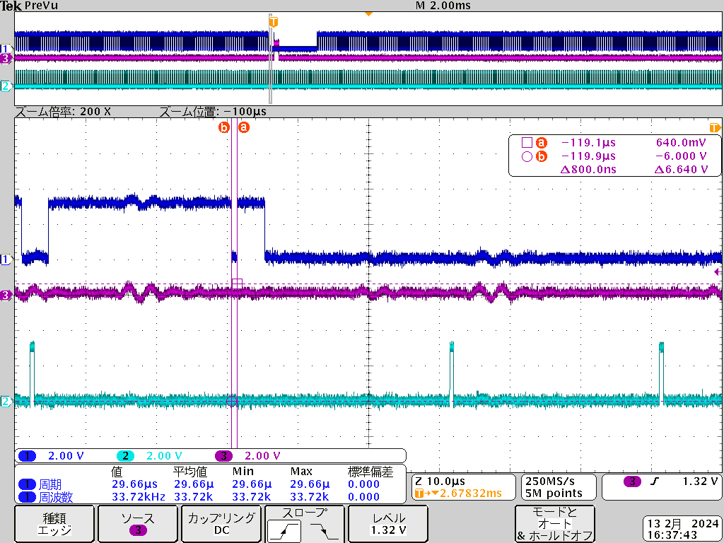
DE OUT
V_SYNC OUT
V_SYNC OUT
H_SYNC does not appear
H_SYNC OUT
H_SYNC OUT
抜けている

Slide 2
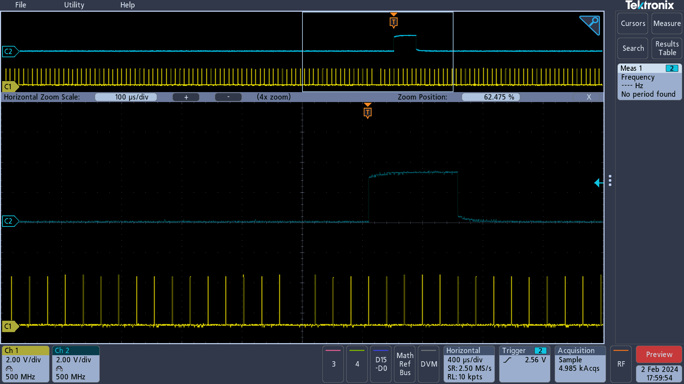
Enlarged waveform↓
V_SYNC OUT
H_SYNC does not appear
H_SYNC OUT
抜けている

Slide 3
In the initial settings of the camera, the customer does not read the EDID and outputs at a fixed resolution. When using the resolution 1080p 29.97Hz, it is output in the CEA VIC34 format (details shown below).
V_SYNC OUT
H_SYNC does not appear
H_SYNC OUT
抜けている

