Slide 1
TFP401A HSYNC Skip
Vishesh Pithadiya

Slide 2
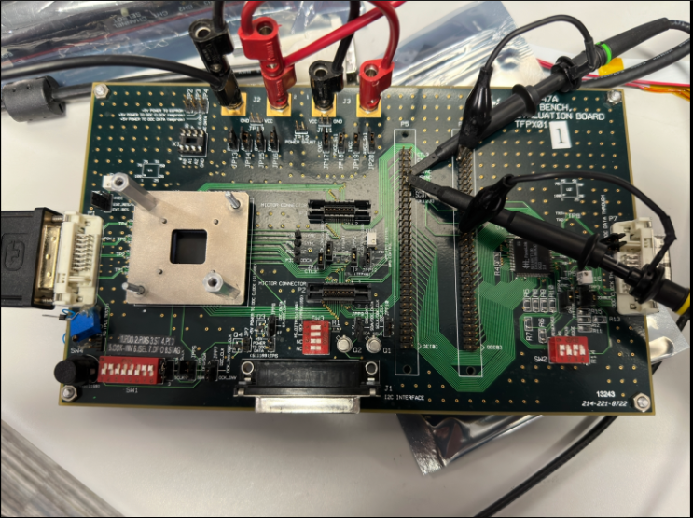
Setup
Resolution: 1920 x1080 29.98Hz

Slide 3
Screen Captures
HSYNC
VSYNC
HSYNC
VSYNC

Slide 4
Screen Captures
HSYNC
DE
HSYNC
DE

