Slide 1
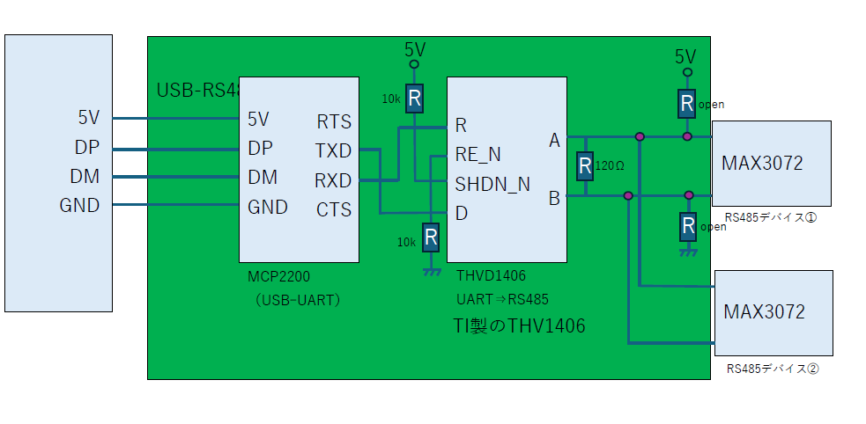

Slide 2
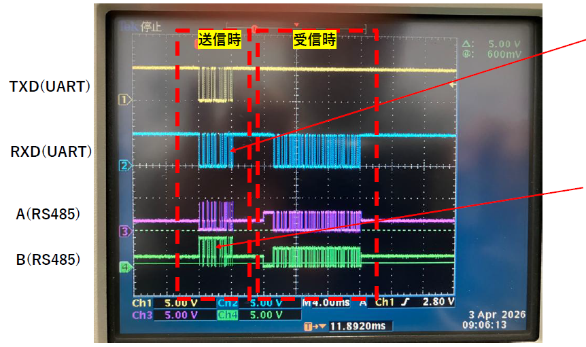
The following is the signal waveform during communication with the current circuit. The A/B signals during transmission have become as shown on the next page. Could you please advise on how to improve this?
TX data is looped back.
A/B signal during transmission
⇒ Enlarge to next page

Slide 3
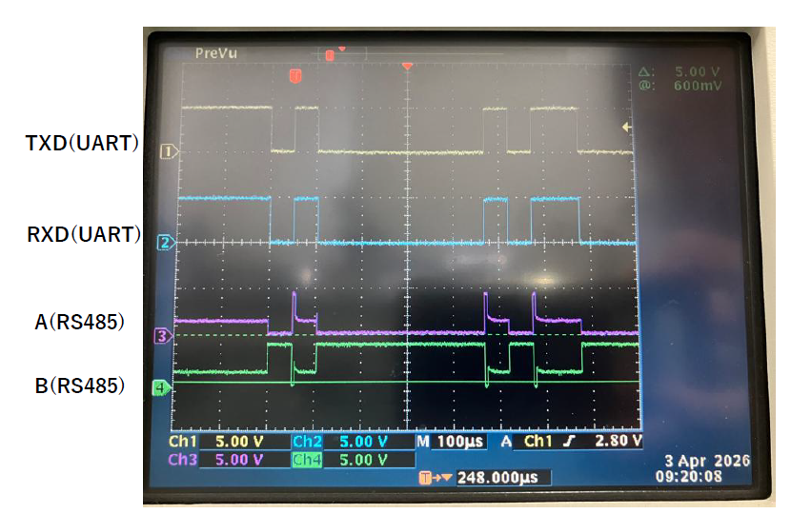
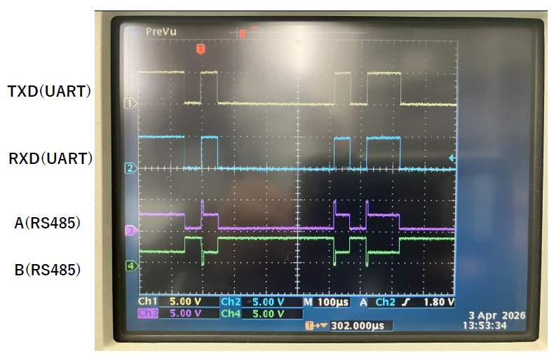
Signal level during loopback (THVD1406) Terminal Resistance: 120Ω
Pull-up/pull-down resistance to A/B line: None
Pull-up/pull-down resistance to A/B lines:
1.5kΩ

Slide 4
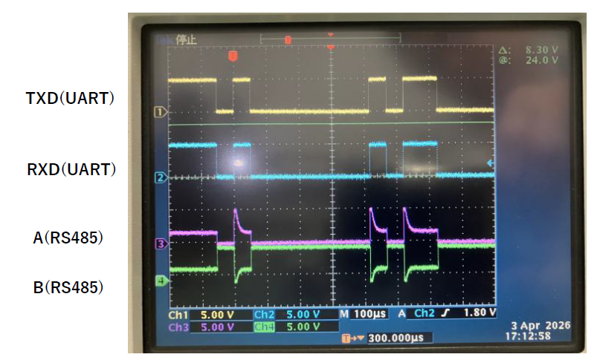
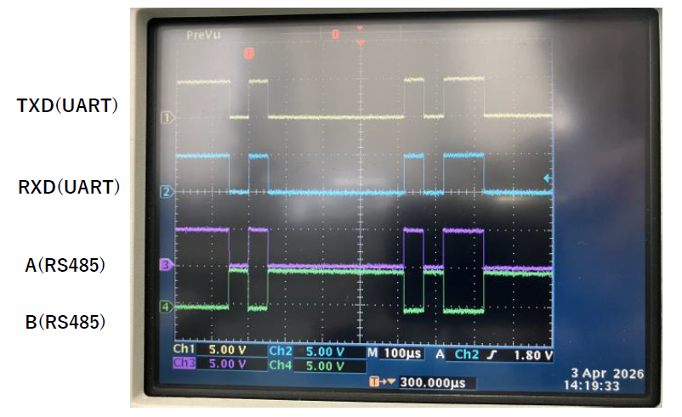
Signal level during loopback (THVD1406) Termination Resistance: None
Pull-up/pull-down resistance to A/B line:
None
Pull-up/pull-down resistance to A/B lines:
1.5kΩ

Slide 5
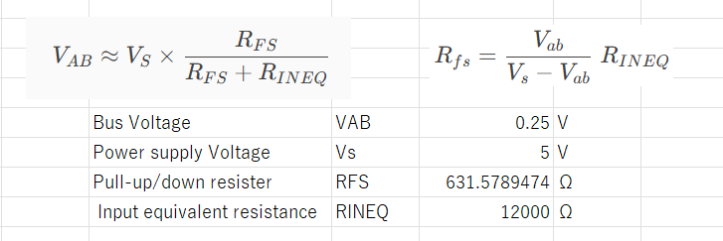
Calculate the pull-up/down resistance values ​​when there is no termination resistor.
Pull-up/down resister

