Slide 1
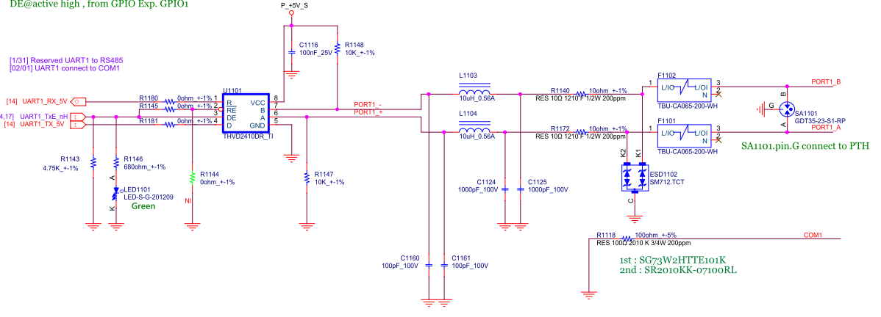

Slide 2
Question
data loss when comment from “ttymxc0 to ttymxc2 (or 2-0)” transfer to “ttymxc2 to ttymxc0 ( or 0-2)”
Need to set 2S delay to fix the issue

Slide 3
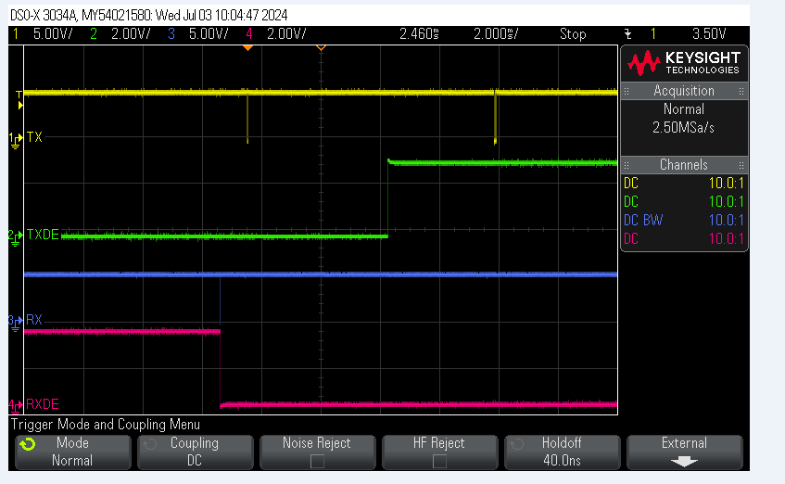
Glitch on Rx

Slide 4
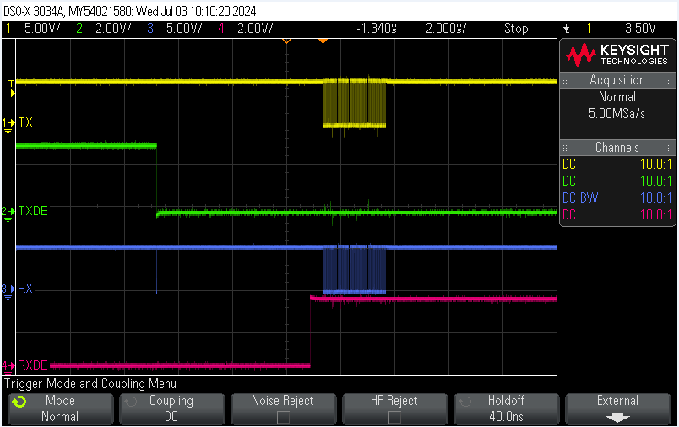
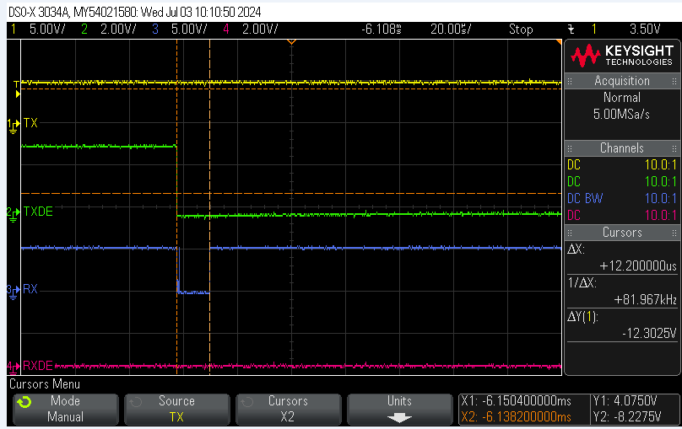

Slide 5
Feedback from customer
From what I can see the issue we are seeing from the glitch is because how the uart ports are configured. The are configured as general purpose uarts in the device tree. If you operate them as such you will see the glitch. The uart ports need to be configured as general purpose RS485 ports so that the driver can control the transmit enable accordingly and RX and TX. If we configure them as such I do not believe we will see the glitch.

