Slide 1
Questions_1
IC pins
- Do you agree with the latest version of 953 IC pins configured?
See the comments I made in “LG_FORD_RGBIR_OV2778_MAX20446_R73_211122_ICC_Reviewed.pdf” for changes that I’ve suggested. Some changes need to be made and some things are suggested to be double-checked. For example, since you intend to connect the UB953 to a UB954 in Non-Synchronous mode, you should use a 50MHz oscillator on the CLKIN pin on the UB953 in order to achieve a 4Gbps Forward Channel line rate.
- Do you agree with the latest version of 953 unused IC pins configured? (3 pins are floating)
Yes, I agree with the current version’s unused pins configuration.
The GPIO pins can be left floating if unused. However, TI recommends setting the GPIOx_INPUT_EN register bits for the unused GPIO pins to 0 to disable them. And the RES1 pin (Pin 22) must be left floating.

Slide 2
Questions_2
Reference Clock
- Do you agree with the refence clock setting when consider Clock jitter requirement?
Yes, the jitter of the selected oscillator is fine. The UI_CLK_IN of the input clock is 40ns. And the jitter needs to be less than 5% of UI_CLK_IN. Since the chosen oscillator’s jitter is much less than 2ns, it can be used. Also, a 25MHz clock results in a 2Gbps FC line rate. Is this intended?
- Do you agree with the Duty cycle when consider 953 specification?
Yes, the duty cycle of the chosen oscillator (component X3) is within the 953 specifications.
[CLK Information]
##. CLKIN duty cycle requirement definitions (requirement of U3 and output of X3)
→ X3 Duty cycle : 55% (max)
→ U3 Duty cycle : Not information
##. CLKIN jitter requirement definitions (requirement of U3 and output of X3)
→ X3 Jitter : 3ps (max)
→ U3 jitter : UI_CLK_IN = 1/freq. = 1/25Mhz → 40ns
→ U3 jitter : 0.05UI_CLK_IN = 0.05*40ns = 2ns

Slide 3
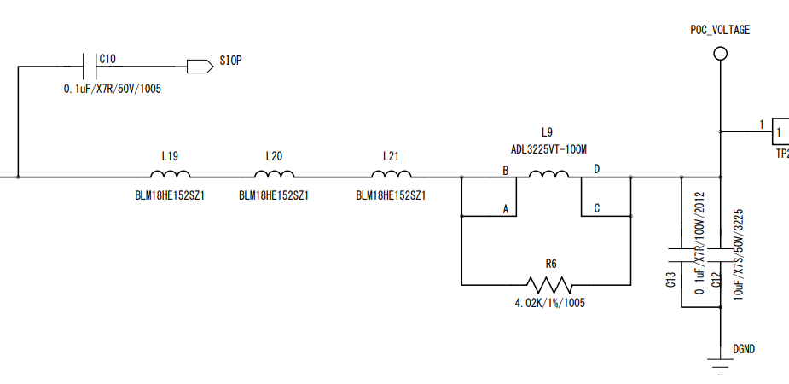
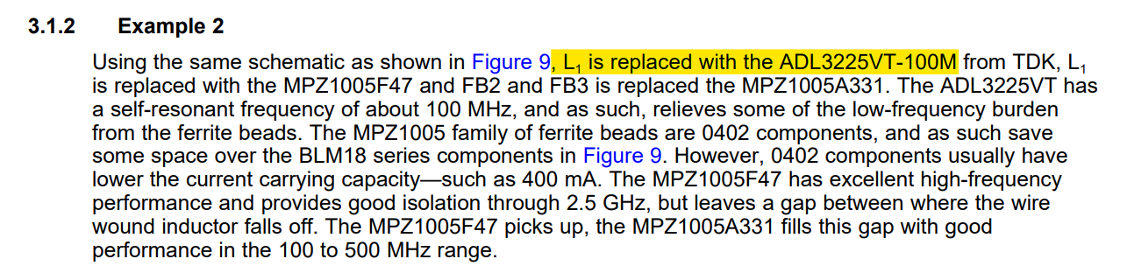
Questions_3
POC Inductor
- Due to temperature and current problems, the POC inductor (L9) was changed from LQH3NPZ100MJRL to ADL3225VT-100M. Please refer to 3.1.2 below and check if there is a problem with only L9 while maintaining the Murata beads. Please check if there's no problem with the POC Components.
What are the “temperature and current problems”?
What is the current through the PoC network?
The original 4G PoC circuit is rated up to 150mA and up to 105ºC. This is because more DC bias current will affect the impedance characteristics of the Ferrite Beads.
Exceeding the max current rating can negatively affect the signal integrity of the FC and BC.
Generally, the current through the Ferrite Bead should be ~25% of its max rating.
We do have a TI internal App Note with different PoC circuits for different temperature and current ratings, but it is under NDA.
Please reach out over email if you can provide proof of NDA.
Also, this is a 4Gbps PoC network. But the oscillator and MODE setting set a 2Gbps FC line rate. Need to choose a PoC network that is rated for the chosen line rate.

Slide 4
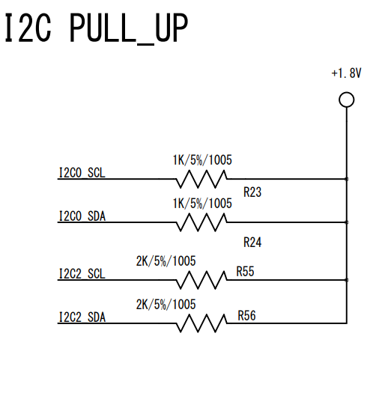
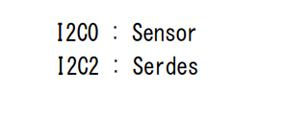
Questions_4
I2C Resistor
- We attached 2K of I2C pull-up resistance according to ISP's guide. Do you agree that there is no problem when using the Fast mode and Standard mode of DS90UB953?
I2C2 : Serializer <-> ISP
I2C0 : ISP <-> Sensor
The 2-kOhm resistors match the general recommendations given in the datasheet, but we recommend following the App Note (SLVA689) linked in the datasheet (See “11.2 Documentation Support” section) for calculating the optimum pull-up resistor values for your system. This depends on the rise time of the selected I2C mode (Standard/Fast) and the capacitive load for each bus line in your system. More details are in the App Note.

